Slide 1
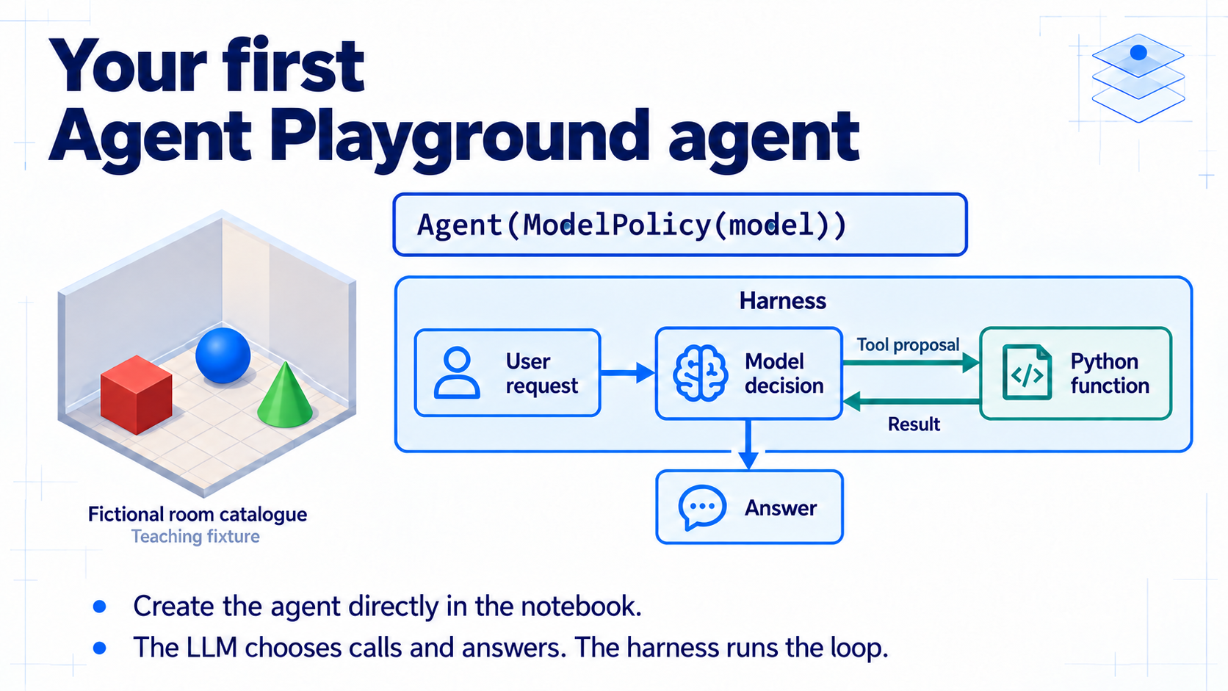
Notes:
### Building the agent
An Agent wraps a ModelPolicy and manages the loop; the main route uses a real LLM, while the labelled replay route uses written actions for deterministic inspection.
### Presenter reminders
Suggested duration: 1 minutes.
Read the main visual in connector order. Ask students to identify the corresponding notebook call. Keep the qualifications beside the example. Transition to the next attached component.
### Near-verbatim delivery
We will build the agent directly in the notebook. The first useful line is Agent with a ModelPolicy around a configured model. The model chooses a call or an answer. The surrounding Agent object manages the loop and the components we attach.
Our task is small: inspect a few fictional objects and prepare a report. Recording a note is a separate effect and asks for approval. You write a short lookup function, then assemble your own agent configuration. The supplied examples let us see each connection before combining them.
The main route uses a real LLM. The replay route uses written actions, clearly labelled in the notebook and evidence. It helps us inspect a deterministic harness path when a model or service is unavailable. Keep that distinction in your explanation.

Slide 2
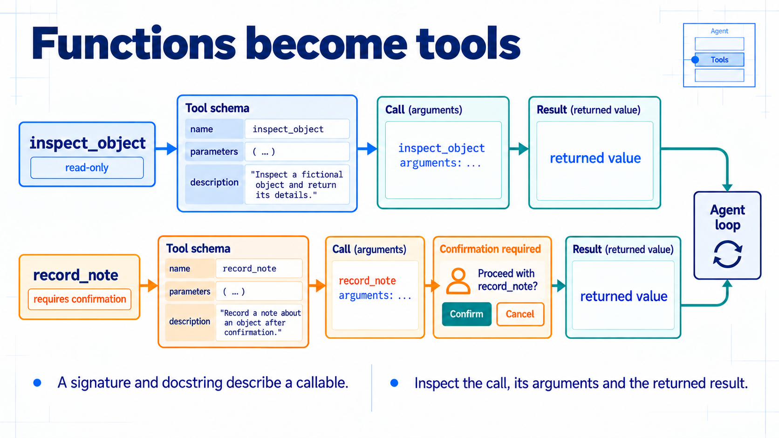
Notes:
### Tools from Python functions
A signature and docstring become the schema; you write a catalogue lookup and trace call to result, with note recording marked for confirmation.
### Presenter reminders
Suggested duration: 1.5 minutes.
Read the main visual in connector order. Ask students to identify the corresponding notebook call. Keep the qualifications beside the example. Transition to the next attached component.
### Near-verbatim delivery
A tool starts as an ordinary Python function. Its signature and docstring describe its name, arguments and purpose. The harness makes that description available to the model. The implementation remains Python code outside the model.
Your first task is a tiny catalogue lookup. You read a named record and return it as JSON. You do not write a parser or another execution loop. We inspect the fn_schema field, then a proposed call with its identifier and arguments, and the result paired with that identifier.
The toolkit groups this lookup with note recording. Lookup reads teaching data. Note recording can change the in-memory list, so it carries a confirmation mark. We will follow that mark later. For now, locate the actual call and result in the log. A proposed call alone does not establish that its function ran successfully.

Slide 3
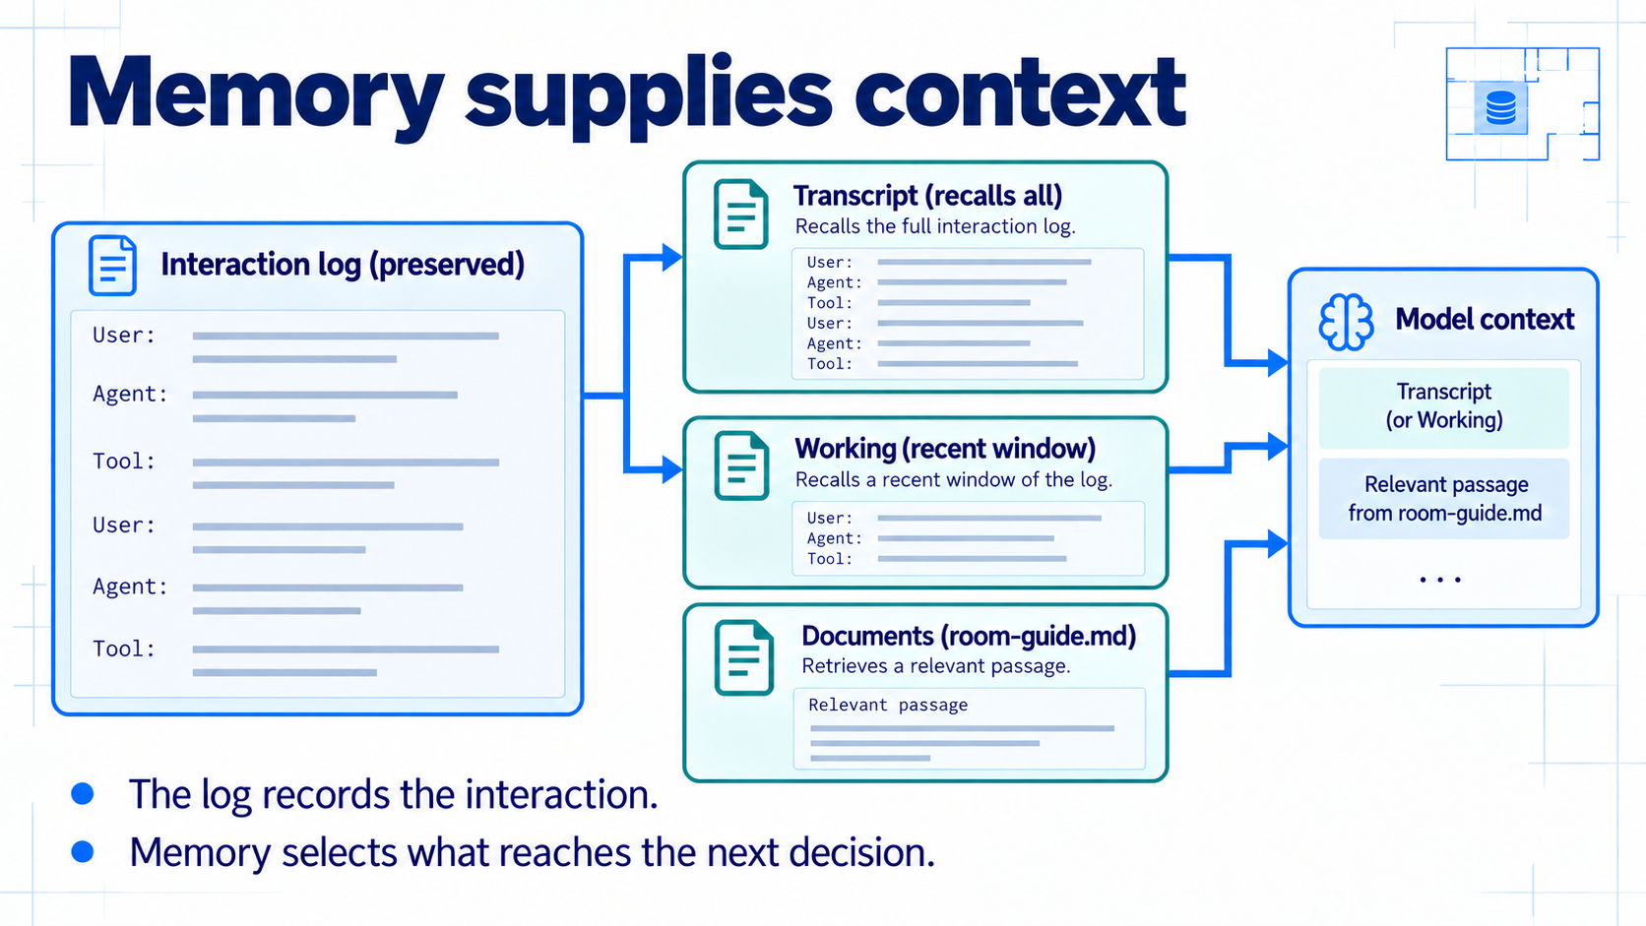
Notes:
### Memory and retrieval
Transcript, a Working window, and word-overlap Documents decide what reaches the next decision — a window selects context without deleting history.
### Presenter reminders
Suggested duration: 1 minutes.
Read the main visual in connector order. Ask students to identify the corresponding notebook call. Keep the qualifications beside the example. Transition to the next attached component.
### Near-verbatim delivery
Memory supplies what the next decision can use. The log records the complete interaction. Transcript recalls that interaction. Working supplies a recent window while leaving the source log intact. A window is a selection of context, not a deletion of history.
Documents contributes another source: a relevant passage from our short room guide. In the notebook we attach it alongside Transcript and also inspect a retrieval using an explicit question. That lets us see which text was available without assuming that the model made good use of it.
This retrieval method uses word overlap. It can miss a paraphrase, and a retrieved passage can still be insufficient. When you explain a follow-up answer, point to the information that reached the decision. Do not infer memory from an answer that a model could have guessed. Comparing recalled views makes the boundary visible.

Slide 4
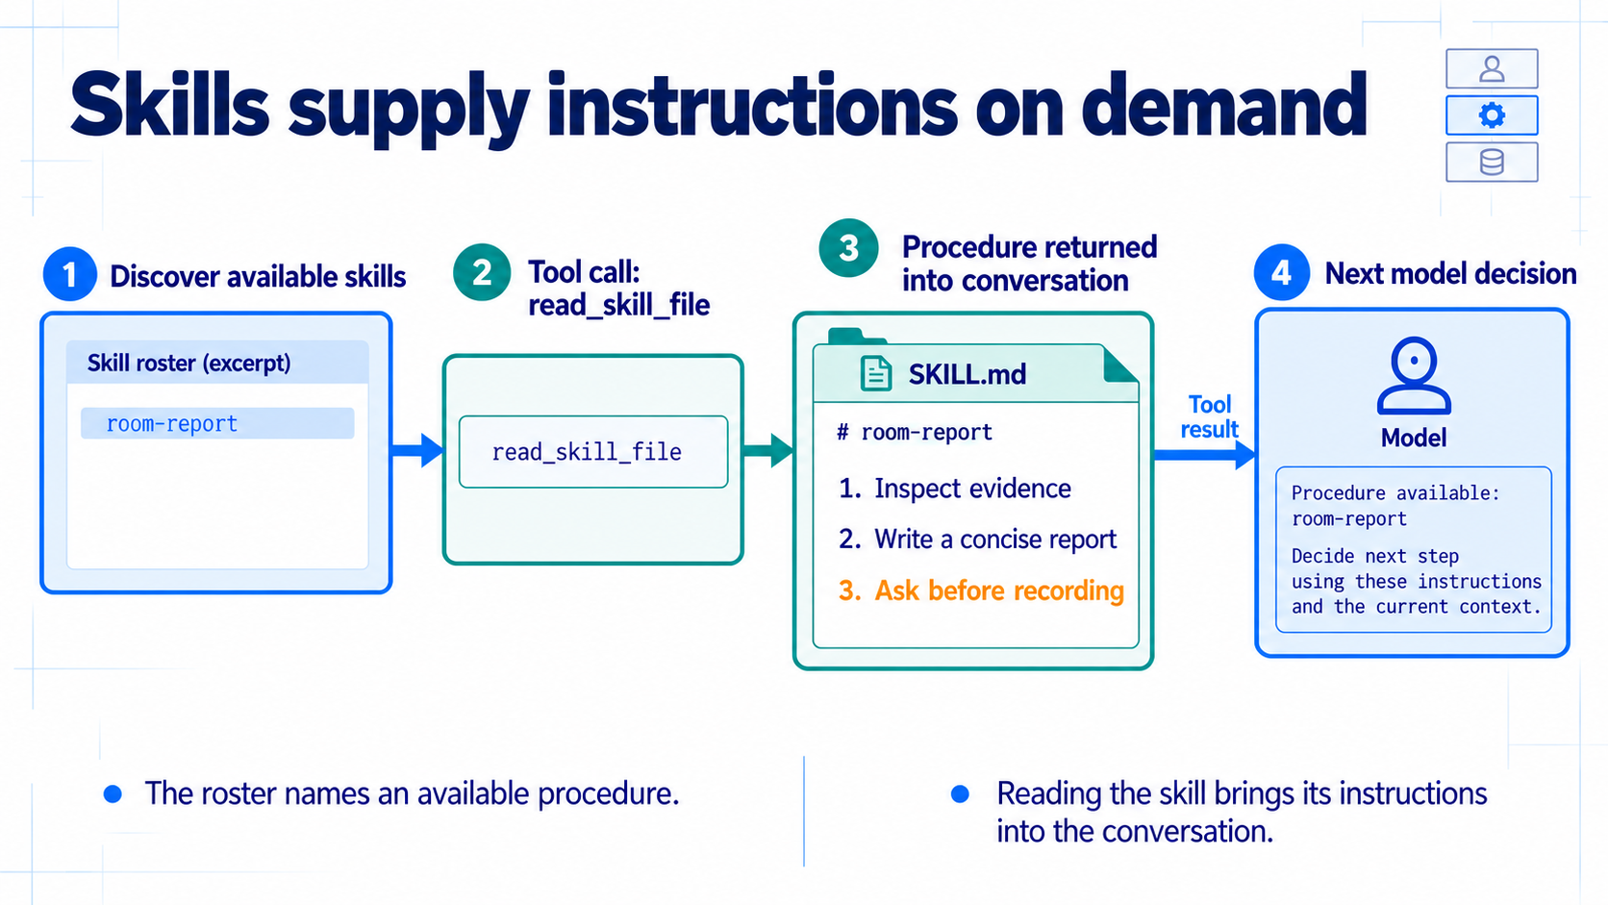
Notes:
### Skills
The roster shows a name and description; the body arrives only via `read_skill_file`, and instructions add no weights or guaranteed compliance.
### Presenter reminders
Suggested duration: 1 minutes.
Read the main visual in connector order. Ask students to identify the corresponding notebook call. Keep the qualifications beside the example. Transition to the next attached component.
### Near-verbatim delivery
The room-report skill gives the agent a procedure for using its evidence. Initially, the roster contains its name and description. The body arrives only when the agent reads the skill through read_skill_file.
Follow that path in the diagram and then in the notebook. Locate the roster, the call and the returned instructions. On a later decision those instructions are available in the conversation. The model still has to follow them.
A skill supplies instructions and may bundle files. It does not add model weights. Our basic example just reads the procedure. A later supplied demonstration explicitly enables a harmless bundled script, so we can distinguish reading instructions from executing code.

Slide 5
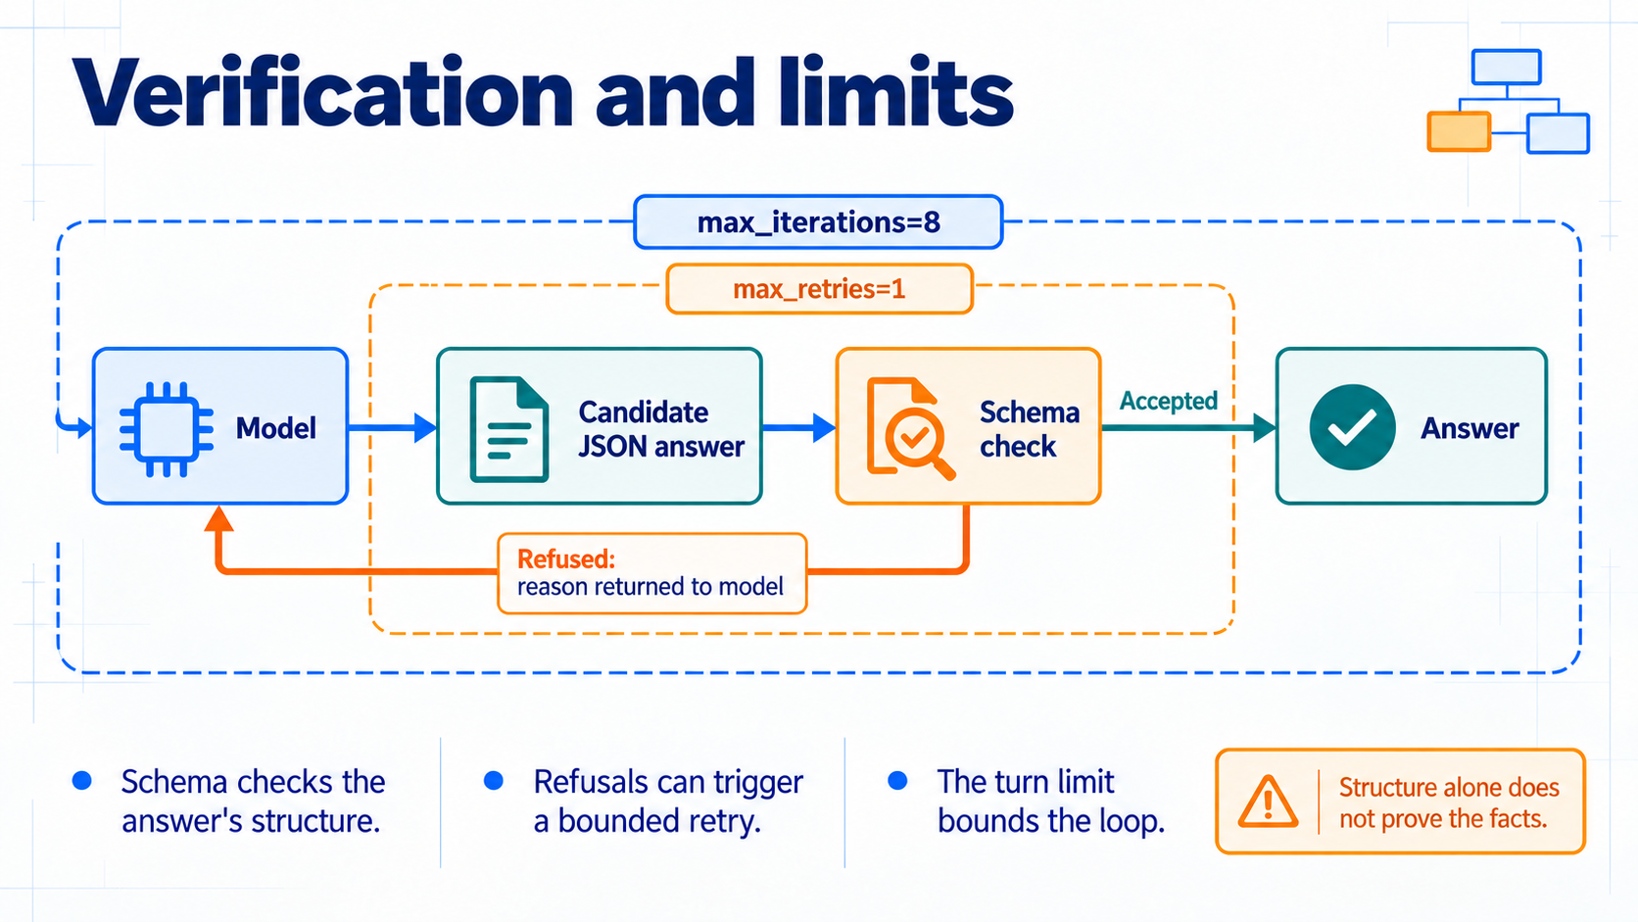
Notes:
### Verifiers and limits
A schema checks format, not truth; iteration limits count decisions, retry limits count refused answers, and context budgets concern request size.
### Presenter reminders
Suggested duration: 1.5 minutes.
Read the main visual in connector order. Ask students to identify the corresponding notebook call. Keep the qualifications beside the example. Transition to the next attached component.
### Near-verbatim delivery
The final answer passes through a check. Here Schema requires a JSON object with two string fields. That is useful because a caller can depend on the format. It does not prove that the finding agrees with the catalogue.
In the replay, the first answer is deliberately invalid. The refusal returns a reason, and a later answer fits the schema. A live model may get the format right immediately, so its trace can differ. We inspect what occurred rather than require the model to reproduce the replay.
Two bounds keep different things finite. The iteration limit counts decisions. The retry limit counts refused answers handed back for correction. A context budget is different again: it concerns request size. The short budget example uses declared illustrative units. It makes a context cut visible without claiming to measure tokens from our live provider.

Slide 6
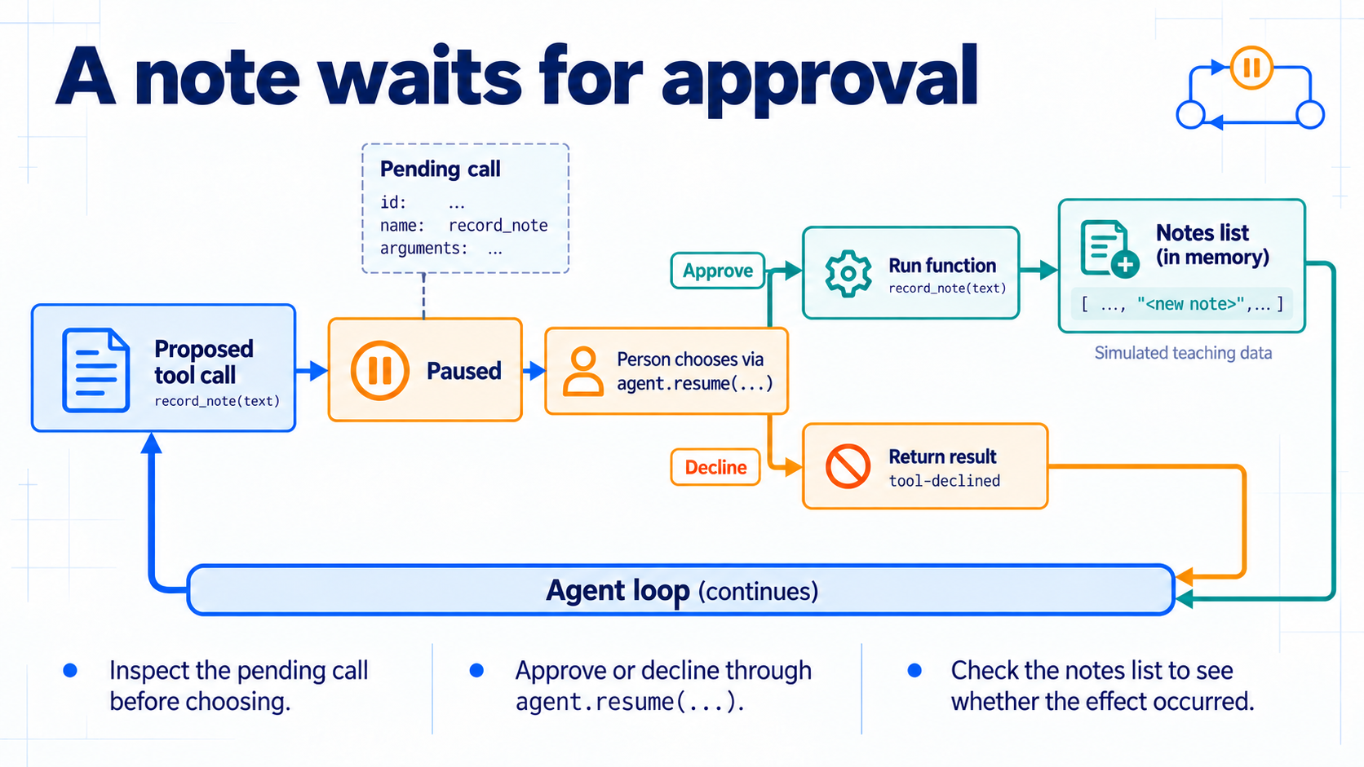
Notes:
### Confirmation and effects
`record_note` pauses before running; approve or decline, then check the actual notes list, not the agent's sentence about it.
### Presenter reminders
Suggested duration: 1.5 minutes.
Read the main visual in connector order. Ask students to identify the corresponding notebook call. Keep the qualifications beside the example. Transition to the next attached component.
### Near-verbatim delivery
Now follow the effect boundary. A proposed record_note call reaches a confirmation pause before its function executes. The pending record exposes the identifier, name and arguments. We inspect that record before deciding.
The caller resumes with approval or decline for that identifier. Approval permits the function to append its teaching note. Decline returns a refusal result and the list stays unchanged. Both outcomes provide information to the continuing loop.
Afterwards, inspect the notes list as well as the agent's answer. A sentence about recording and an actual append are different evidence. This is a small simulated effect, with the caller making a local decision. It is not a complete deployed authorization service. For the exercise, change the approval choice and explain exactly why the resulting list differs.

Slide 7
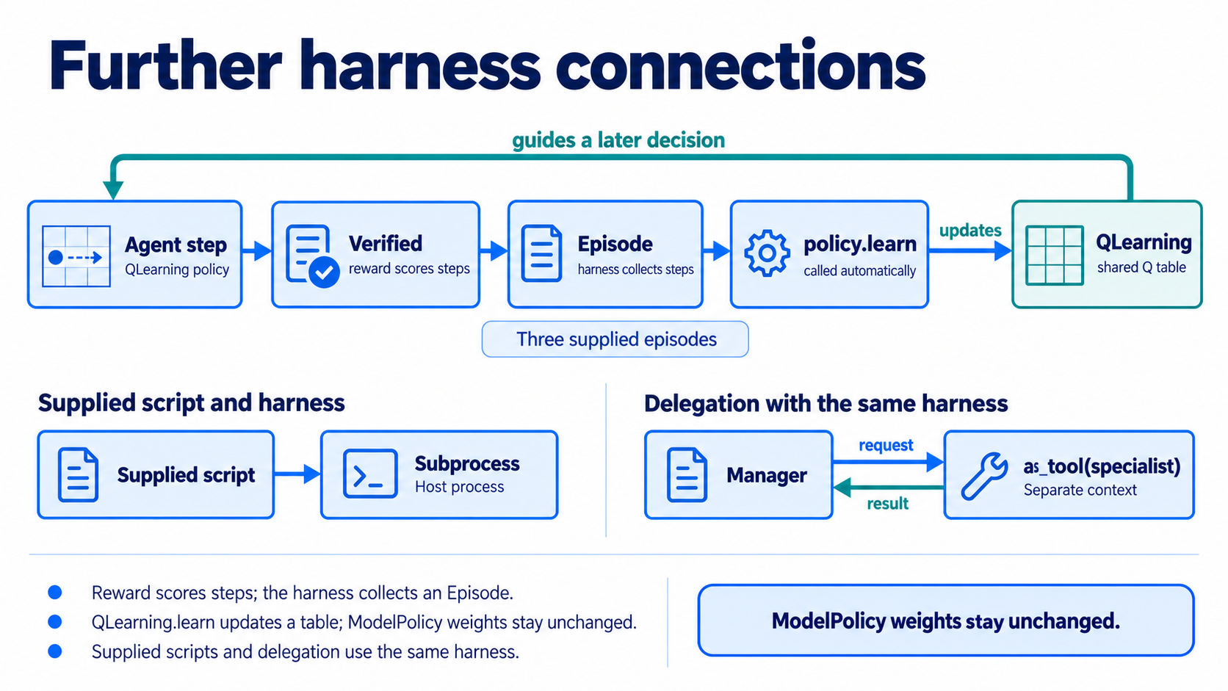
Notes:
### Learning, execution, and delegation
Rewards feed episodes, a Q-table really learns call-then-answer, a subprocess is no sandbox, and a specialist joins via `as_tool` with its own context.
### Presenter reminders
Suggested duration: 1.5 minutes.
Read the main visual in connector order. Ask students to identify the corresponding notebook call. Keep the qualifications beside the example. Transition to the next attached component.
### Near-verbatim delivery
The remaining examples connect to the same agent interfaces. Verified scores each step. The harness collects those steps in an Episode and calls the policy's learn method when the run ends. ModelPolicy leaves its weights unchanged.
In the required notebook we also put QLearning in that same loop. Three short episodes share a learner, with a fresh transcript for each episode. Compare the first invalid answer with the later call-then-answer path and inspect the Q-table update. The supplied catalogue function provides the text; the table chooses whether to call it or answer. This is real table learning, with no LLM weight update. Epsilon is zero to make the example deterministic, so we are not investigating exploration or generalization.
The executor example runs a supplied formatter through a skill. Subprocess means a process on this host, not an isolated sandbox. The script is harmless and its implementation is supplied. We do not enable arbitrary model-written code.
Finally, the manager receives a specialist through the as_tool function. The specialist has its own transcript and receives a stated request. Inspect that request and the returned answer. Another agent is callable through the same tool mechanism; its context is not automatically the manager's context.

Slide 8
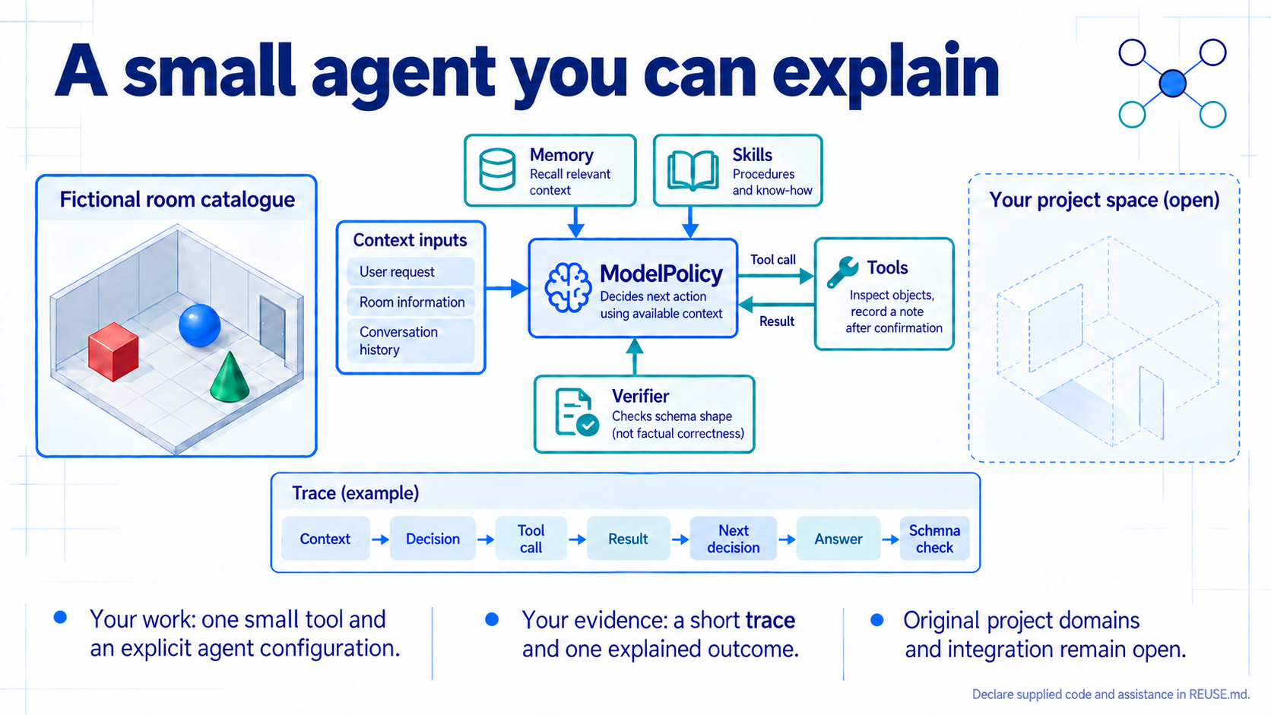
Notes:
### Assembling your own agent
Build an explicit configuration, explain one outcome from the trace, and declare supplied code in REUSE.md.
### Presenter reminders
Suggested duration: 1 minutes.
Read the main visual in connector order. Ask students to identify the corresponding notebook call. Keep the qualifications beside the example. Transition to the next attached component.
### Near-verbatim delivery
Finish by assembling your own explicit Agent configuration. Keep the policy, instruction, tools, transcript, skills, verifier, limits and listener visible in that constructor. You have already seen each component separately.
Save a short trace and explain one outcome with public evidence. Identify a call and result, the relevant context or skill, a verdict and the confirmation choice. For homework, make one small change to this supplied example and compare your prediction with the observation.
The framework, catalogue and supplied demonstrations are common scaffolding. Your original project still needs its own domain, contracts, subsystem design, integration and evaluation on new scenarios. Declare supplied code and assistance in REUSE.md. The goal of this lab is an agent whose construction and behaviour you can explain.

