Slide 1
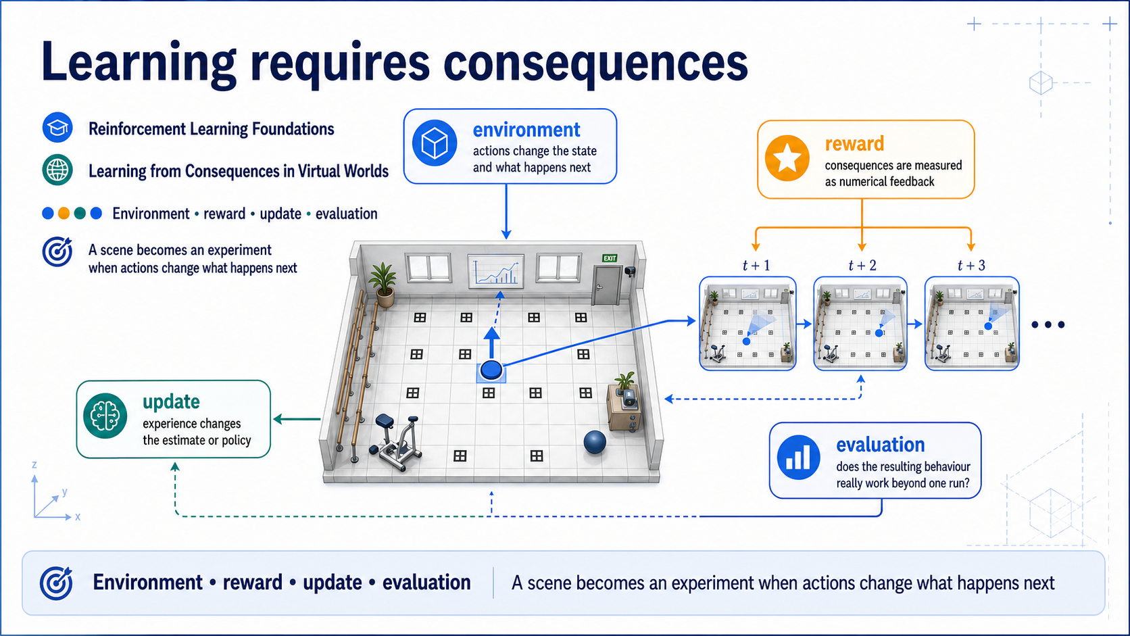
Notes:
### The world becomes an experiment
An action must change state and have measured consequences; environment, reward, update, and evaluation frame the lesson.
### Presenter reminders
- Suggested duration: **2 minutes**.
- Start from the room, then reveal the action trace.
- Connect directly to the course arc: represent → align → learn.
- Establish “consequences” and “experiment” as the lesson's anchor words.
- Do not open with algorithm names.
- [Transition] Ask which viewpoint the agent should choose.
### Near-verbatim delivery
Until now, we have represented a world, reconstructed relationships to a
physical room, and aligned content with a moving observer. Today the world
becomes an experiment.
Look at the room in the centre. If this were only a rendered scene, the agent's
arrow would be an animation. For reinforcement learning, that action must enter
an environment whose state changes, whose consequences are measured, and whose
future choices depend on what happened.
The four words around the room are the contract for the lesson. The
environment defines what actions do. Reward exposes a numerical learning
signal. The update changes an estimate or policy from experience. Evaluation
asks whether the resulting behaviour really works beyond one convenient run.
Our goal is not to survey every modern RL algorithm. It is to make this
contract precise enough that we can implement, test, and criticize a small
policy in Lesson 07—and later give RL an identifiable role in the final lab.
[Transition.] We will begin with the task, not the equation: where should an
observer move inside our instrumented room?

Slide 2
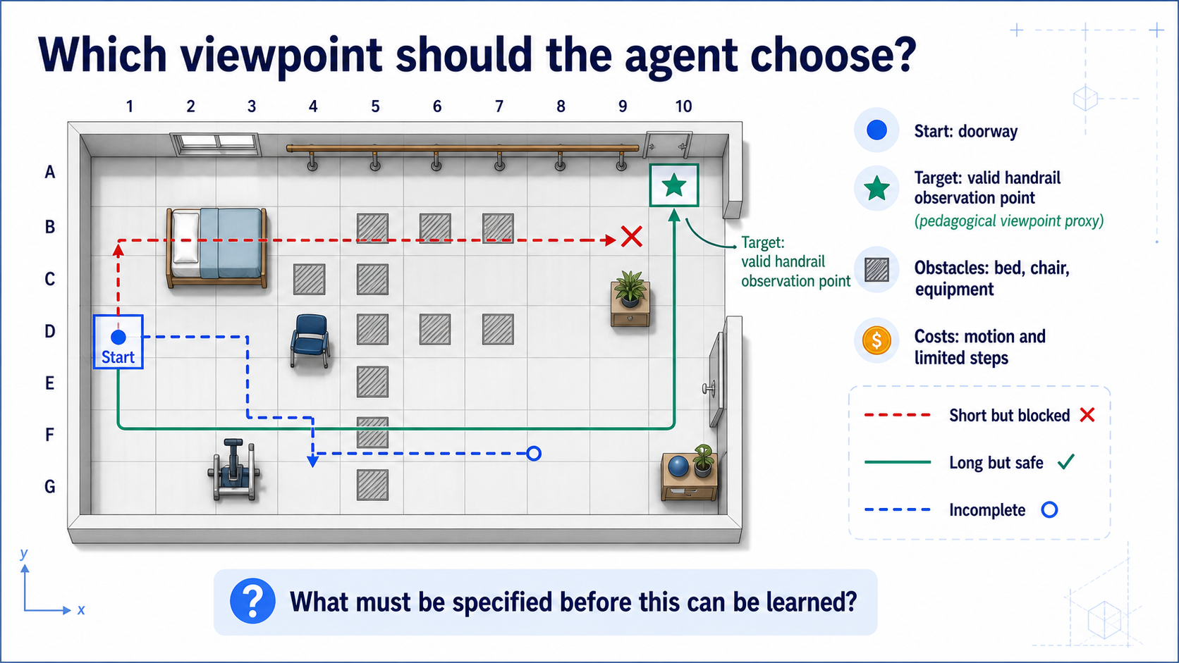
Notes:
### Which path should the observer choose?
The rendered room answers none of the questions learning needs — observation, actions, collisions, termination, reward.
### Presenter reminders
- Suggested duration: **3 minutes**.
- [Ask] Give students 20 seconds to inspect the three paths.
- Collect nouns first: agent, target, obstacle, action, cost, success.
- Then ask what changes over time and what the agent can observe.
- Qualify the healthcare interpretation as pedagogical.
- [Transition] Compare sources of feedback.
### Near-verbatim delivery
[Ask.] An observer begins near the doorway. We want it to reach a useful
viewpoint near the handrail. Which path should it choose?
The short answer could be “the shortest collision-free path,” but that already
assumes a known map, deterministic motion, a fixed target, and a planning
objective. If the observer learns from interaction, we need to say much more.
Who is the agent? What does it receive as an observation? Are actions moves on
a grid, velocities, or camera commands? What happens when an action points
through an obstacle? Is the handrail cell a terminal success? Does the episode
end after forty steps? Is motion deterministic? And what numeric signal is
returned after each transition?
Notice that the rendered room does not answer those questions. We must define
an experimental interface around it. Also, “valid viewpoint” is a proxy in
this classroom model. It does not establish real sensing quality, clinical
utility, or patient safety.
[Ask.] Name one variable that could change the correct action even when the
agent is in the same grid cell. Possible answers include a moving person,
battery state, current heading, remaining time, or an occluded target.
[Transition.] Before formalizing the room, let us separate RL from other ways
we could produce the route.

Slide 3
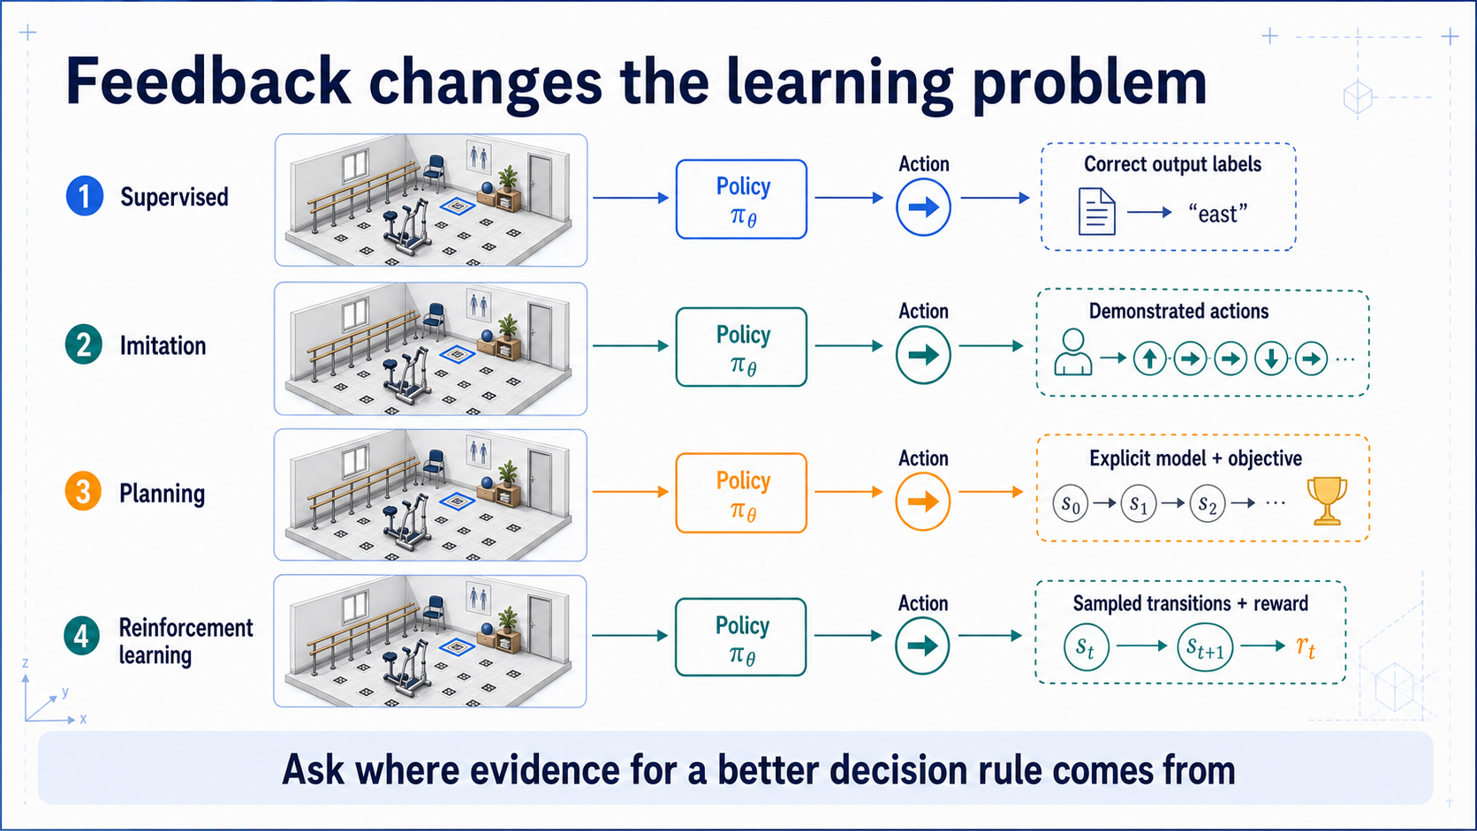
Notes:
### Where does the feedback come from?
Supervised, imitation, planning, and RL differ in their evidence source, and a simple heuristic may make learning unnecessary.
### Presenter reminders
- Suggested duration: **3 minutes**.
- Read down the feedback column, not across all details.
- Avoid presenting the categories as mutually exclusive systems.
- Use the same “move east” decision in each paradigm.
- Name fixed control and search verbally as alternatives to learning.
- [Transition] Keep only the RL strip and close the loop.
### Near-verbatim delivery
These paradigms can all produce an action, but they obtain evidence in
different ways.
In supervised learning, the training set supplies a target output. If the
input describes this room state, the label might say “east.” In imitation
learning, an expert or demonstrator supplies actions or trajectories. In
planning, we use an explicit model to evaluate candidate futures according to
an objective. In reinforcement learning, the agent acts, observes a sampled
transition and reward, and uses that consequence to improve later decisions.
The boundaries can be combined. RL can begin from demonstrations. A learned
model can support planning. A learned policy can sit inside a conventional
controller. So the useful diagnostic question is not “which fashionable label
does this system have?” It is: where does evidence for improving the decision
rule come from?
We should also ask whether learning is needed. If a shortest-path algorithm
with a known map solves the task reliably, a learned policy has to justify its
extra complexity. This is why the heuristic will return later as an evaluation
baseline, not as an enemy of RL.
For the rest of the lesson, we follow the bottom strip: sampled transitions and
reward from an environment.
[Transition.] That interaction has a stable shape, regardless of whether the
policy is a table or a large network.

Slide 4
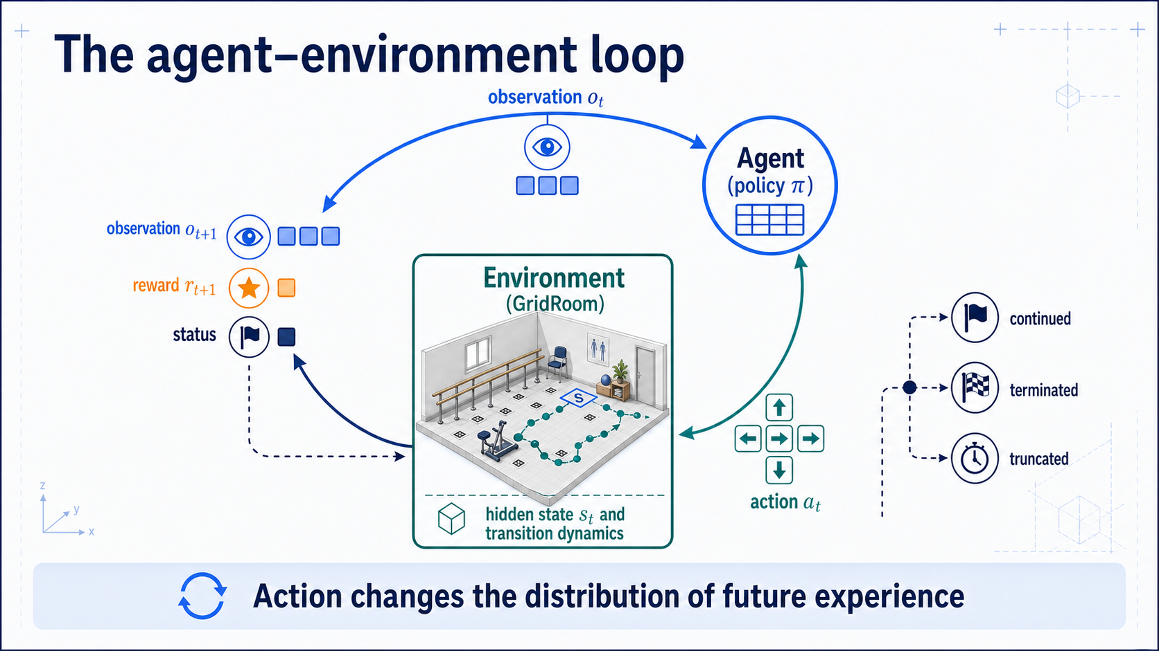
Notes:
### The agent–environment loop
Observation → action → transition → next observation, reward, and status: an interface that survives swapping a table for a network.
### Presenter reminders
- Suggested duration: **2 minutes**.
- Read clockwise from observation.
- Point out that reward follows the action.
- Keep policy and environment responsibilities visually separate.
- Name status now; define termination and truncation later.
- [Transition] Explain why simulation makes the loop experimentally useful.
### Near-verbatim delivery
Read the loop clockwise. At time t, the policy receives an observation and
selects an action. The environment applies its transition dynamics. It returns
the next observation, a reward associated with the transition, and status
information about whether the sampled episode continues.
The environment may retain information that the policy does not see. That is
why the room boundary encloses hidden state, while the arrow carries an
observation. We will make this distinction explicit shortly.
Reward also sits on the return arrow. It is not normally a label saying which
action was correct. It evaluates a sampled consequence. The action changes not
only the immediate location, but also which states, observations, rewards, and
choices the agent can encounter later.
This loop is the stable interface. We can replace the table with a neural
network later, or connect the policy to another application, while preserving
the meaning of observation, action, transition, reward, and status.
[Transition.] Virtual worlds are useful because they let us run this loop
under controlled interventions—if the virtual experiment represents the task
we actually care about.

Slide 5
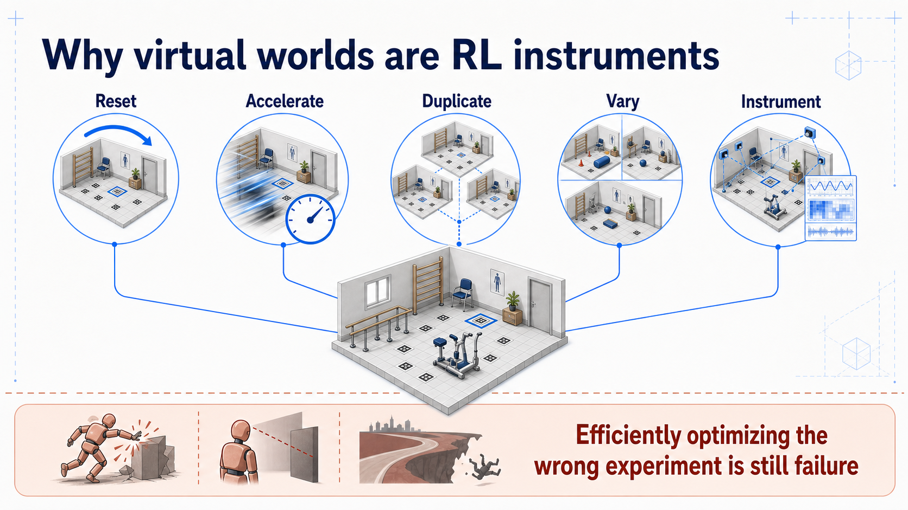
Notes:
### Simulation as an instrument
Resets, speed, and exact logging are powerful, but they also scale mistakes, so assumptions must be declared and tested.
### Presenter reminders
- Suggested duration: **2 minutes**.
- Read the five capabilities clockwise.
- Connect “instrument” to access to hidden state and exact events.
- Make the simulation-validity caveat explicit.
- Avoid introducing sim-to-real in depth; defer it to Lesson 11.
- [Transition] Instantiate the instrument as GridRoom.
### Near-verbatim delivery
A virtual world can reset the room after every episode. It can run faster than
real time, duplicate thousands of controlled trials, vary starts and
obstacles, and record exact internal state and reward components. Those are
powerful experimental capabilities.
They also make mistakes scalable. If collision dynamics are unrealistic, if
the observation reveals information the real system would not have, or if the
reward omits an important consequence, the learner can become very effective
inside the wrong experiment.
So we should treat the virtual world as an instrument. An instrument requires
a declared measurement model, operating conditions, and limits. We will not
solve sim-to-real today—that belongs primarily to Lesson 11—but we will adopt
the habit of recording assumptions and testing held-out conditions.
The instrument is especially useful here because every estimate can be
inspected. We can render the path, examine the Q-table, repeat with a fixed
seed, and then change one assumption deliberately.
[Transition.] Let us now define the smallest room that preserves those
contracts without hiding them behind an engine or RL framework.

Slide 6
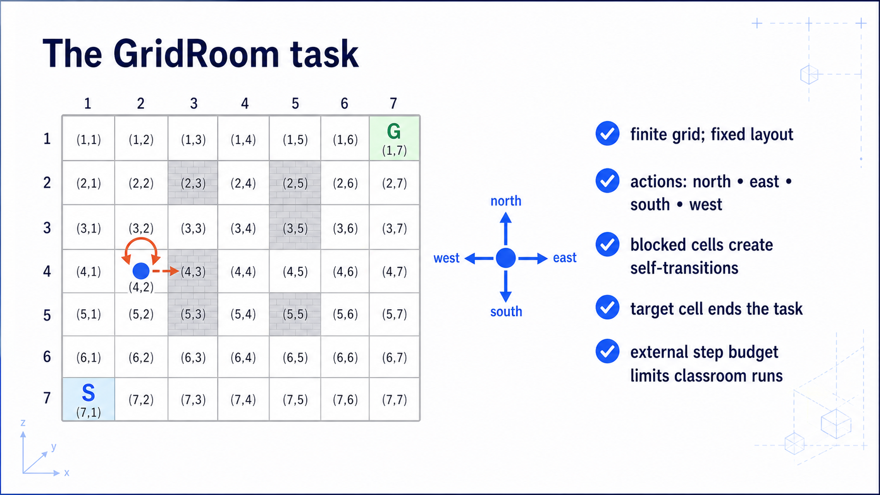
Notes:
### GridRoom
Four movement requests, self-transition on collision, target termination, and a step budget that is not a task end.
### Presenter reminders
- Suggested duration: **2 minutes**.
- Establish units as abstract cells, not physical metres.
- Point to the attempted collision and resulting same-state marker.
- Separate target termination from the step budget.
- Mention deterministic first, stochastic extension later.
- [Transition] Wrap these choices into an MDP.
### Near-verbatim delivery
GridRoom is deliberately small. The agent occupies one free cell in a fixed
layout. It can request north, east, south, or west. A move into a free cell
changes position. A move through a wall or obstacle leaves the agent in the
same cell. Reaching the target ends the task.
For the first model, actions are deterministic. Later we can add a slip
probability to show that the same action can produce several possible
successors. The grid cells are abstract teaching units; we are not claiming
that one cell equals a certified physical distance or that the target fully
represents viewpoint quality.
The external step budget stops a classroom run that is taking too long. It is
not automatically a terminal state in the task. That distinction will affect
the Q-learning target.
This environment is small enough that a table can hold every state–action
estimate, yet rich enough to expose collision semantics, delayed reward,
exploration, reward shortcuts, and evaluation mistakes.
[Transition.] An MDP gives names and mathematical meaning to each of these
choices.

Slide 7
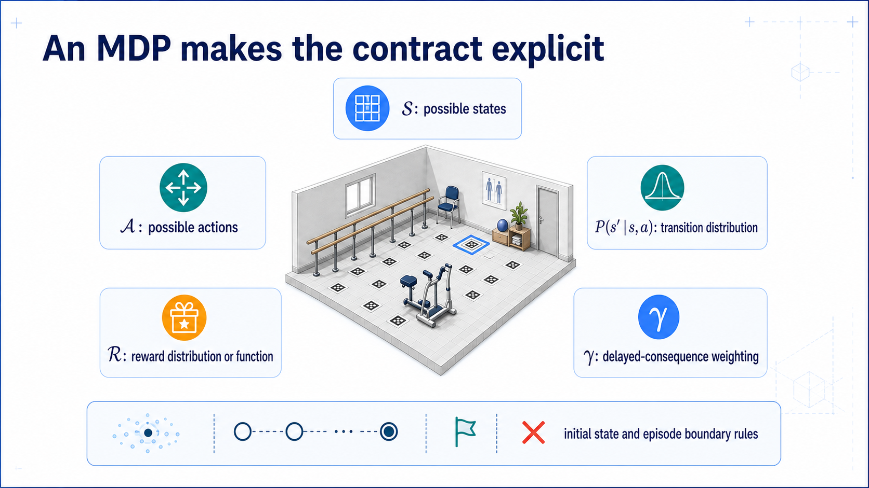
Notes:
### The MDP
S, A, P, R, and γ bound to GridRoom, plus reset and boundary rules — dynamics and reward, not rendering code.
### Presenter reminders
- Suggested duration: **3 minutes**.
- Pronounce each symbol and bind it immediately to GridRoom.
- State that practical episodic specifications also require reset and boundary
rules.
- Avoid treating P as code for the renderer.
- Emphasize distribution, even when deterministic.
- [Transition] Split state from observation.
### Near-verbatim delivery
We write a finite Markov decision process as S, A, P, R, and gamma.
S is the set of environment states. In the simplest room, it is the set of
free grid cells. A is the set of actions: four movement requests. P gives the
distribution of the next state, conditioned on the current state and action.
Even deterministic motion can be written as a distribution that assigns
probability one to one successor. R describes the reward associated with a
transition. Gamma determines how delayed rewards contribute to the return.
For an episodic implementation, the lower strip matters as well. We need an
initial-state distribution, success and failure rules, and a decision about
which external conditions merely truncate a sample.
An MDP is not identical to the rendering code. The room image helps us
interpret state, but P and R define the experimental dynamics and learning
signal. Two tasks can use the same geometry and have different states,
actions, rewards, or boundaries.
[Ask.] If the objective changed from reaching the handrail to maximizing
camera information, which parts of this ring would change? At least reward;
probably state, observation, and termination as well.
[Transition.] The policy may not receive all the information that the
environment uses to produce those transitions.

Slide 8
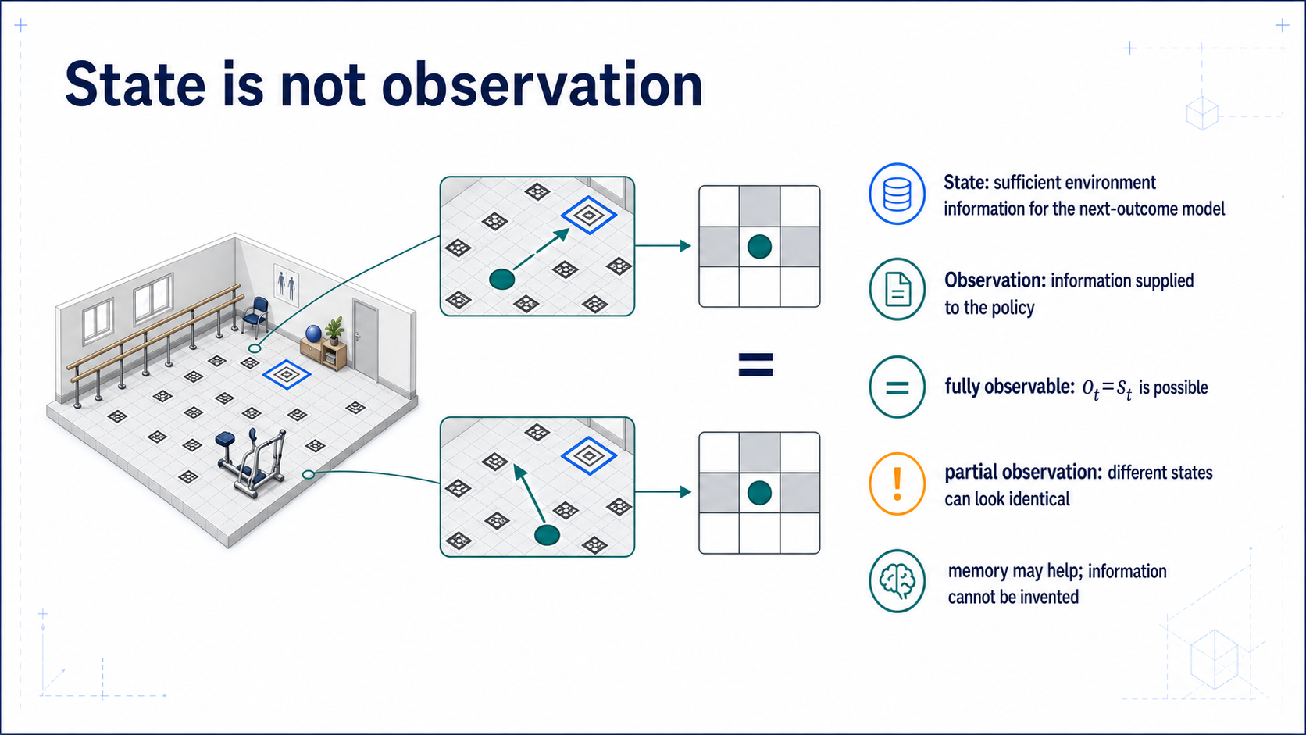
Notes:
### State vs. observation
Two identical local windows at different positions prove a memoryless policy can't tell them apart.
### Presenter reminders
- Suggested duration: **3 minutes**.
- Read left-to-right: environment knows, policy receives.
- Use the two aliased local windows as the central proof object.
- State that “state” is task-relative.
- Do not develop POMDP algorithms.
- [Transition] Ask whether the chosen state is Markov.
### Near-verbatim delivery
The environment's state and the agent's observation answer different
questions.
State is the information used by our environment model to determine the
distribution of the next outcome. Observation is what the policy receives. In
the fully observable baseline, we can let the observation be the state index.
That convenience should not become a definition.
Look at the two local windows on the right. They contain the same nearby walls,
so the observation is identical. But the positions in the full room differ,
and the useful direction to the target differs. A memoryless policy indexed
only by that local observation must choose the same action in both situations.
Memory can sometimes distinguish how the agent arrived, and a belief can
represent uncertainty over possible states. But memory cannot create a sensor
measurement that was never available. We will not solve the complete partially
observable problem today. The important habit is to name policy input as an
observation unless we have justified that it is an adequate state.
[Transition.] We now need a test for that justification: does the current
state make older history unnecessary for predicting the next outcome?

Slide 9
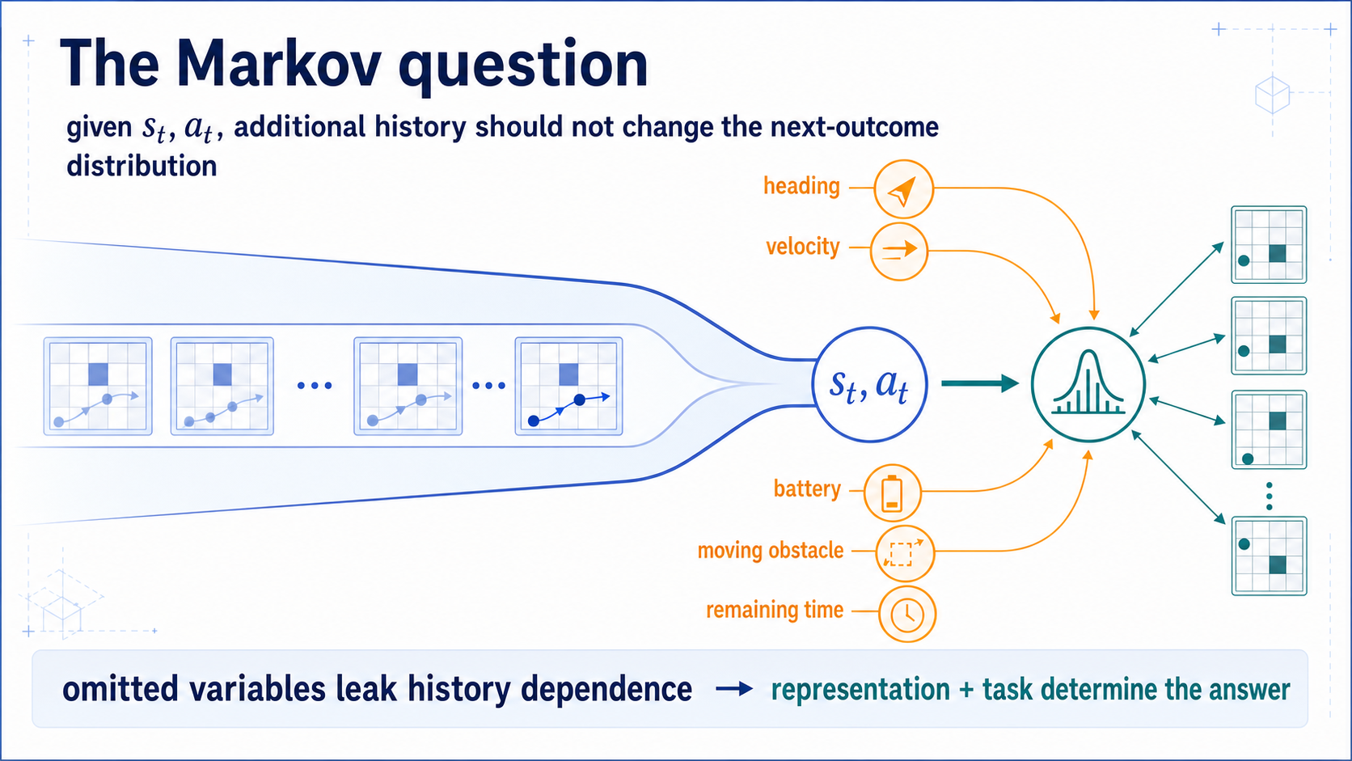
Notes:
### The Markov property
Whether current state makes history unnecessary is a claim about your representation, not about the world.
s### Presenter reminders
- Suggested duration: **2 minutes**.
- Explain the property verbally before showing probability notation.
- Point to omitted remaining time because it will return with truncation.
- Avoid saying that the physical world “is Markov.”
- [Transition] Show one action with several successors.
### Near-verbatim delivery
The Markov question is: once I know the current state and action, would older
history change my prediction of the next state and reward?
This is a claim about our representation for a task. Suppose position is the
only state variable, but the agent has momentum. The same cell and movement
request can produce different successors depending on velocity inherited from
history. If battery level changes motion, or a person moves through the room,
position alone is also insufficient. If a finite task horizon affects value,
remaining time may need to be represented.
We can respond by expanding state, maintaining memory or a belief, or accepting
an approximation. What we should not do is assume Markov simply because our
Python array contains one integer called `state`.
For deterministic GridRoom, position plus the fixed layout and task definition
is adequate. When we add action noise, the process can remain Markov; the next
outcome becomes a distribution rather than a single successor.
[Transition.] Let us make that transition distribution visible.

Slide 10
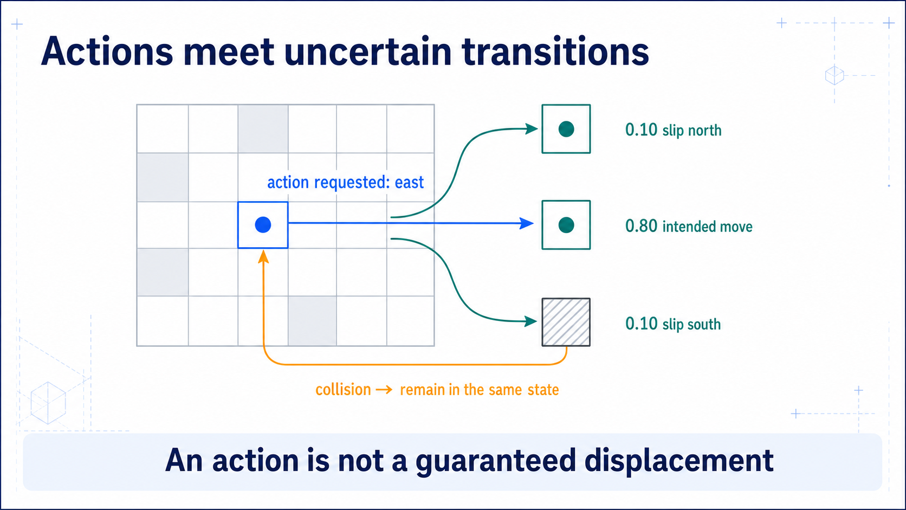
Notes:
### Stochastic transitions
An action is a request: slip probabilities and collision rules belong to the transition model, not to sensor noise.
### Presenter reminders
- Suggested duration: **2 minutes**.
- Distinguish probability model from sensor noise.
- Read the intended branch first, then slips, then collision.
- State that the baseline code can begin deterministic.
- [Transition] Ask how the learner knows which outcomes are desirable.
### Near-verbatim delivery
The action is a request to move east. It is not necessarily a guaranteed
displacement.
In this example, the intended successor has probability point eight. A north
or south slip each has probability point one. If a sampled successor would
enter an obstacle, the collision rule leaves the agent in the current state.
This uncertainty belongs to the transition model. It is different from noisy
observation: the environment may actually move to a different state, even if
the agent observes the resulting state perfectly.
We will begin Lesson 07 with deterministic transitions because they make tests
and debugging easier. Then one bounded extension can add slip. The important
contract is that the probabilities and collision semantics are explicit and
testable. Otherwise two implementations can train different policies while
appearing to use the same room.
The transition model tells us what can happen. It does not tell the learner
which consequences satisfy the task.
[Transition.] That pressure comes from reward—but reward is only the signal we
write down, not the intention in our head.

Slide 11
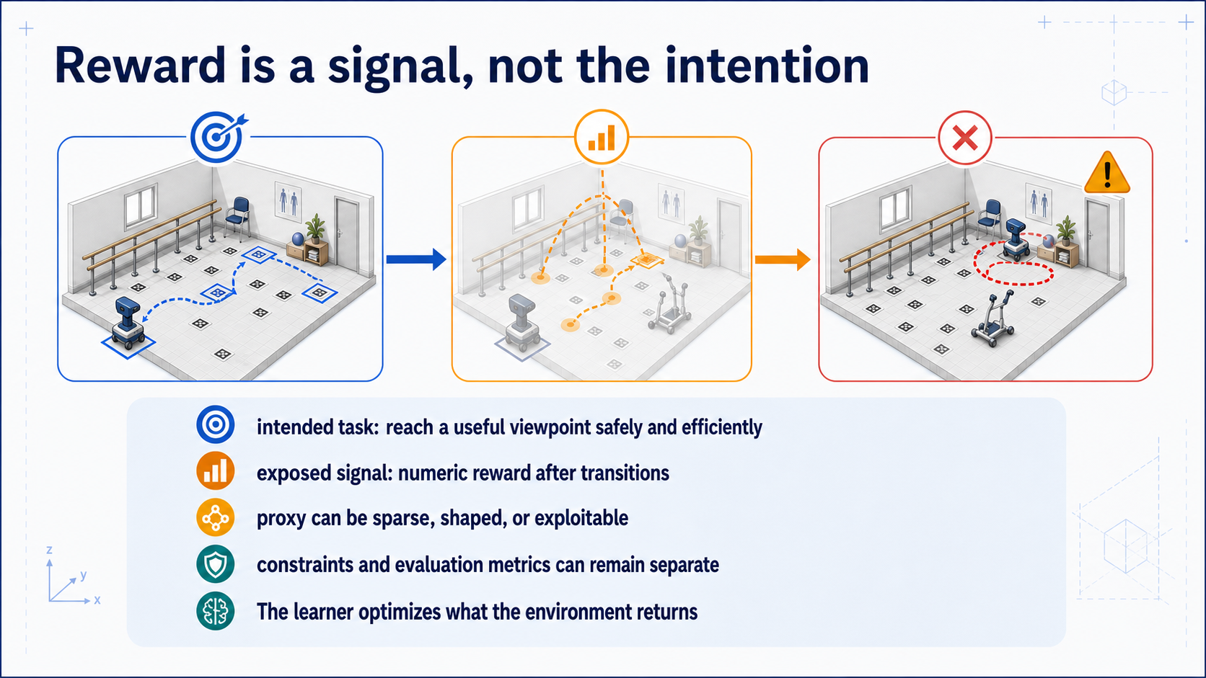
Notes:
### Reward vs. intention
The learner sees numbers, not your goal — a visibility reward teaches loitering instead of arriving.
### Presenter reminders
- Suggested duration: **1 minute**.
- State the distinction crisply; details return on Slide 33.
- Use the loitering path as the visual proof.
- Do not imply that more reward terms always repair the problem.
- [Transition] Define when an episode ends.
### Near-verbatim delivery
Our intention is a useful viewpoint reached safely and efficiently. The
learner does not observe that sentence. It receives numbers after transitions.
If we give positive reward every time the handrail is visible, the agent may
learn to remain near it and collect the proxy repeatedly instead of completing
the task. Adding a step cost can encourage shorter paths, but it also changes
the return scale and may create other tradeoffs.
Some requirements are better expressed as environment constraints or safety
checks. Some measures should remain outside reward so they can reveal that the
policy is gaming the optimized signal.
The engineering principle is simple: reward is executable task
specification, and observable behaviour is the test of what we actually
specified.
[Transition.] We must also specify exactly when the task has ended and when an
experiment has merely been stopped.

Slide 12
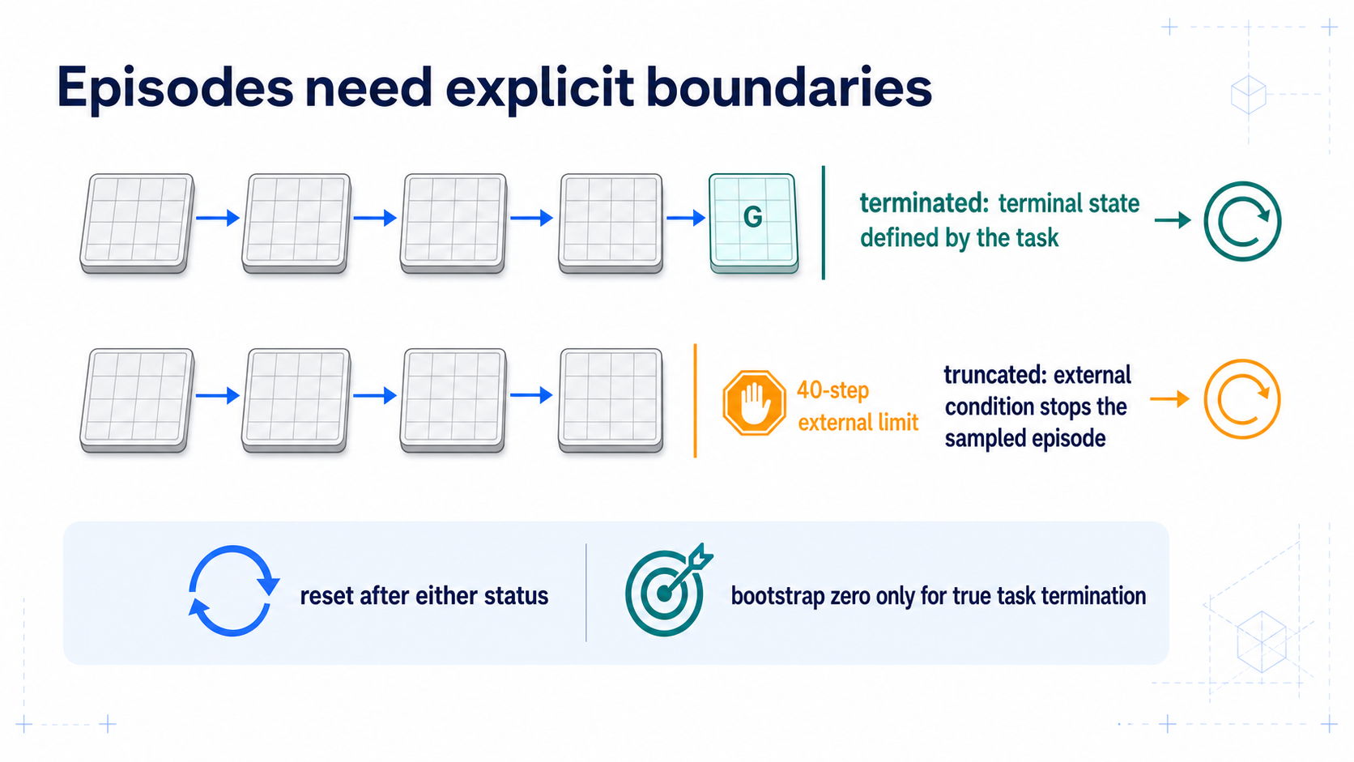
Notes:
### Termination vs. truncation
Both reset, but only a true terminal drops the continuation value; a time limit keeps bootstrapping.
### Presenter reminders
- Suggested duration: **1 minute**.
- Read the two timelines before the code rule.
- Say “reset decision” and “bootstrap decision” separately.
- Mention finite-horizon qualification.
- [Transition] Let students specify the complete room MDP.
### Near-verbatim delivery
Both timelines stop and both require a reset, but they mean different things.
The top episode reaches a terminal state defined by the task. There is no task
continuation after that transition, so its continuation value is zero. The
bottom episode is stopped by an external classroom limit while the agent
occupies an ordinary state. The task state can still have future value, so the
learning target normally keeps the bootstrap term.
If a fixed horizon is itself part of the task, then remaining time belongs in
the state and the terminal semantics must be defined accordingly.
Modern Gymnasium APIs expose `terminated` and `truncated` separately precisely
because this distinction matters to bootstrapping algorithms. We will preserve
it in our framework-independent code.
[Transition.] You now have all the pieces needed to write the room contract in
one place.

Slide 13
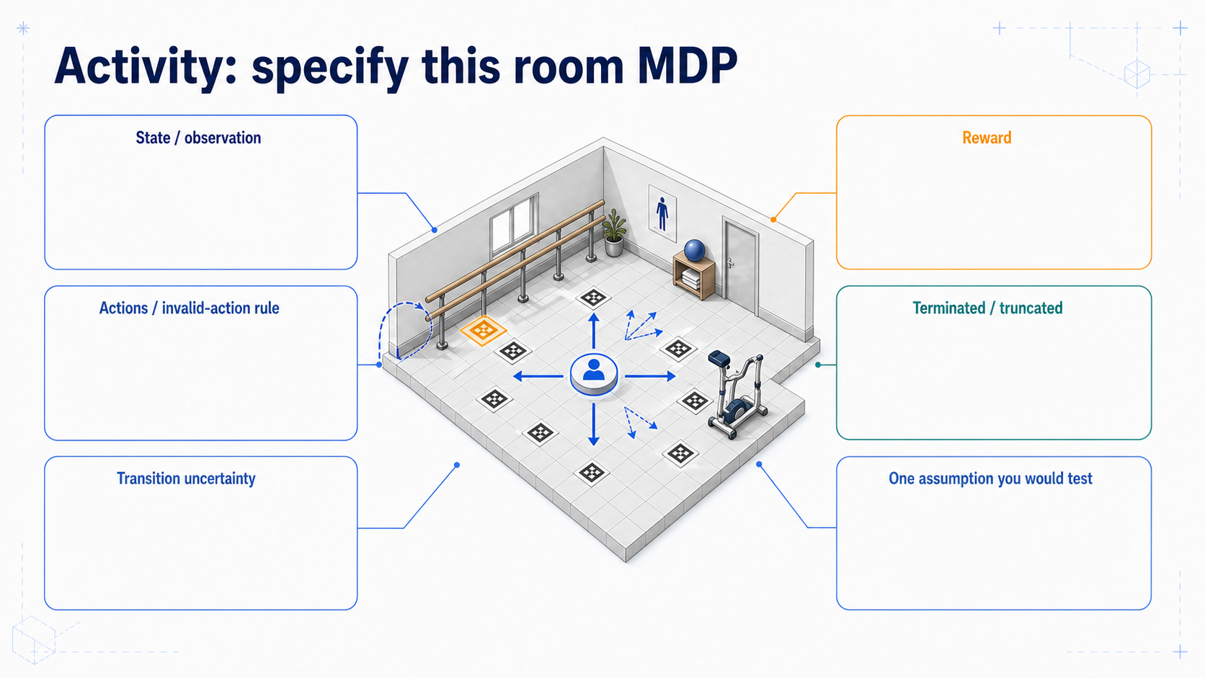
Notes:
### Activity: specify the room MDP
In pairs, fill the six-field contract and name one assumption to test; correctness is relative to the stated task.
### Presenter reminders
- Suggested duration: **4 minutes**.
- [Ask] Pairs work for 90 seconds before the reveal.
- Require state and observation as separate fields.
- Sample two different valid formulations.
- Ask each pair for one hidden assumption, not only component names.
- Keep the revealed baseline visible for the rest of the lesson.
- [Transition] Run one episode under the baseline.
### Near-verbatim delivery
[Ask.] Work with the person next to you. You have ninety seconds. Fill the six
fields for this exact task: reach the marked viewpoint near the handrail.
[Pause for pair work.]
Let us compare two answers. Our baseline state is the agent's position in a
fixed known layout. The observation is the state index, so this version is
fully observable. The actions are four movement requests. Invalid moves create
a self-transition. We begin deterministically, then we can introduce a known
slip probability.
The baseline reward is positive at target with a small step cost. Target
arrival terminates. The external step budget truncates. Reset samples a start
from the training set.
Now the final field: what assumption would you test? Good candidates include
whether the layout is actually fixed, whether position is observed correctly,
whether all target cells are equally useful, and whether the motion model
matches the intended system.
There is not one universally correct MDP for the room. There is a correct or
incorrect contract relative to a stated task. If another pair defines the task
as maximizing information, it should produce different reward and likely
different state and termination rules.
[Transition.] Once the contract is fixed, interaction produces ordered
samples—trajectories—from which we can define the learning objective.

Slide 14
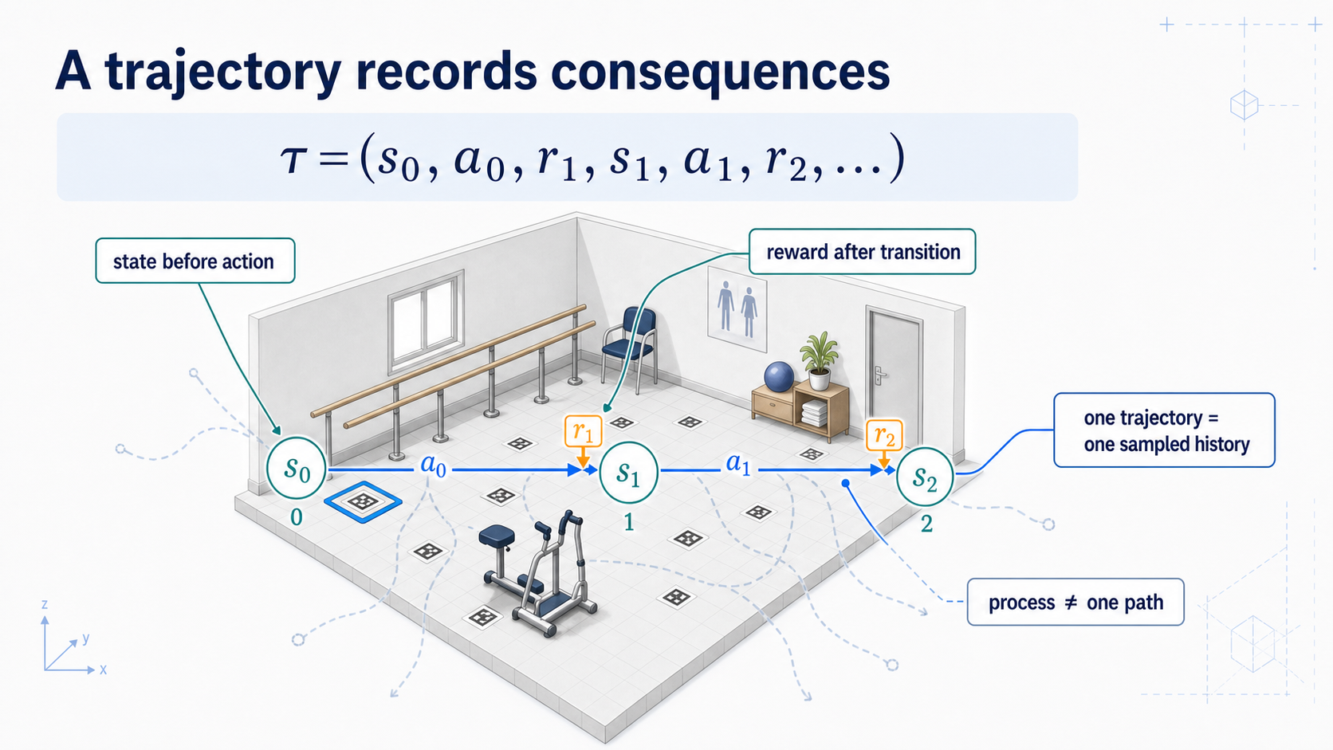
Notes:
### Trajectories
An ordered record of interaction, where one attractive rollout is a sample, not the policy.
### Presenter reminders
- Suggested duration: **2 minutes**.
- Read the tuple in temporal order.
- Point out the reward index convention.
- Contrast the dark sampled path with faint alternatives.
- [Transition] Collapse future rewards into return.
### Near-verbatim delivery
A trajectory is an ordered record of interaction: state zero, action zero,
reward one, state one, and so on.
The reward index reminds us that reward one arrives as a consequence of action
zero and the transition into the next state. Different texts and APIs may name
the variables differently, so the temporal relationship matters more than
memorizing one index convention.
The dark path is one sample. The faint alternatives show what could have
happened under other action choices or stochastic transitions. We should not
confuse one attractive rollout with the policy or the environment process as a
whole.
A trajectory contains several rewards at different times. To compare a
decision now, we need a way to aggregate the consequences that follow from
it.
[Transition.] That aggregate is the return.

Slide 15
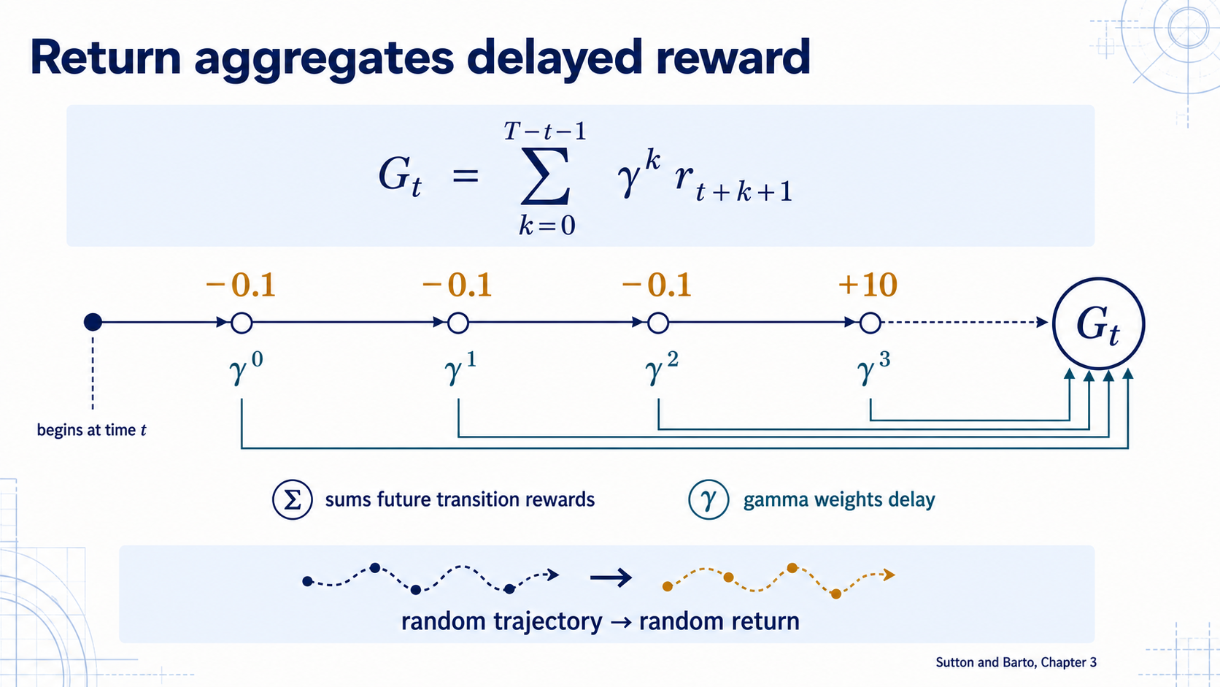
Notes:
### Return
The discounted sum of future rewards — a random variable, already encoding efficiency through step costs.
### Presenter reminders
- Suggested duration: **3 minutes**.
- Pronounce the equation in words before discussing indices.
- Read left-to-right along the reward timeline.
- State that return is a random variable under stochastic policy/dynamics.
- Ask how a long successful route compares with a short one under a step cost.
- [Transition] Isolate gamma's role.
### Near-verbatim delivery
The return from time t is the sum of future rewards, with reward k steps ahead
weighted by gamma to the power k.
Read the timeline. The first step cost enters with weight one. The next enters
with gamma. The target reward arrives later and receives a higher power. If
gamma is one in this finite episode, all listed rewards keep their original
weight. If gamma is below one, delayed reward contributes less.
Because the future trajectory is random under stochastic actions or
transitions, the return is also a random variable. A policy does not generally
promise one return; it induces a distribution of possible returns.
[Ask.] Suppose every movement costs minus point one and success gives ten.
Which successful route has higher undiscounted return: four steps or twelve?
The shorter route, because it accumulates fewer costs. Reward design has
already expressed an efficiency preference.
Return is the quantity whose expectation will define value. Before that, we
should separate gamma from the other parameters students often confuse with
it.
[Transition.] Gamma changes the effective horizon of the objective; it does
not control how quickly a table entry is updated.

Slide 16
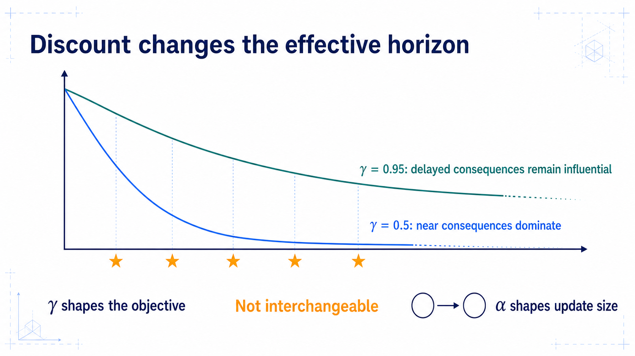
Notes:
### γ vs. α
Gamma sets the objective's effective horizon; alpha sets how far one estimate moves.
### Presenter reminders
- Suggested duration: **2 minutes**.
- Read the decay curves first.
- Use “effective horizon,” not a fixed cutoff claim.
- State the episodic gamma-equals-one possibility.
- Point to alpha only to prevent confusion; define it fully later.
- [Transition] Introduce the policy whose future choices values average.
### Near-verbatim delivery
Gamma weights delayed consequences. With point five, a reward ten steps away
has very little influence. With point nine five, it remains much more
important. This is why we speak of an effective horizon rather than a strict
cutoff.
Gamma is part of the decision objective. Changing it can change which policy
is preferred, especially when one route gives a small result quickly and
another gives a larger result later. In a finite episodic task with a
well-defined end, gamma can be one.
Alpha, shown separately, is the learning rate. It determines how far one
estimate moves toward one sampled target. A smaller alpha does not make the
agent care less about delayed reward; a smaller gamma does.
When reporting an experiment, these parameters need meanings, not only values.
[Transition.] The future actions that produce those delayed consequences are
selected by a policy.

Slide 17
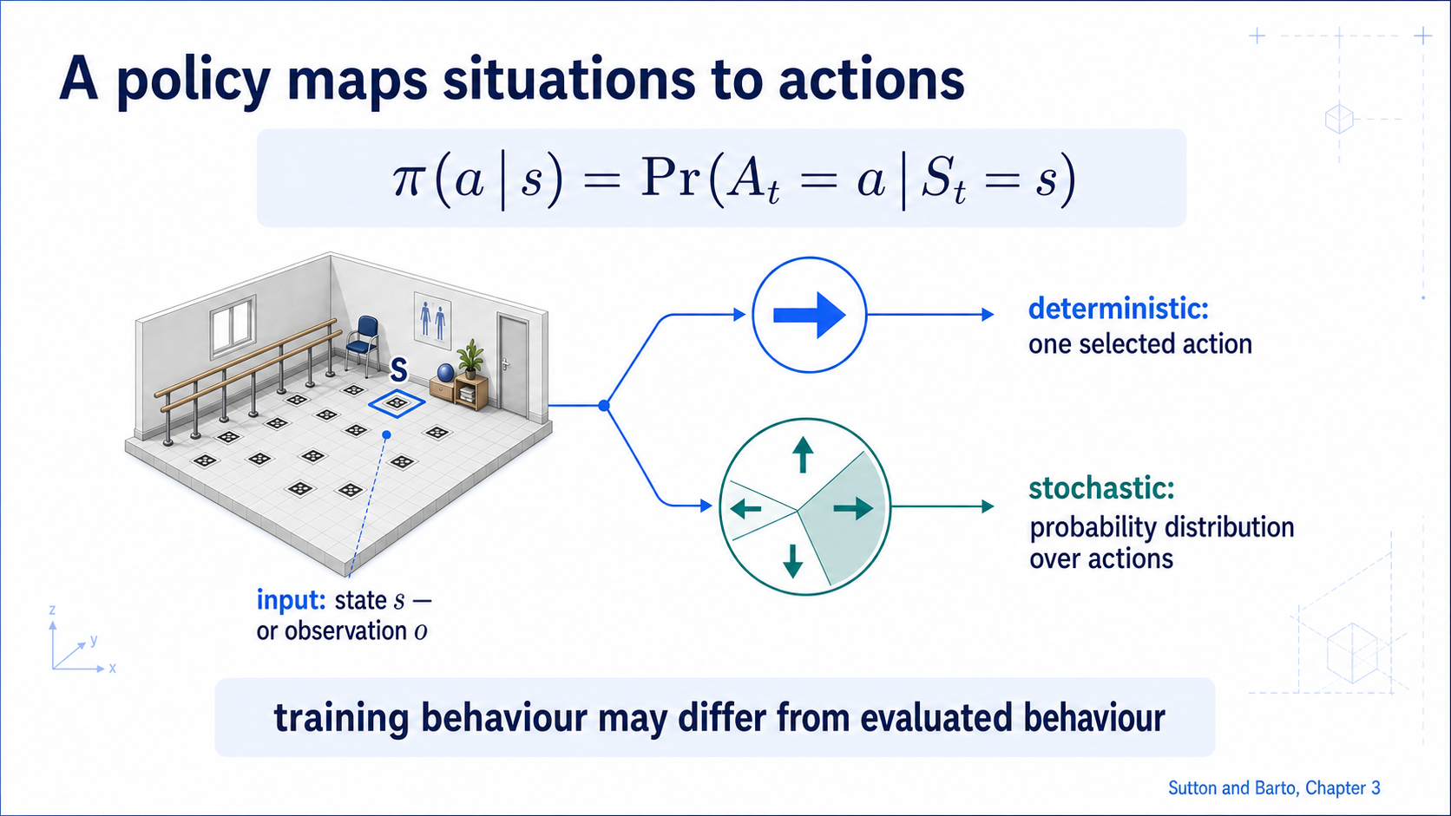
Notes:
### Policies
π(a|s) as a distribution, written π(a|o) when the agent only observes — recording which policy collected data and which was evaluated.
### Presenter reminders
- Suggested duration: **2 minutes**.
- Pronounce pi of a given s.
- Use deterministic policy as a special case.
- Reconnect to state-versus-observation qualification.
- [Transition] Show why a greedy policy alone may not collect adequate data.
### Near-verbatim delivery
A stochastic policy, pi of a given s, is the probability of selecting action a
in state s. The probability wheel is one policy representation. A
deterministic policy is a special case in which one action has probability one.
If the policy actually receives an observation rather than full state, we
should write or say pi of a given o. The notation must not silently grant the
agent information it does not have.
During training, the behaviour policy may remain stochastic to collect varied
experience. During evaluation, we may use the greedy action if that is the
intended deployed behaviour. We therefore record which policy generated data
and which policy was evaluated.
A deterministic arrow map is easy to inspect, but if it always follows its
current belief, it may never gather evidence that another action is better.
[Transition.] Exploration changes the dataset that the policy creates for
itself.

Slide 18
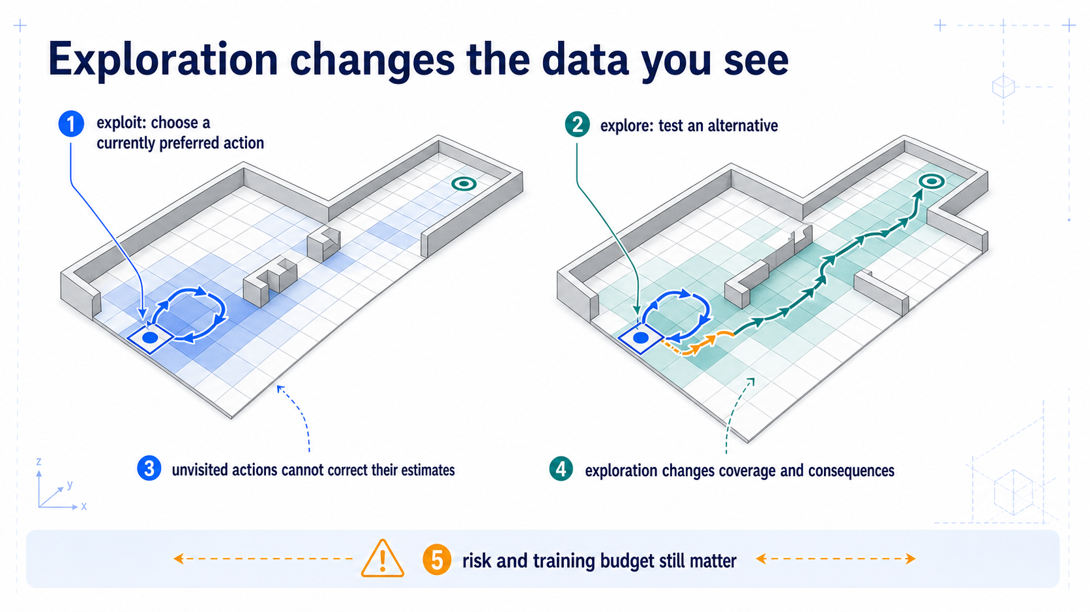
Notes:
### Exploration
A data-collection decision: actions never tried can never be corrected, and physical exploration has real costs.
### Presenter reminders
- Suggested duration: **3 minutes**.
- Compare coverage maps before final returns.
- Avoid saying exploration is always random or always safe.
- Connect exploration to data collection, not personality.
- Note that physical exploration has consequences; simulation is useful but
not automatically faithful.
- [Transition] Define expected return from a state.
### Near-verbatim delivery
The left policy exploits its current estimates. It chooses the action it
believes is best and repeats a safe loop. The coverage map shows that several
actions were never tried. Their estimates cannot correct themselves from
experience that never occurs.
The right trace explores an alternative and discovers a shorter corridor.
That one outcome does not prove the corridor is best, but it supplies evidence
the greedy trace could not obtain.
Exploration is a data-collection decision. It changes which state–action pairs
are visited, which rewards are observed, and which failures are encountered.
Random action is one simple mechanism, not the complete definition.
In a simulator, exploration can often be reset after failure. In a physical or
health-related system, exploratory actions can have unacceptable consequences.
This is one reason training environments, constraints, human oversight, and
deployment policies must be distinguished.
We now have policies and random returns. Value functions summarize the
expected consequences of following a policy.
[Transition.] First: what happens from this state if we continue with policy
pi?

Slide 19
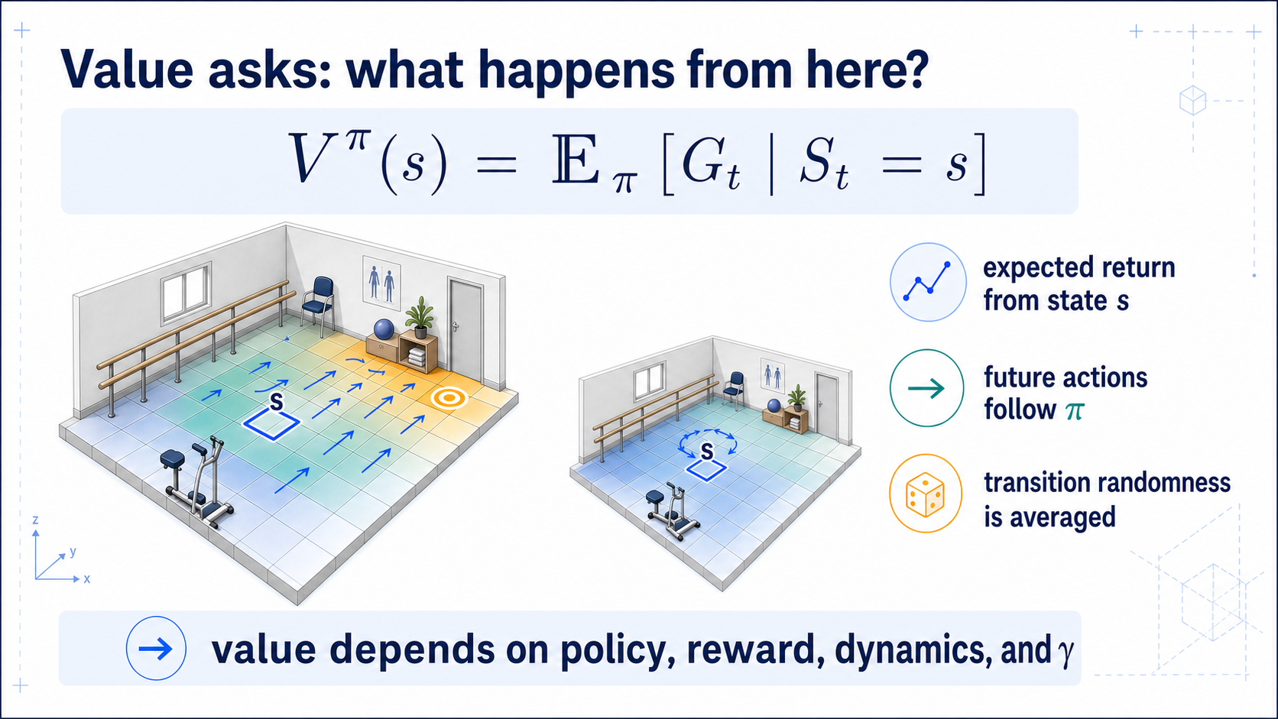
Notes:
### State value
V^π(s) is expected return under a named policy, not a geometric property of the cell.
### Presenter reminders
- Suggested duration: **3 minutes**.
- Pronounce the conditioning statement.
- Read the heatmap under one named policy.
- Use the second-policy inset to prove value is not intrinsic to the cell.
- [Transition] Condition additionally on the first action.
### Near-verbatim delivery
V pi of s is the expected return when we start in state s and follow policy pi
afterward.
The word expected matters. We average over stochastic transitions and future
action choices. The superscript pi matters as well. In the main heatmap, the
policy tends to move toward the target, so nearby states have high value. In
the inset, another policy loops near the wall, so the same cell has a lower
value.
Value is therefore not a geometric property of the cell. Change the reward,
transition noise, discount, or policy, and the value can change. A value
heatmap is meaningful only with those contracts attached.
The state value averages over the action selected at the current state. To
choose or compare actions, we want a quantity that conditions on the first
action explicitly.
[Transition.] That quantity is the action-value function, Q pi of s comma a.

Slide 20
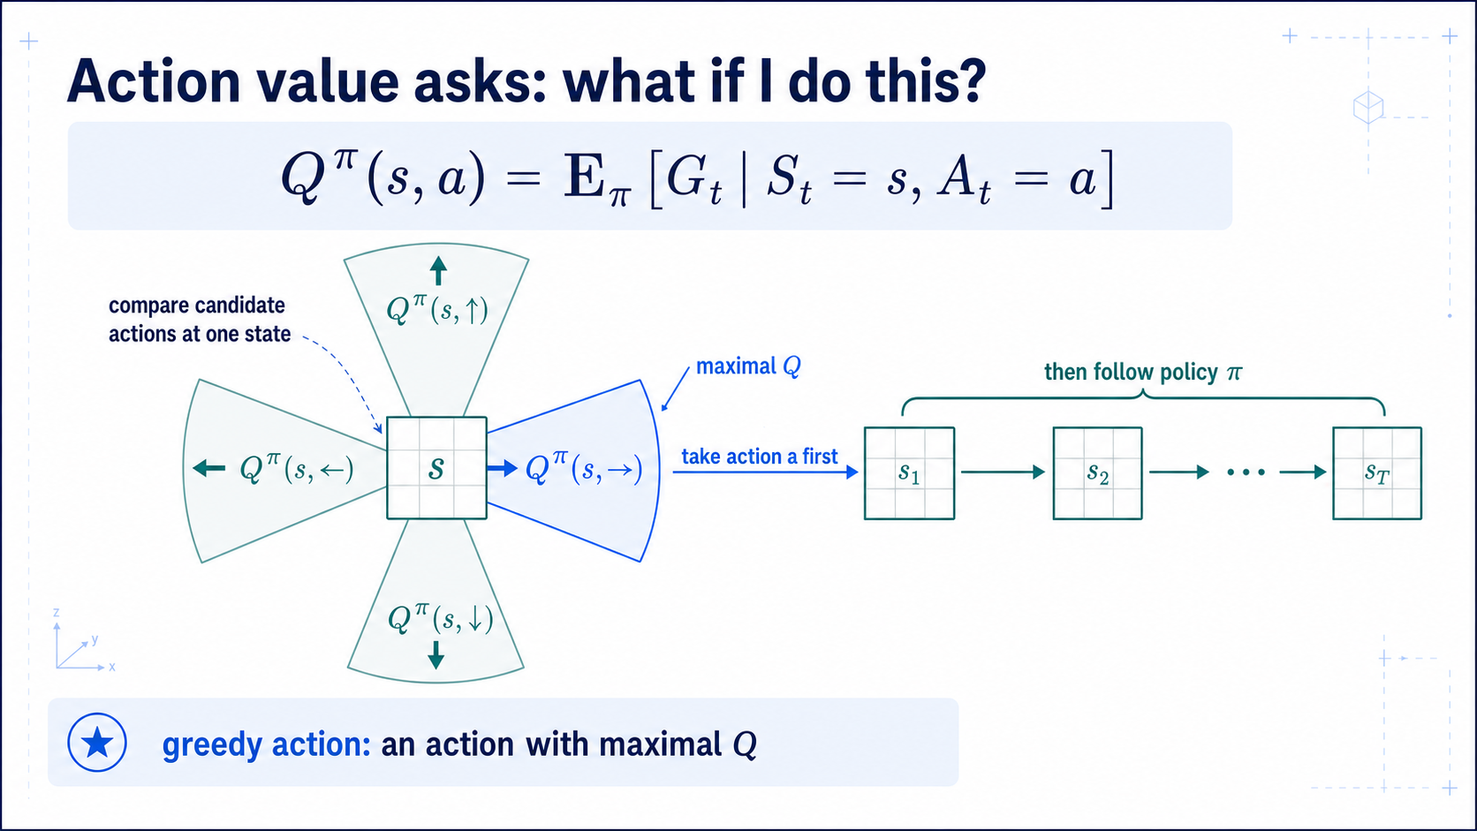
Notes:
### Action value
Q^π(s,a) fixes the first action; one table row, with explicit tie-breaking to avoid directional bias.
### Presenter reminders
- Suggested duration: **3 minutes**.
- Point to the forced first action, then the policy continuation.
- Explain tie handling.
- Connect the four wedges to one Q-table row.
- [Transition] Derive recursive consistency with one-step lookahead.
### Near-verbatim delivery
Q pi of s comma a is the expected return if we start in state s, take action a
first, and then follow policy pi.
The four wedges correspond to one row of a Q-table. At this state, east has the
largest current estimate. A greedy policy can select an action with maximal Q.
If several actions tie, the implementation should break ties explicitly;
always choosing the first array index can create an accidental directional
bias.
Again, these estimates include more than immediate reward. A move can have a
small cost now and still have high action value because it leads to a useful
future position.
The definition refers to the entire future return. Bellman relationships make
that future recursive: one immediate transition plus a continuation value.
[Transition.] We will read the next equation as a diagram before reading it as
algebra.

Slide 21
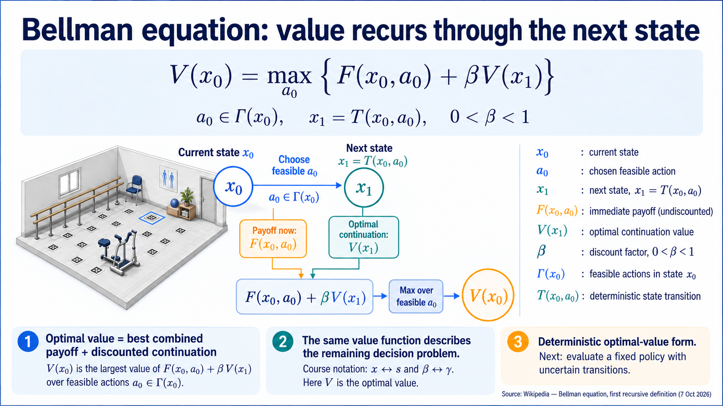
Notes:
### The Bellman Equation
The Bellman equation is a recursive formula that breaks down the total expected reward into an immediate reward plus the discounted value of the next state.
### Presenter reminders
- Suggested duration: **3 minutes**.
- Read the equation as current choice, immediate payoff, and optimal continuation.
- Define x₀, a₀, x₁, F, V, Γ, T, and β while following the transition diagram.
- Emphasize that V is optimal value here; it is not the fixed-policy Vπ on the next slide.
- Keep both feasibility and transition constraints visible. The max selects an action, not a random outcome.
- Source notation follows Wikipedia's first recursive definition under “The Bellman equation”; β plays the role of the course's γ.
- Transition: retain the immediate-plus-continuation decomposition while changing to evaluation of a fixed policy with uncertain outcomes.
### Near-verbatim delivery
Before introducing the sums, let us isolate the recursive idea in a deterministic
decision problem. We begin in state x zero and choose an action a zero from the
feasible set Gamma of x zero. The transition function T determines the next
state, x one. F of x zero and a zero is the payoff received for that choice.
V of x zero denotes the best discounted return available from the current
state. On the right, the payoff now is added to beta times V of x one. That
second value summarizes all the decisions still to come, assuming they are
made optimally. Beta lies strictly between zero and one in this formulation;
it has the same discounting role as gamma in our course notation.
The maximum compares the combined immediate payoff and continuation value
across feasible first actions. An action with a larger immediate payoff need
not win if it leaves a much worse future. The next state depends on the action,
so the continuation term participates in that comparison.
This is recursive because the problem remaining after one action is another
instance of the same decision problem, now starting from x one. We use the
same value function again. The equation characterizes a function that is
consistent with optimal decisions; it is not yet an algorithm for learning
that function from samples. We assume the decision problem is well-defined
and the displayed maximum can be attained.
Here the transition is deterministic and V means optimal value, corresponding
to V star. Next we will evaluate a specified policy instead: we will average
over that policy's choices and the environment's uncertain outcomes. The
immediate-payoff-plus-discounted-continuation structure will remain.

Slide 22
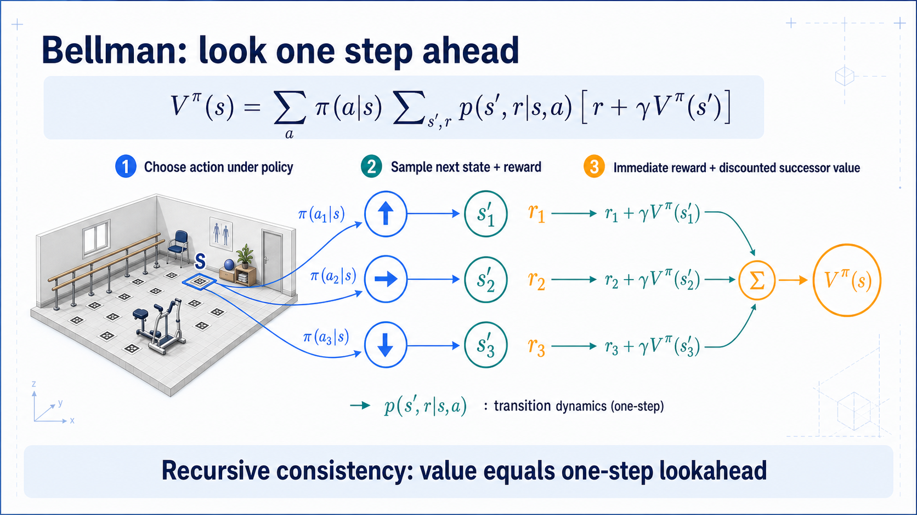
Notes:
### Bellman expectation
Value equals one step of real consequence plus discounted successor value, averaged over policy and dynamics.
### Presenter reminders
- Suggested duration: **3 minutes**.
- Read the diagram in three stages before the summations.
- Explain each weighting distribution.
- Define a backup as information moving backward from successors.
- Avoid proofs or contraction arguments.
- [Transition] Replace policy averaging with optimal choice.
### Near-verbatim delivery
Start with the diagram, not the symbols. From state s, the policy defines a
distribution over actions. For each action, the environment defines a
distribution over next states and rewards. Each branch contributes immediate
reward plus gamma times the value of the successor.
The first sum averages over actions using pi. The second averages over
transition outcomes using p. If the value on the left is correct for this
policy, it must agree with that one-step decomposition on the right. This is a
recursive consistency relationship.
A backup takes information from successor branches and updates information at
the predecessor. In a known model, we can sum over outcomes. In sample-based
learning, we will use one observed transition as evidence.
We are building intuition, not proving convergence. The useful mental model is
one step of real consequence plus a summary of what is expected afterward.
[Transition.] For optimal action value, the continuation assumes the best
next action rather than averaging under a fixed policy.

Slide 23
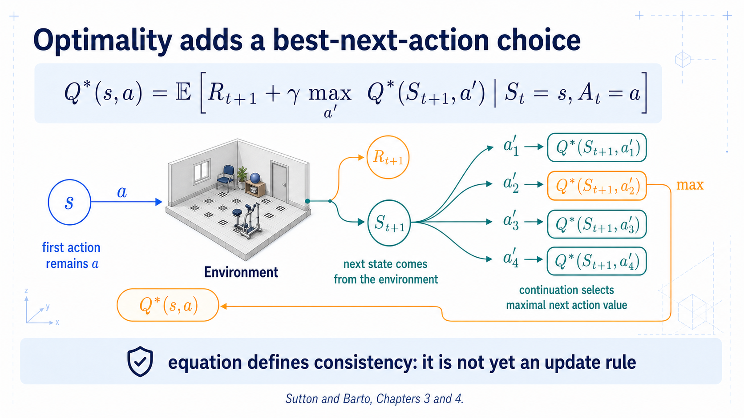
Notes:
### Bellman optimality
The max is over the agent's next actions, not the environment's outcomes — and is still not the Q-learning algorithm.
### Presenter reminders
- Suggested duration: **3 minutes**.
- Keep the first action fixed while pointing to the next-state max.
- Say “optimal continuation” rather than “the environment chooses.”
- Distinguish expectation equation from Q-learning update.
- [Transition] Turn the relationship into one numeric sampled backup.
### Near-verbatim delivery
The first action a is fixed by the action-value question. The environment then
produces a next state and reward. At that next state, optimal continuation uses
the largest action value.
The max does not mean the environment chooses the best outcome. Transition
uncertainty is still averaged by the expectation. The max is over the agent's
candidate next actions after the successor has been reached.
This equation describes how the optimal action-value function must be
consistent. It is not yet the Q-learning algorithm. Q-learning replaces the
unknown expectation with sampled experience and moves the current estimate
toward a target containing the greedy successor estimate.
Before writing the update, we will calculate one backup numerically. The
numbers are deliberately small enough that every term can be checked aloud.
[Transition.] Take out a calculator only if you want one; the arithmetic is
designed for inspection.

Slide 24
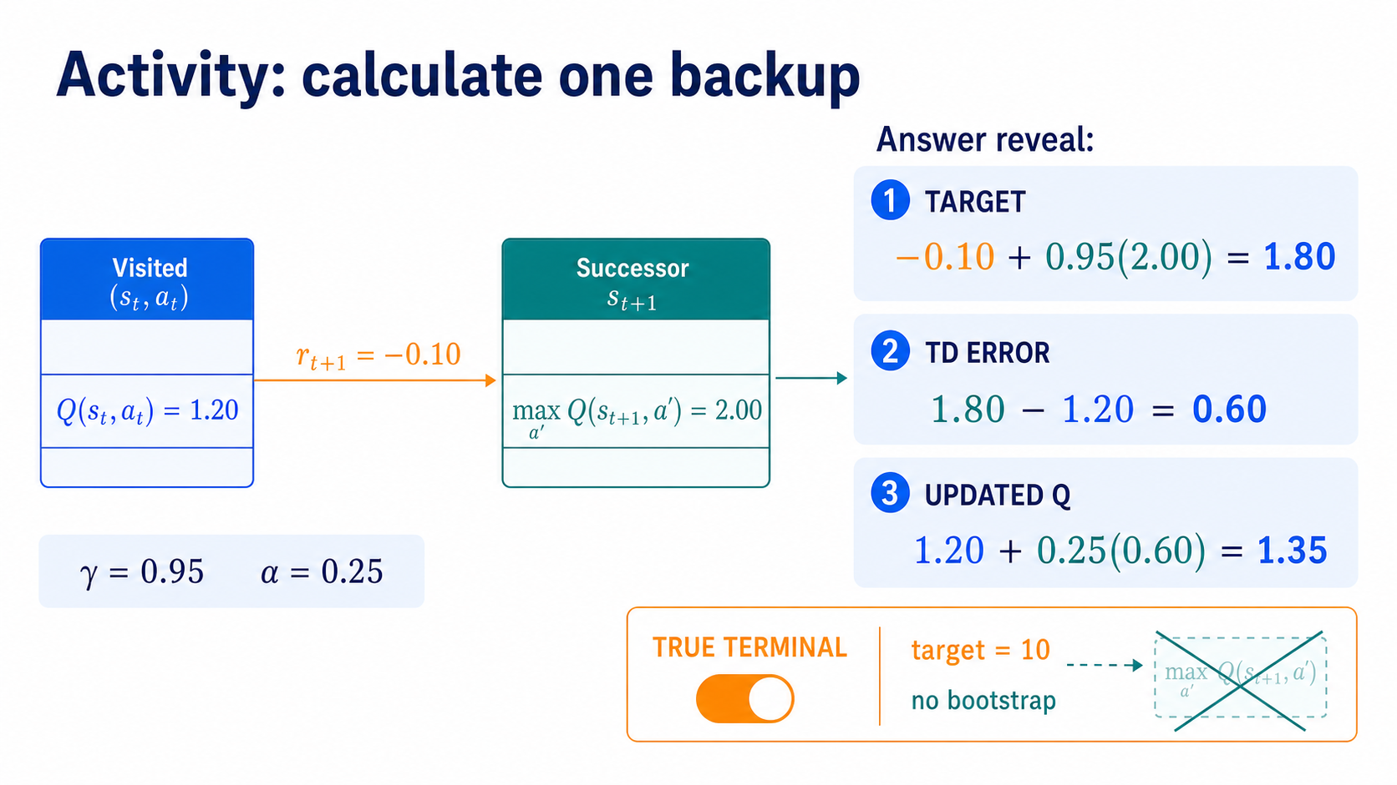
Notes:
### A worked backup
Target 1.8, TD error 0.6, new value 1.35 — only the visited entry changes, and a terminal removes the bootstrap.
### Presenter reminders
- Suggested duration: **4 minutes**.
- [Ask] Give 60 seconds before revealing the target.
- Reveal target, error, and update separately.
- Require students to say which table entry changes.
- Toggle to terminal and ask what disappears.
- [Transition] Pause after fixing the three-step calculation.
### Near-verbatim delivery
[Ask.] Calculate three quantities: the target, the temporal-difference error,
and the new value of the visited table entry.
[Pause for one minute.]
First, the target is reward plus discounted best next value: minus point one
plus point nine five times two. That equals one point eight.
Second, the TD error is target minus current estimate: one point eight minus
one point two, which equals point six.
Third, move the current estimate by alpha times the error: one point two plus
point two five times point six. The updated value is one point three five.
Only Q of the visited state and action changes in this tabular update. The
successor row supplied a target; it was not itself updated by this transition.
[Ask.] Now toggle the transition to true terminal with reward ten. What is the
target? Ten. The successor maximum disappears because there is no task
continuation. The alpha-scaled update may still be gradual, but the target
contains no bootstrap.
That distinction between sampled target, error, and update will map directly
to three lines of Python.
[Transition.] We will take a ten-minute break. When we return, keep one
question in mind: how does this one backup become a learning algorithm?

Slide 25
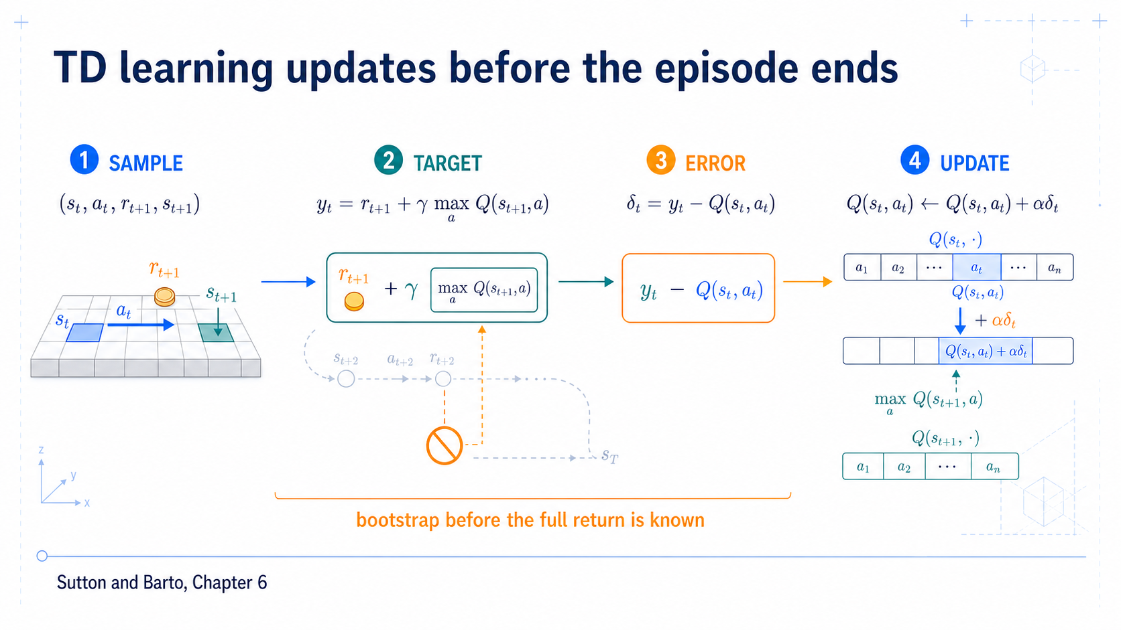
Notes:
### Temporal-difference learning
Sample → target → error → update, bootstrapping from estimates before the full return is known.
### Presenter reminders
- Suggested duration: **2 minutes**.
- Resume by answering the break question.
- Point to the full-return trace behind the sampled target.
- Define bootstrapping in one sentence.
- [Transition] Assemble all stages into the Q-learning equation.
### Near-verbatim delivery
The visited state–action entry changes; the successor row supplies the target.
Temporal-difference learning updates from a sampled transition before the
entire episode return is known. It combines the observed reward with an
estimate of future value. Using an estimate to update another estimate is
called bootstrapping.
The pipeline has four stages. Observe a transition. Construct a target. Compare
that target with the current estimate to obtain a TD error. Move the estimate
toward the target.
The target can be noisy because it contains a sampled reward, a sampled
successor, and an imperfect current estimate. Repeated experience and an
appropriate learning-rate schedule are therefore important. The algorithm is
not memorizing one transition as truth.
[Transition.] Q-learning instantiates this pipeline with a greedy
action-value estimate at the successor.

Slide 26
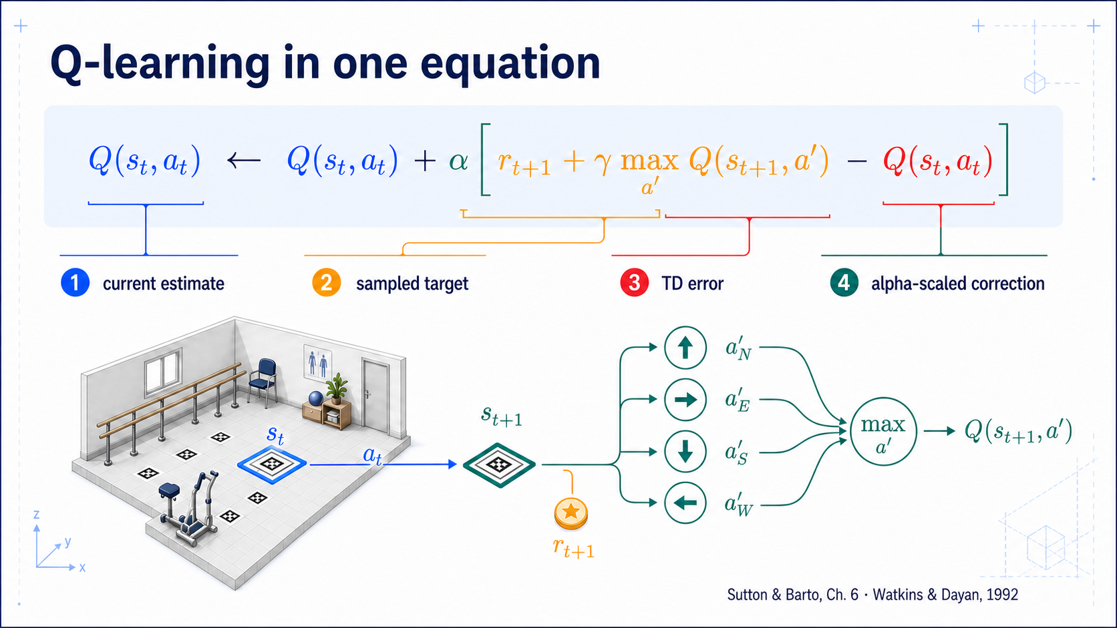
Notes:
### The Q-learning update
Read in colour-coded blocks; tabular convergence holds only under specific conditions.
### Presenter reminders
- Suggested duration: **3 minutes**.
- Read the equation by semantic blocks, not symbol-by-symbol.
- Link every colour to Slide 25 and the numeric calculation.
- State the non-terminal assumption; terminal masking returns on Slide 30.
- Distinguish alpha from gamma again.
- [Transition] Put the equation onto a real table.
### Near-verbatim delivery
Read the equation from the inside outward.
The amber block is the sampled target: observed reward plus gamma times the
largest estimated action value at the successor. Subtract the blue current
estimate to obtain the red temporal-difference error. Multiply by alpha to
control the correction size, then add that correction to the current table
entry.
Gamma controls how delayed consequence enters the target. Alpha controls how
far this one estimate moves toward the target. The max defines a greedy target
continuation even if the behaviour that collected the transition was
exploratory.
As written, the equation assumes bootstrapping is valid. For a true terminal
transition, the continuation term becomes zero. We will make that condition
explicit rather than hiding it inside a generic `done` flag.
Watkins and Dayan established convergence for tabular Q-learning under
particular conditions, including adequate repeated sampling and appropriate
updates. That result is not a blanket guarantee for arbitrary function
approximation or short training runs.
[Transition.] Now locate the same terms in two Q-table rows.

Slide 27
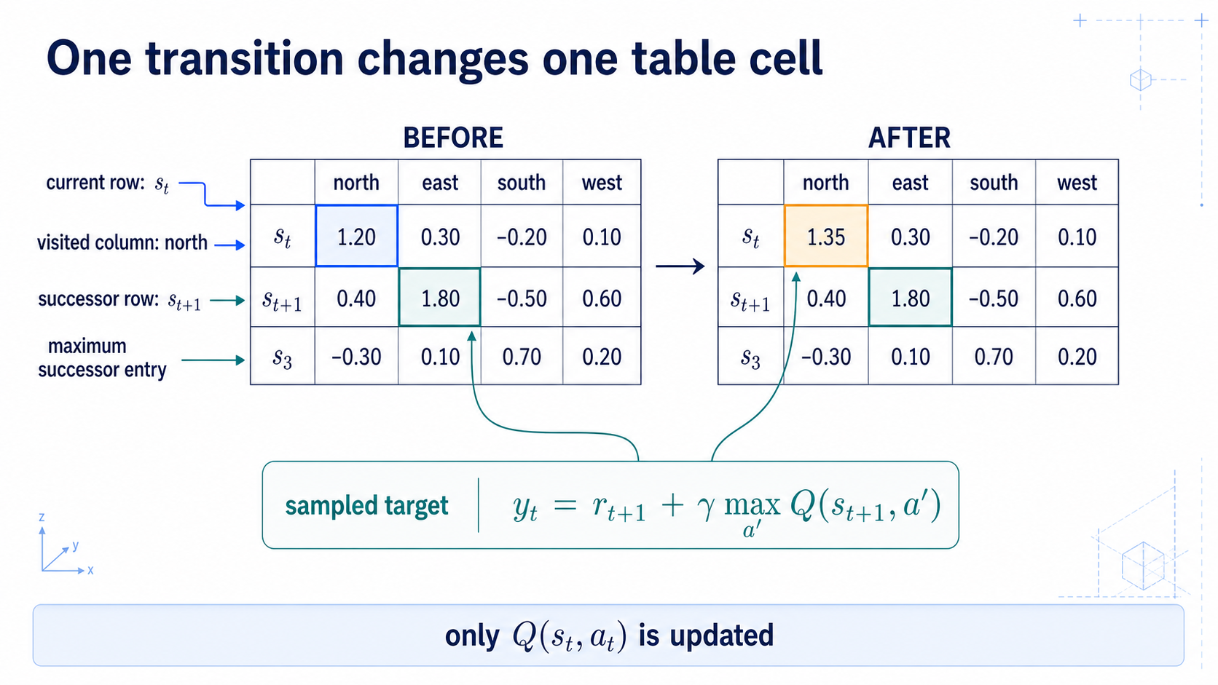
Notes:
### Backup on the Q-table
The successor row's maximum flows back into one visited cell; everything else stays unchanged this step.
### Presenter reminders
- Suggested duration: **3 minutes**.
- Trace the backup arrow from successor maximum to visited cell.
- State that unvisited cells remain unchanged in this step.
- Mention propagation through later visits, not simultaneous table diffusion.
- Ask what happens if several successor actions tie.
- [Transition] Define epsilon-greedy behaviour and tie handling.
### Near-verbatim delivery
The current state identifies a row. The executed action identifies the visited
column. Together they locate the only table entry updated by this transition.
The successor state identifies another row. Q-learning takes the maximum value
from that row as its continuation estimate. The backup arrow carries that
information backward, together with the observed reward, to the visited cell.
Every other table cell remains unchanged in this step. Consequences propagate
through the table only as relevant transitions are visited repeatedly. This is
one reason exploration and coverage matter.
If several successor actions tie for the maximum, the numeric target is still
well-defined, but the greedy policy needs a tie rule. Random tie breaking
avoids an accidental preference caused by array order.
The table makes the algorithm inspectable. It also makes the scaling problem
obvious: one entry is required for every represented state–action pair.
[Transition.] Before discussing scale, we need the simple behaviour policy
that will collect varied transitions in the lab.

Slide 28
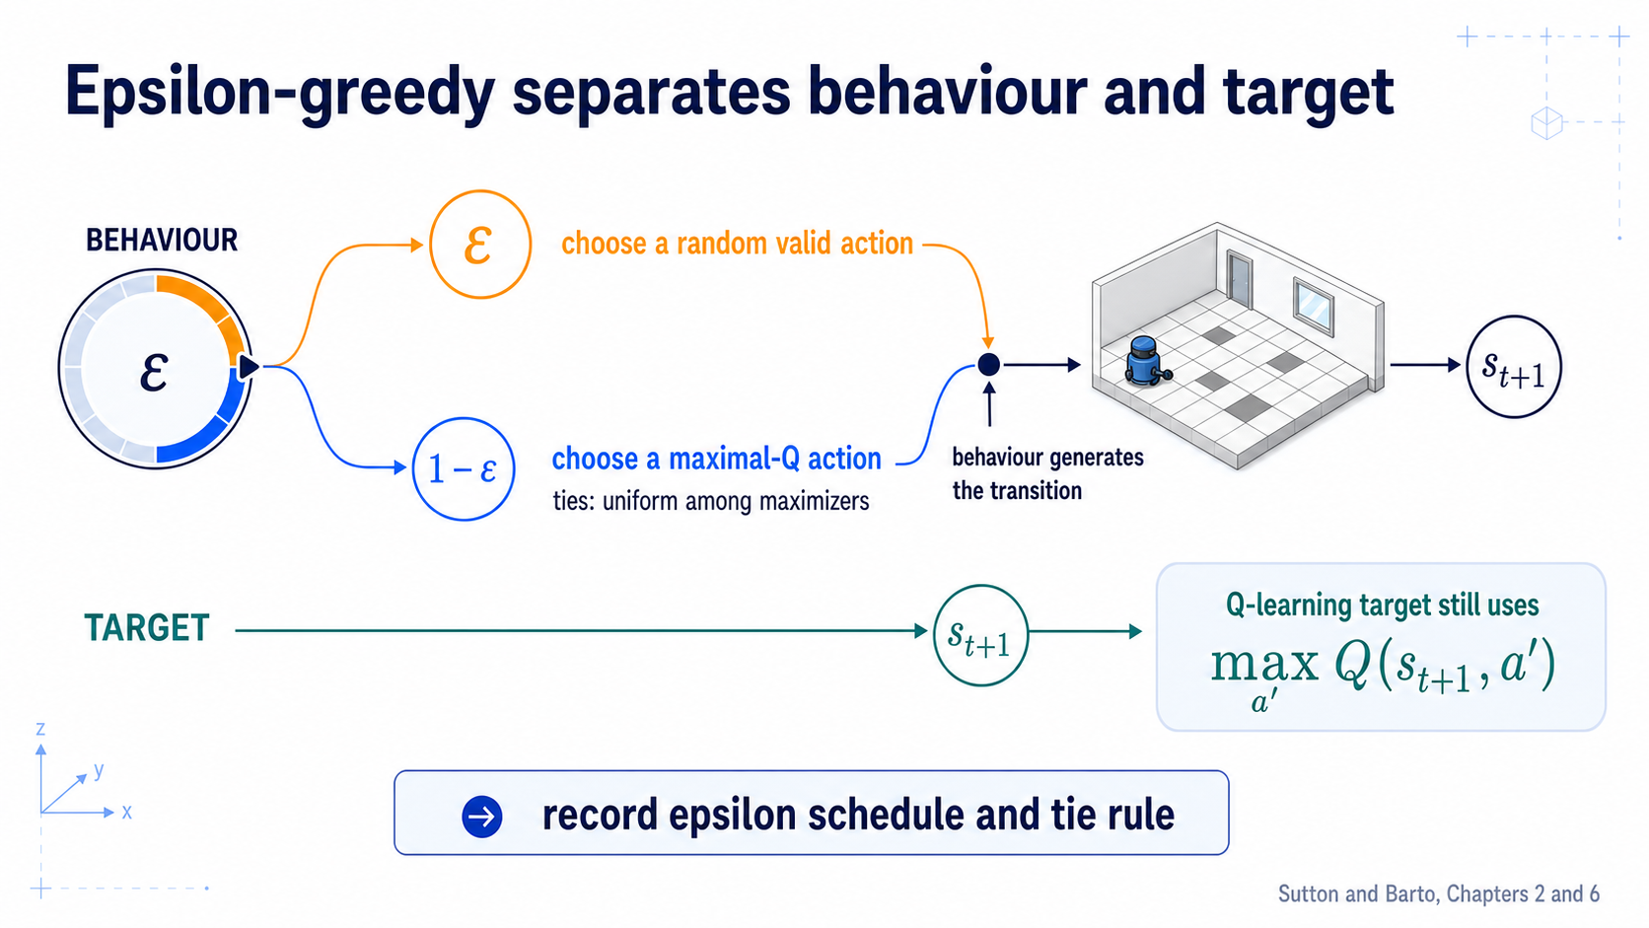
Notes:
### Epsilon-greedy
Exploratory behaviour collects data while the target stays greedy, with no universal ε schedule.
### Presenter reminders
- Suggested duration: **3 minutes**.
- Read behaviour lane first, target lane second.
- State whether “random” includes only valid actions in this implementation.
- Ask what epsilon zero does before estimates are reliable.
- Avoid implying one universal schedule.
- [Transition] Name the off-policy relationship.
### Near-verbatim delivery
Epsilon-greedy defines the behaviour that generates experience. With
probability epsilon, select a random valid action. Otherwise, select an action
with maximal current Q-value. In our lab, invalid moves remain valid movement
requests whose environment consequence can be a self-transition; the exact
action-set rule will be documented.
The lower lane is separate. Regardless of whether the sampled action was
exploratory, the Q-learning target uses the greedy maximum at the successor.
This separation between behaviour and target makes the method off-policy.
If epsilon is zero before the estimates are useful, the policy can lock into
arbitrary early choices. If epsilon remains high during evaluation, measured
performance may reflect continued random exploration rather than the intended
greedy policy. We record both the schedule and the evaluated action rule.
There is no universal epsilon schedule. The environment, risk, coverage, and
training budget determine what is defensible.
[Transition.] Off-policy learning permits this separation, but it does not
remove the need for relevant data and clear assumptions.

Slide 29
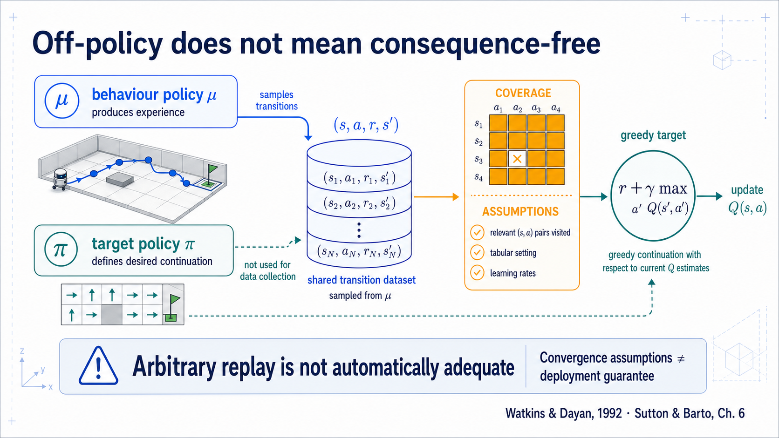
Notes:
### Off-policy learning
Separating behaviour from target doesn't make arbitrary data adequate — unvisited actions stay unlearned.
### Presenter reminders
- Suggested duration: **2 minutes**.
- Define behaviour and target policies verbally.
- Reject the interpretation “any historical data is automatically adequate.”
- Keep convergence qualification short and precise.
- [Transition] Apply semantics to episode-ending code.
### Near-verbatim delivery
The behaviour policy produces experience. The target policy describes the
continuation used by the update. In Q-learning, that target continuation is
greedy with respect to the current Q estimates.
Off-policy does not mean that arbitrary data is adequate. The behaviour must
visit relevant state–action pairs often enough to correct estimates. If an
action is never tried, its value cannot be learned from this tabular update.
The original convergence result has assumptions about the tabular setting,
sampling, and learning rates. A finite classroom run can still produce poor
estimates. Function approximation introduces additional difficulties. And
convergence inside a simulator does not prove that the task model or reward is
appropriate outside it.
[Transition.] The next implementation detail is equally semantic: when an
episode stops, does the task value really end?

Slide 30
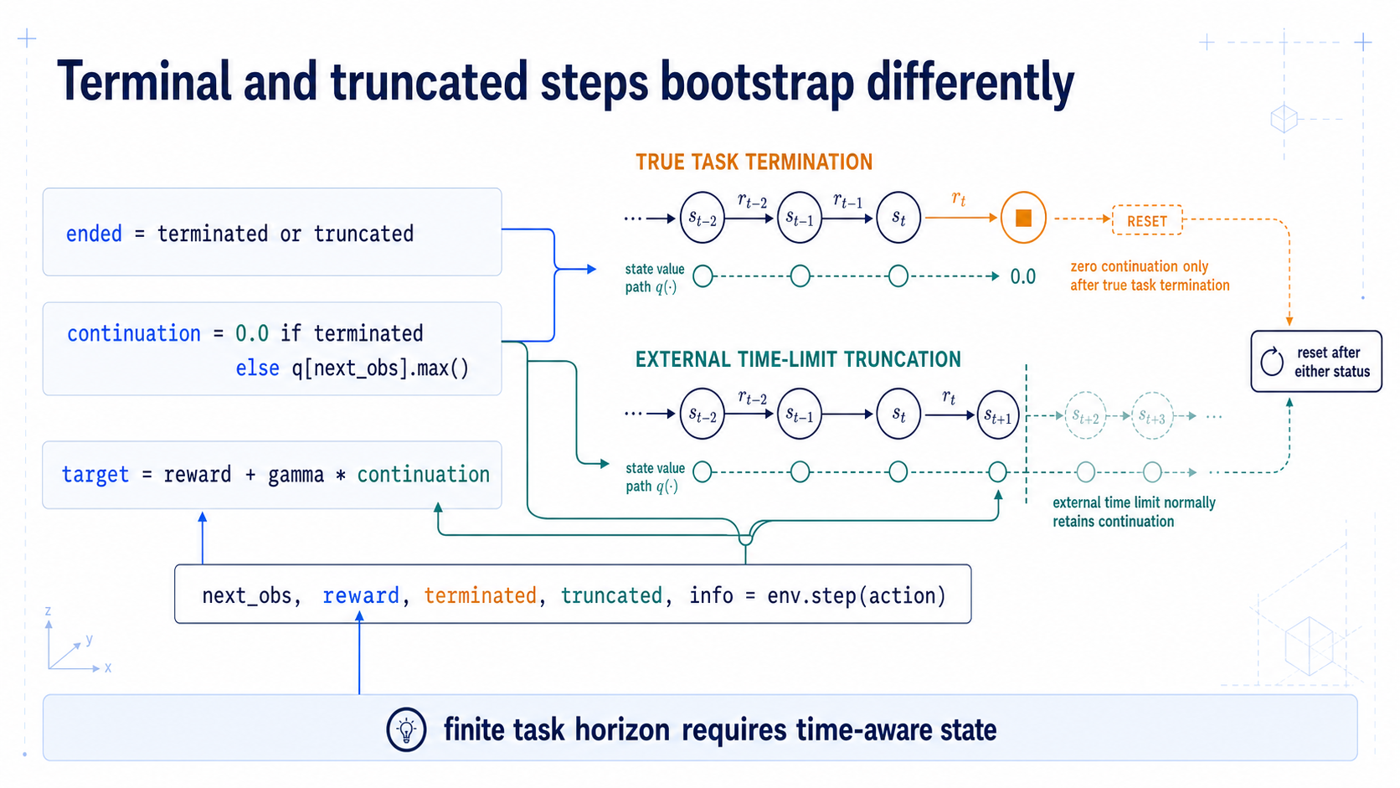
Notes:
### Terminal masking in code
"Episode ended" and "task has no future value" are two separate questions, hence `terminated` vs. `truncated`.
### Presenter reminders
- Suggested duration: **3 minutes**.
- Read the reset line separately from the continuation line.
- Use the two timelines to explain why `ended` must not mask both cases.
- State the finite-horizon qualification.
- [Transition] Embed this rule in the complete Python loop.
### Near-verbatim delivery
The first line asks whether the sampled episode has ended. Either status means
we will reset before collecting another transition.
The second line asks a different question: does the task have continuation
value after this state? For a true terminal transition, no, so continuation is
zero. For an external time-limit truncation, the current task state can still
have value, so we normally bootstrap from the successor estimate.
The third line constructs the target from reward and the qualified
continuation.
If the task itself has a fixed horizon—perhaps only three decisions are
allowed—remaining time must be represented so that the state is Markov and the
terminal rule reflects the actual task. The code cannot decide the modelling
semantics for us.
This distinction is why Gymnasium replaced one ambiguous `done` signal with
separate `terminated` and `truncated` outputs.
[Transition.] We can now read a complete environment interaction without
letting the framework hide the mathematics.

Slide 31
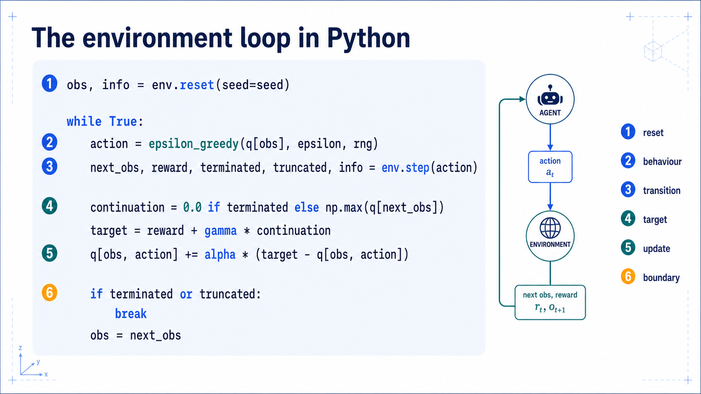
Notes:
### The Python loop
Six callouts from reset to update, with an explicit RNG and `info` kept out of policy input.
### Presenter reminders
- Suggested duration: **4 minutes**.
- Read by numbered callouts, not line-by-line syntax narration.
- Point out the explicit RNG passed to epsilon-greedy.
- Keep `info` diagnostic, not policy input by accident.
- State that full environment and tests belong to Lesson 07.
- [Transition] Show the three outputs produced by repeated episodes.
### Near-verbatim delivery
Callout one resets the environment and establishes reproducibility. In a
framework-independent class, the exact method signature can differ, but the
contract should still return an observation and diagnostic information.
Callout two selects an action from the behaviour policy using an explicit
random-number generator. Callout three applies the action and unpacks the next
observation, reward, and the two boundary signals.
Callout four constructs the continuation with terminal masking. Callout five
performs the exact Q-learning update we calculated. Callout six decides whether
to break and reset or advance the current observation.
`info` is useful for logging hidden state, success, collision count, and reward
components. It should not leak privileged information into the policy unless
that information is explicitly part of the observation contract.
The deck shows only the algorithmic spine. Lesson 07 will supply the complete
GridRoom, tests for deterministic transitions and boundary semantics, training
loops, plots, and a small optional Gymnasium adapter.
[Transition.] Repeated episodes turn the table into three inspectable pieces
of evidence: a learning trace, a greedy policy map, and evaluated rollouts.

Slide 32
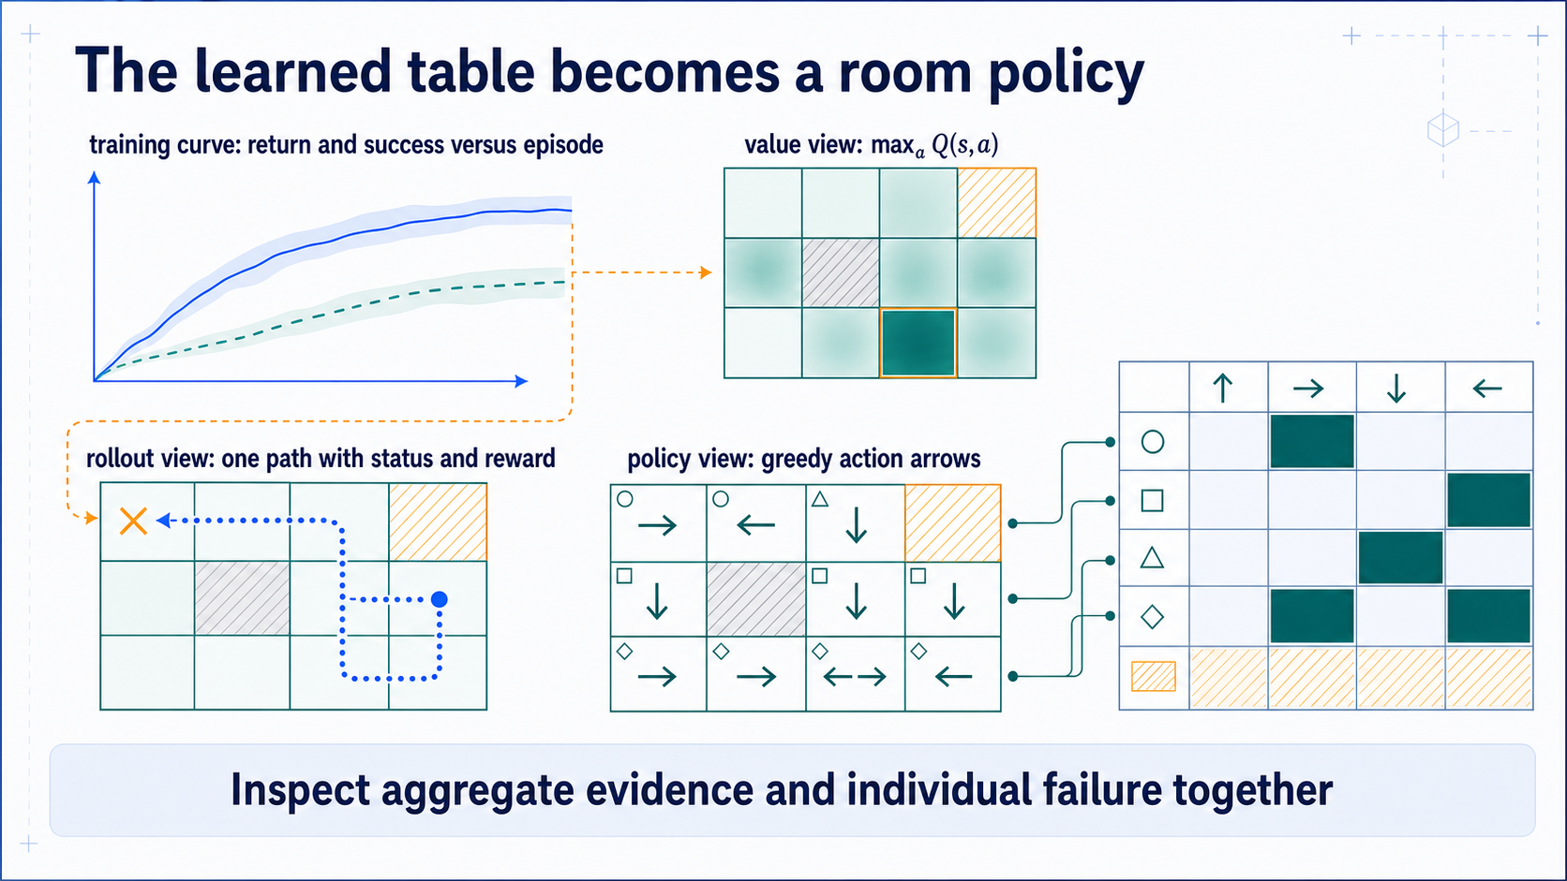
Notes:
### Four views of a learned policy
Training curve, value heatmap, arrow map, and rollout answer different questions; none suffices alone.
### Presenter reminders
- Suggested duration: **6 minutes**.
- Read clockwise: training curve, value heatmap, arrows, rollout.
- Label training evidence and evaluation evidence separately.
- Use one failure trace, not only the best rollout.
- Point out inaccessible/blocked cells and ties.
- Do not claim convergence from visual flattening alone.
- [Transition] Challenge the reward that produced the policy.
### Near-verbatim delivery
Repeated episodes produce a Q-table, but the table alone is difficult to
interpret. We create four linked views.
At top left, the training curve shows what happened while data were being
collected. A rising return or success rate suggests change, but it does not
prove general performance. At top right, the maximum action value at each cell
forms a value heatmap. Blocked and unreachable cells must remain explicitly
marked rather than coloured as if estimated.
At bottom right, arrows convert each row into a greedy action. Ties need a
visible convention. Loops and arrows into walls reveal policy defects quickly.
At bottom left, one rollout explains a particular success or failure in room
coordinates.
These views answer different questions. The curve summarizes many training
episodes. The heatmap exposes the learned estimate. The arrows show the
decision rule. The rollout provides a trace for diagnosis. None is sufficient
alone.
For the final deck, every displayed number and path will come from the verified
reference implementation, with parameters and seeds recorded. We will also
separate evaluation rollouts from training episodes so exploratory behaviour
does not contaminate the policy claim.
[Ask.] If the policy reliably reaches a cell beside the handrail but never
enters the declared target, is that almost success or reward failure? The
answer depends on the task contract, not visual sympathy.
[Transition.] Let us now compare three reward contracts that can produce very
different behaviour in the same room.

Slide 33
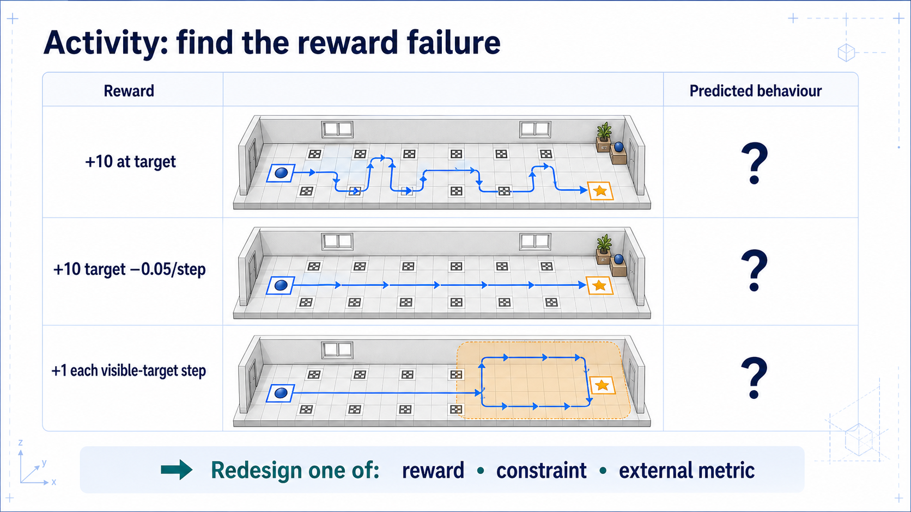
Notes:
### Three reward contracts
Sparse, step-cost, and visibility rewards yield different behaviour, with repairs split across reward, constraints, and evaluation.
### Presenter reminders
- Suggested duration: **4 minutes**.
- [Ask] Predict behaviour before revealing paths.
- Allow 45 seconds individually, then collect three answers.
- Ask whether the repair belongs in reward, environment constraint, or
evaluation.
- Make the healthcare caveat explicit.
- [Transition] Audit an overconfident evaluation claim.
### Near-verbatim delivery
[Ask.] Predict the behaviour encouraged by each reward. You have forty-five
seconds.
[Pause.]
The sparse target reward expresses completion clearly, but early experience
may contain little positive feedback. Adding a small step cost encourages
shorter successful paths, although it changes the return scale and can make
long necessary routes unattractive.
The third proxy gives one point whenever the target is visible. The revealed
rollout loiters inside the visibility zone. It collects reward without
completing the intended task.
[Ask.] How would you repair it? One option is to reward a one-time completion
event. A constraint can prohibit unsafe cells. An external metric can count
task completion, collision, or repeated proxy collection without entering the
optimized return. The right answer may use all three layers.
Adding more reward terms is not automatically safer; every new proxy can
create another tradeoff. In a rehabilitation interpretation, comfort, human
intent, and clinical usefulness cannot be established by this classroom
reward. The simulation teaches specification failure, not patient-facing
policy validation.
[Transition.] Even with a plausible reward, one successful trace is much too
little evidence.

Slide 34
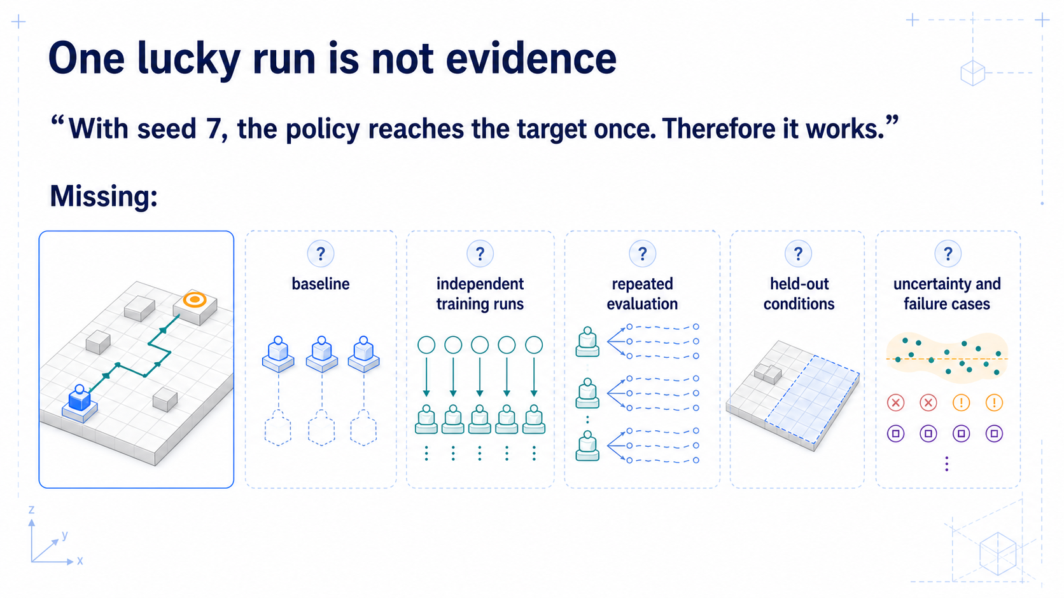
Notes:
### One success is not evidence
A seed-7 rollout is a demonstration; claims need independent runs, held-out conditions, uncertainty, and baselines.
### Presenter reminders
- Suggested duration: **3 minutes**.
- [Ask] Let students falsify the claim.
- Distinguish training seed from evaluation episode.
- Name demonstration versus evaluation.
- Avoid prescribing one universal sample count.
- [Transition] Build the minimum comparison.
### Near-verbatim delivery
[Ask.] With seed seven, the policy reaches the target once. Does it work?
The rollout is a demonstration. It proves that this particular execution
reached the target. It does not estimate reliability, compare alternatives, or
test generalization.
We need to know whether seed seven was a training seed, an evaluation seed, or
both. We need independent training runs because learning outcomes can vary. We
need repeated evaluation episodes for each trained policy. We need held-out
starts, transition noise, or layout changes that match the claim. We need
uncertainty and categorized failures.
Most importantly, we need baselines. If a random policy succeeds equally often
because the room is trivial, the learning claim is weak. If a transparent
heuristic is better, the experiment has not justified learning.
The exact number of runs depends on variance, cost, and the precision required.
The principle is that the evidence should be designed to falsify the claim,
not to showcase its luckiest trace.
[Transition.] Our minimum evaluation compares three policies under the same
declared test conditions.

Slide 35
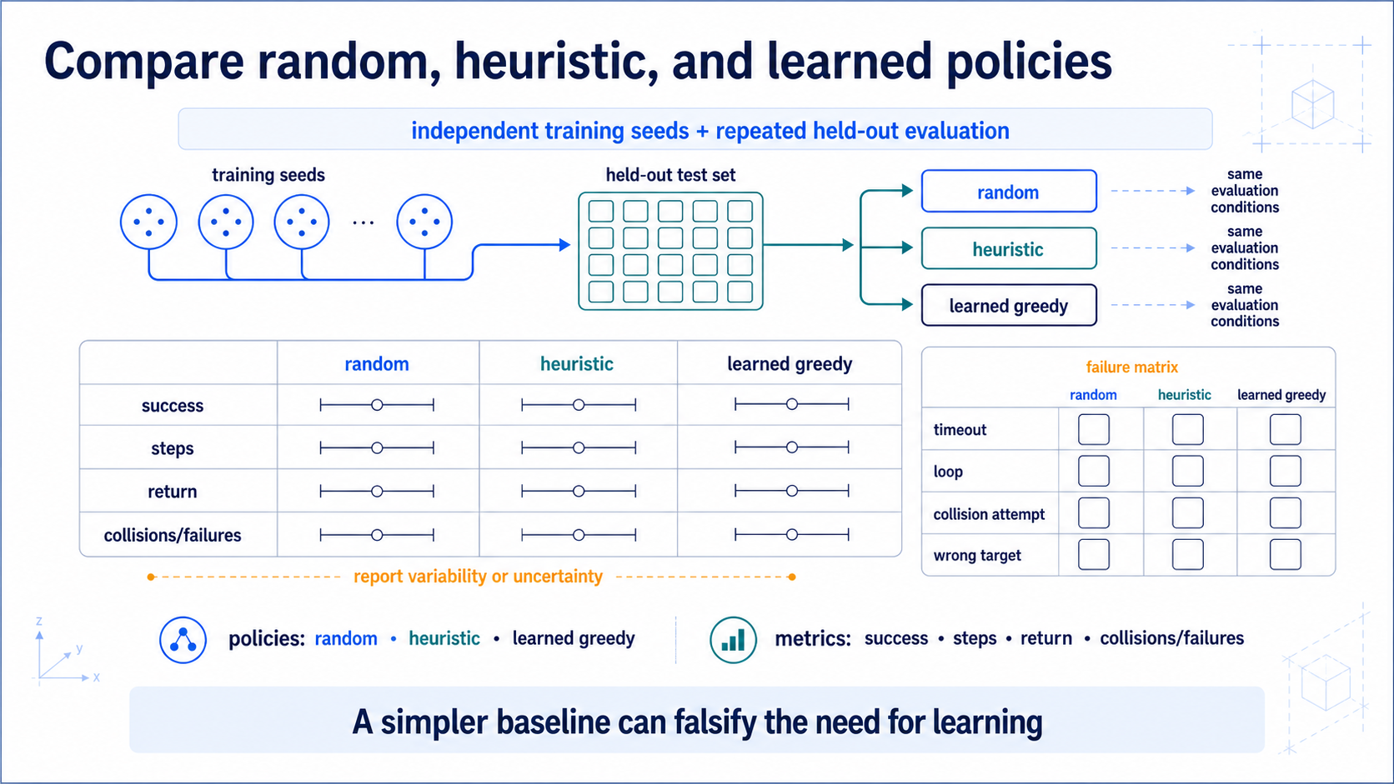
Notes:
### The minimum evaluation
Random, heuristic, and learned policies under one protocol — and if the heuristic wins, that's a valid result.
### Presenter reminders
- Suggested duration: **5 minutes**.
- Read protocol before result bars.
- Ensure all policies receive only declared information.
- Separate trained-policy variability from episode variability.
- Explain why return and success can disagree.
- Use the heuristic as a scientific control.
- [Transition] Convert the evidence standard into the Lesson 07 contract.
### Near-verbatim delivery
Before reading any bar, read the protocol. Each learned policy is trained with
an independently controlled seed. It is then evaluated greedily over repeated
episodes drawn from a held-out set. Random and heuristic policies face the same
conditions and receive only the information declared in their interfaces.
We report success because task completion matters. We report steps because two
successful policies can have very different efficiency. We report return
because it is the optimized quantity. We report collisions and categorized
failures because averages can hide unacceptable behaviour.
Return and success can disagree. A policy can collect shaped reward without
finishing, or succeed through a long path with lower return. That disagreement
is diagnostic evidence about reward design.
Variability also has layers. Different training seeds produce different
learned tables. Different evaluation episodes expose stochastic outcomes.
The final chart should communicate uncertainty rather than display only one
mean or best run.
The heuristic is a scientific control. If it is simpler, more reliable, and
more efficient, the honest conclusion may be that learning is unnecessary for
this formulation. That is a successful experiment, even if it is not a
successful RL product claim.
[Transition.] Lesson 07 turns this complete contract into code, tests, plots,
and a reusable policy interface.

Slide 36
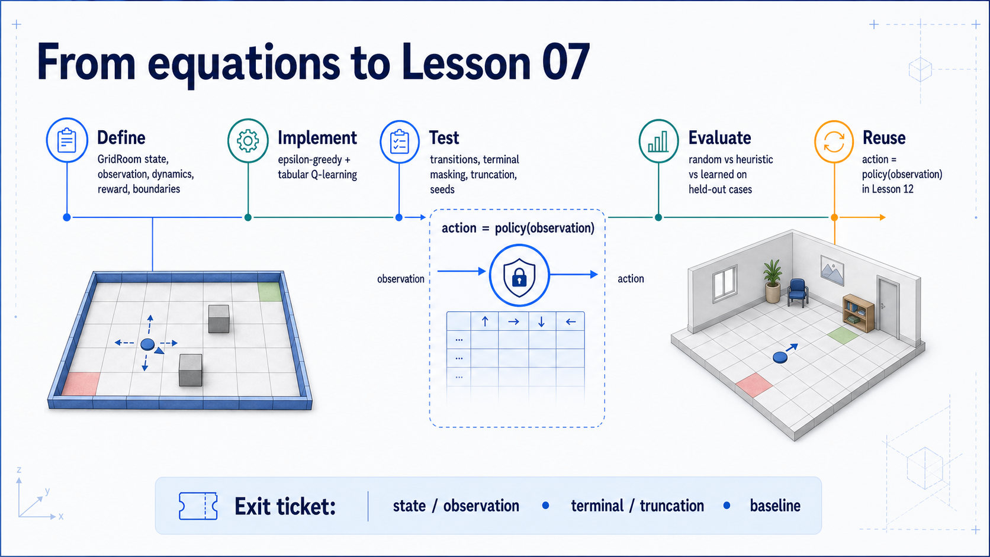
Notes:
### Bridge to Lesson 07
Define, implement, test, evaluate, interface — then the exit ticket: learning must earn its complexity.
### Presenter reminders
- Suggested duration: **4 minutes**.
- Read the five verbs left-to-right.
- Make testing part of implementation, not an afterthought.
- State the final-lab RL role: navigation or viewpoint selection.
- [Ask] Give two minutes for the exit ticket.
- Close on “learning must earn its complexity.”
### Near-verbatim delivery
Lesson 07 follows five verbs.
Define the GridRoom contract, including state versus observation, collision
dynamics, reward, termination, and truncation. Implement epsilon-greedy action
selection and the tabular Q-learning update. Test the transition function,
terminal masking, time-limit behaviour, and reproducible randomness. Evaluate
random, heuristic, and learned policies on held-out conditions. Then preserve
a small interface: given an observation, return an action.
That interface matters later. In Lesson 12, another component should not need
to know whether the policy is a Q-table or a prepared model. RL will perform an
identifiable function—navigation or viewpoint selection—inside the integrated
virtual and real-world flow.
[Ask.] Complete the exit ticket. First, name one state variable and the
observation that exposes or hides it. Second, name one true terminal condition
and one external truncation. Third, name a baseline that could falsify the need
for learning.
[Pause for two minutes.]
The central lesson is this: RL is not only an update equation. It is an
environment specification, an experience-collection process, and an empirical
claim. Learning must earn its complexity through evidence.
[Transition.] The next lesson implements the contract and makes every failure
visible.

Slide 37
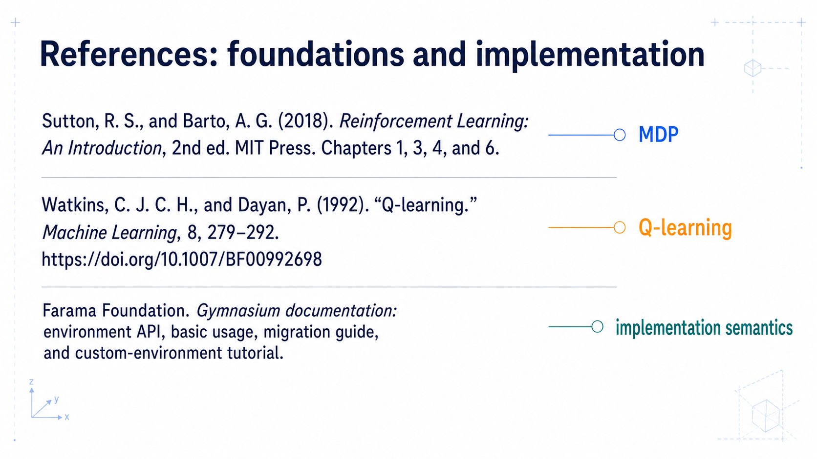
Notes:
### References: foundations
Sutton and Barto, Watkins and Dayan, and Gymnasium documentation.
### Presenter reminders
- Suggested duration: **not presented**.
- Not normally presented.
- Keep links readable in the PPTX Notes and source ledger.
- Use this page when students ask for the mathematical or API foundation.
### Near-verbatim delivery
This reference page is not part of the timed presentation. Sutton and Barto
provide the core vocabulary and mathematical development. Watkins and Dayan
support the original tabular Q-learning result and its qualifications.
Gymnasium documentation supports the contemporary environment interface,
including separate termination and truncation signals.

Slide 38
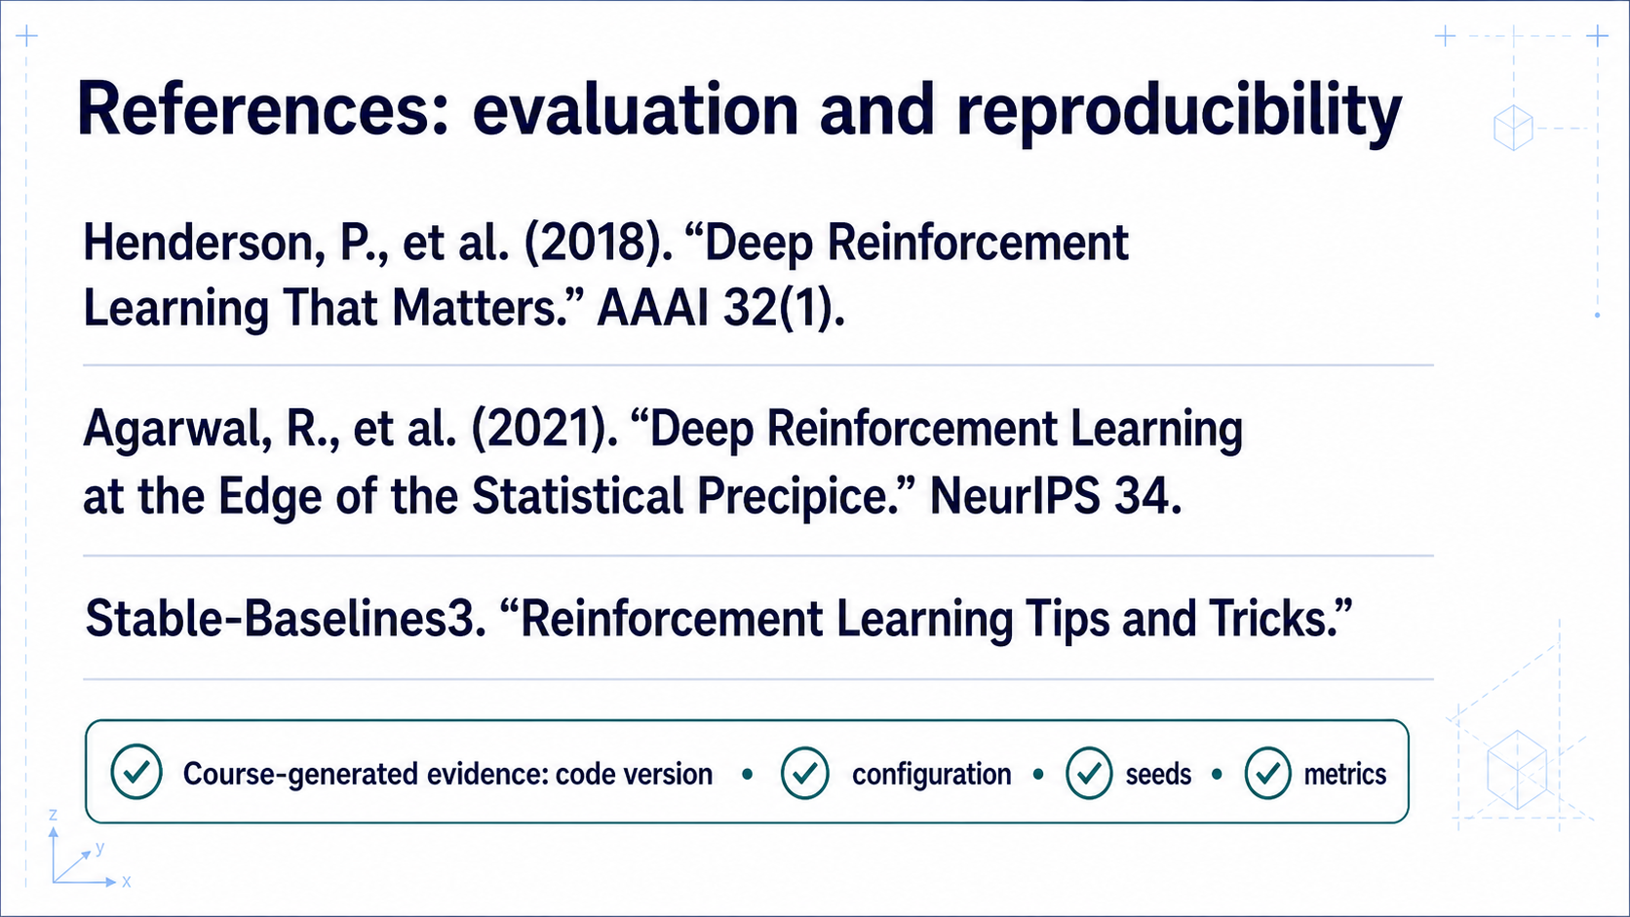
Notes:
### References: evaluation practice
Henderson, Agarwal, and Stable-Baselines3 guidance on reliable RL comparison.
### Presenter reminders
- Suggested duration: **not presented**.
- Not normally presented.
- Emphasize that the papers study deep-RL evaluation, while the lesson applies
their experimental discipline to a transparent tabular case.
- Keep framework guidance subordinate to primary sources.
### Near-verbatim delivery
This reference page is also outside the timed presentation. Henderson and
colleagues document how implementation choices and variance can undermine RL
claims. Agarwal and colleagues develop more reliable statistical comparison
practices. Stable-Baselines3 provides practical evaluation guidance but is not
the definition of the field. Every chart in this lesson will additionally
record the course code version, environment configuration, seeds, and metrics
that produced it.

