Slide 1
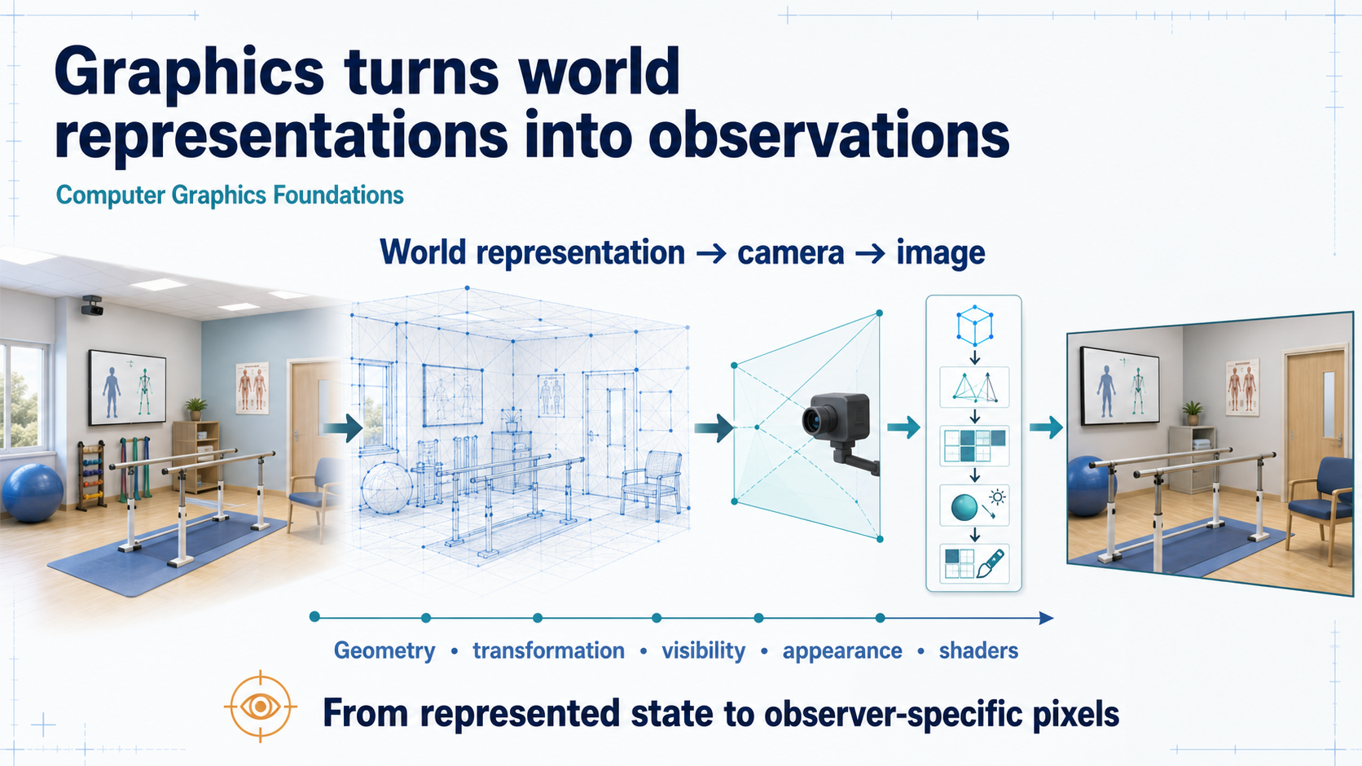
Notes:
### Opening: graphics as the observation function
Rendering starts from represented state — geometry, transforms, camera, appearance rules — and ends at pixels; the image is an observer-specific result, not the world itself.
### Presenter reminders
- Suggested duration: **2 minutes**.
- Establish the thesis before naming individual topics.
- Read the visual left to right.
- Connect explicitly to Lesson 01's state–observation distinction.
- Do not imply that rendering is the whole virtual world.
### Near-verbatim delivery
Today we move from the definition of a virtual world to the machinery that
makes part of that world observable. Computer graphics does not begin with a
pixel. It begins with a representation: geometry, attributes, transformations,
a camera, and rules for appearance. The renderer turns those inputs into a
frame for a particular observer at a particular time.
Look from left to right. The room exists first as represented state. Geometry
describes spatial structure. Transformations place that structure relative to
the world and the camera. Visibility determines which parts can contribute.
Materials, lights, textures, and shaders determine how the visible parts are
evaluated. Only at the end do we obtain pixels.
This is one implementation of the observation function we introduced in Lesson
01. The world is not the image, and the image is not the entire world. It is an
observer-specific result computed from it. [Transition.] We will start by
looking at how many different representations can describe the same place.

Slide 2
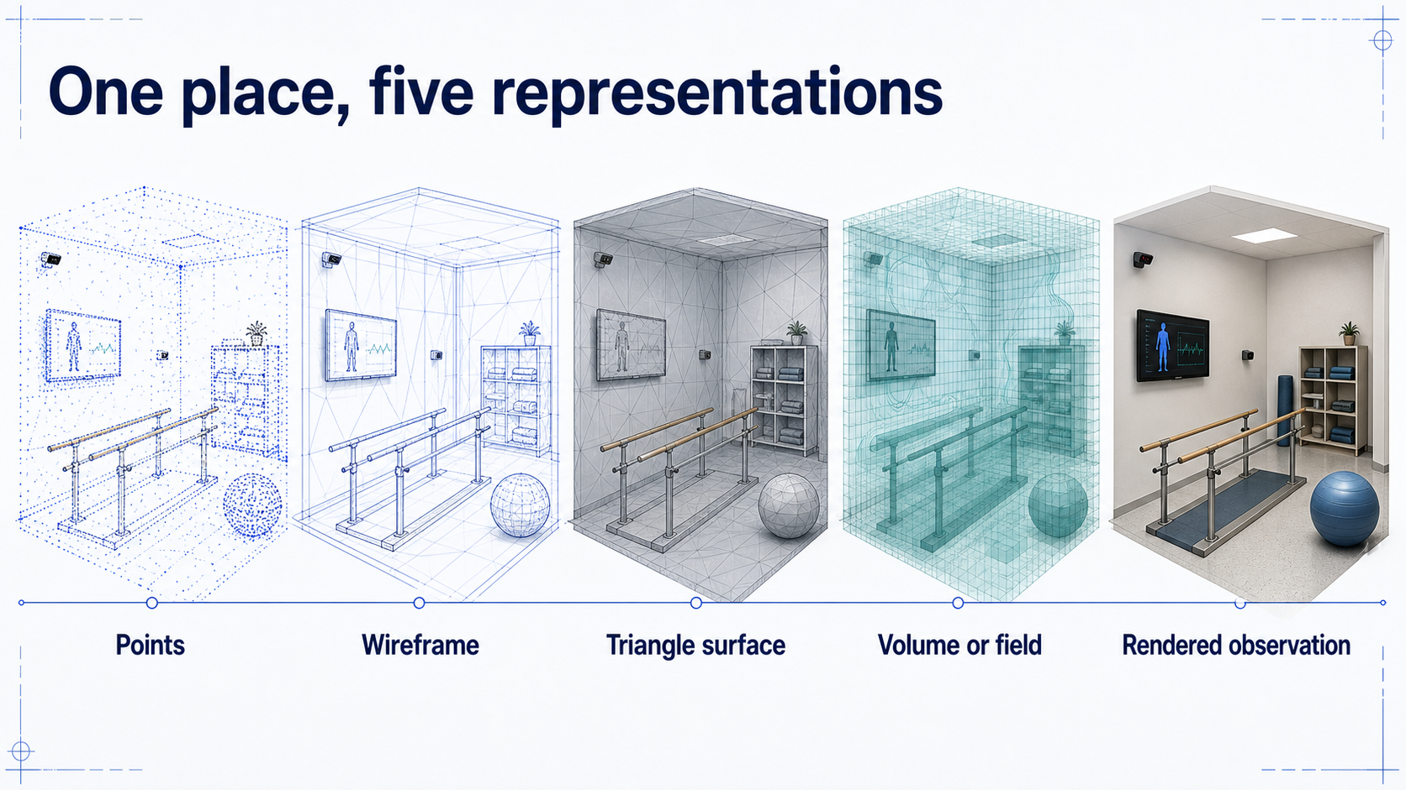
Notes:
### Five representations of one place
Points, wireframe, triangle surface, volume, and rendered frame describe the same room with different information; this is a set of commitments, not a ladder from primitive to advanced.
### Presenter reminders
- Suggested duration: **3 minutes**.
- [Ask] Which representation would you choose for collision, acquisition,
medical density, and final display?
- Accept multiple answers when assumptions are explicit.
- Avoid presenting the sequence as a maturity ladder.
### Near-verbatim delivery
These five images refer to the same place, but they do not contain the same
information. On the left, we have samples: points with positions and perhaps
colour or confidence. A wireframe shows explicit connectivity. A triangle
surface adds filled geometric primitives. A volume stores values throughout a
three-dimensional domain. The final image is a rendered observation.
[Ask.] If I need to display an opaque wall quickly, which representation would
you choose? A triangle surface is a strong candidate. If I have just measured
the room with a depth sensor, I may start with points. If I need to inspect
density inside tissue, a surface may remove the information I care about, so a
volume becomes more appropriate.
The important idea is that this is not a ladder from primitive to advanced or
from unrealistic to realistic. Each representation commits to particular data
and operations. Production systems often combine several. [Transition.] A
renderer then converts the chosen representation into a frame through a
pipeline.

Slide 3
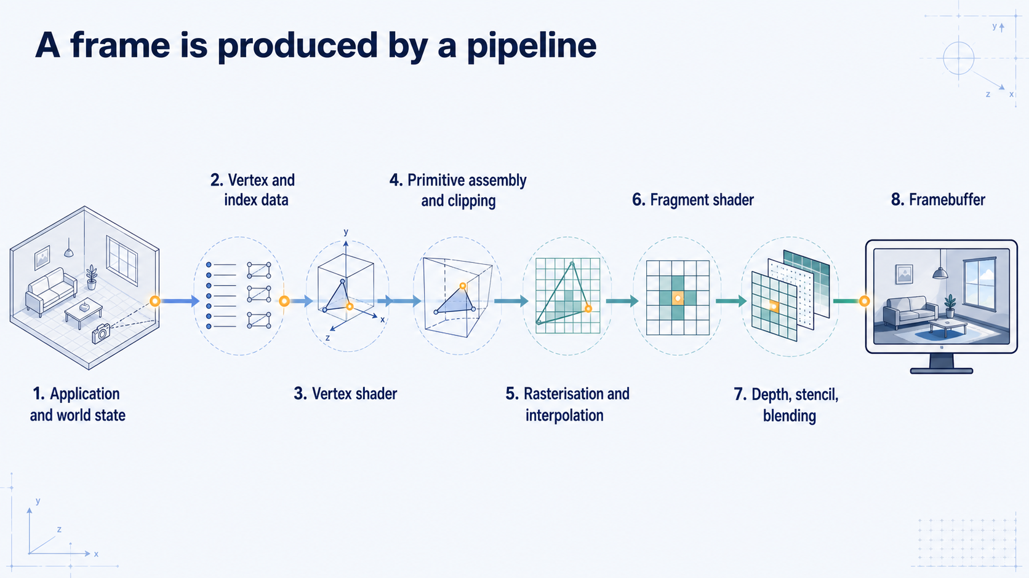
Notes:
### The graphics pipeline
The lesson's central map: application state and buffers feed vertex shading, primitive assembly, clipping, rasterisation, fragment shading, and per-sample tests — a conceptual API contract, not a literal hardware schedule.
### Presenter reminders
- Suggested duration: **3 minutes**.
- Treat the pipeline as a conceptual contract, not literal hardware schedule.
- Keep the highlighted vertex visible across stages.
- Define framebuffer briefly.
### Near-verbatim delivery
This is the central map for the lesson. The application chooses what should be
drawn: objects, transforms, camera, material parameters, and render state.
Vertex and index buffers provide structured data. A vertex shader processes
each submitted vertex. The processed vertices are assembled into points,
lines, or triangles and clipped against the visible region.
Rasterisation asks which framebuffer samples are covered by each primitive and
interpolates values across it. A fragment shader evaluates candidate outputs.
Depth, stencil, scissor, and blending operations then decide whether and how
those outputs update the framebuffer. The framebuffer is the collection of
attachments that hold the image and related per-sample data such as depth.
Real GPUs execute work in parallel and may optimise it aggressively, so we
should not read this as a slow serial assembly line. It is a conceptual and API
contract: each stage receives particular inputs and produces particular
outputs. [Transition.] This contract is executed by parallel hardware, so we first
look at the architecture that makes interactive throughput possible.

Slide 4
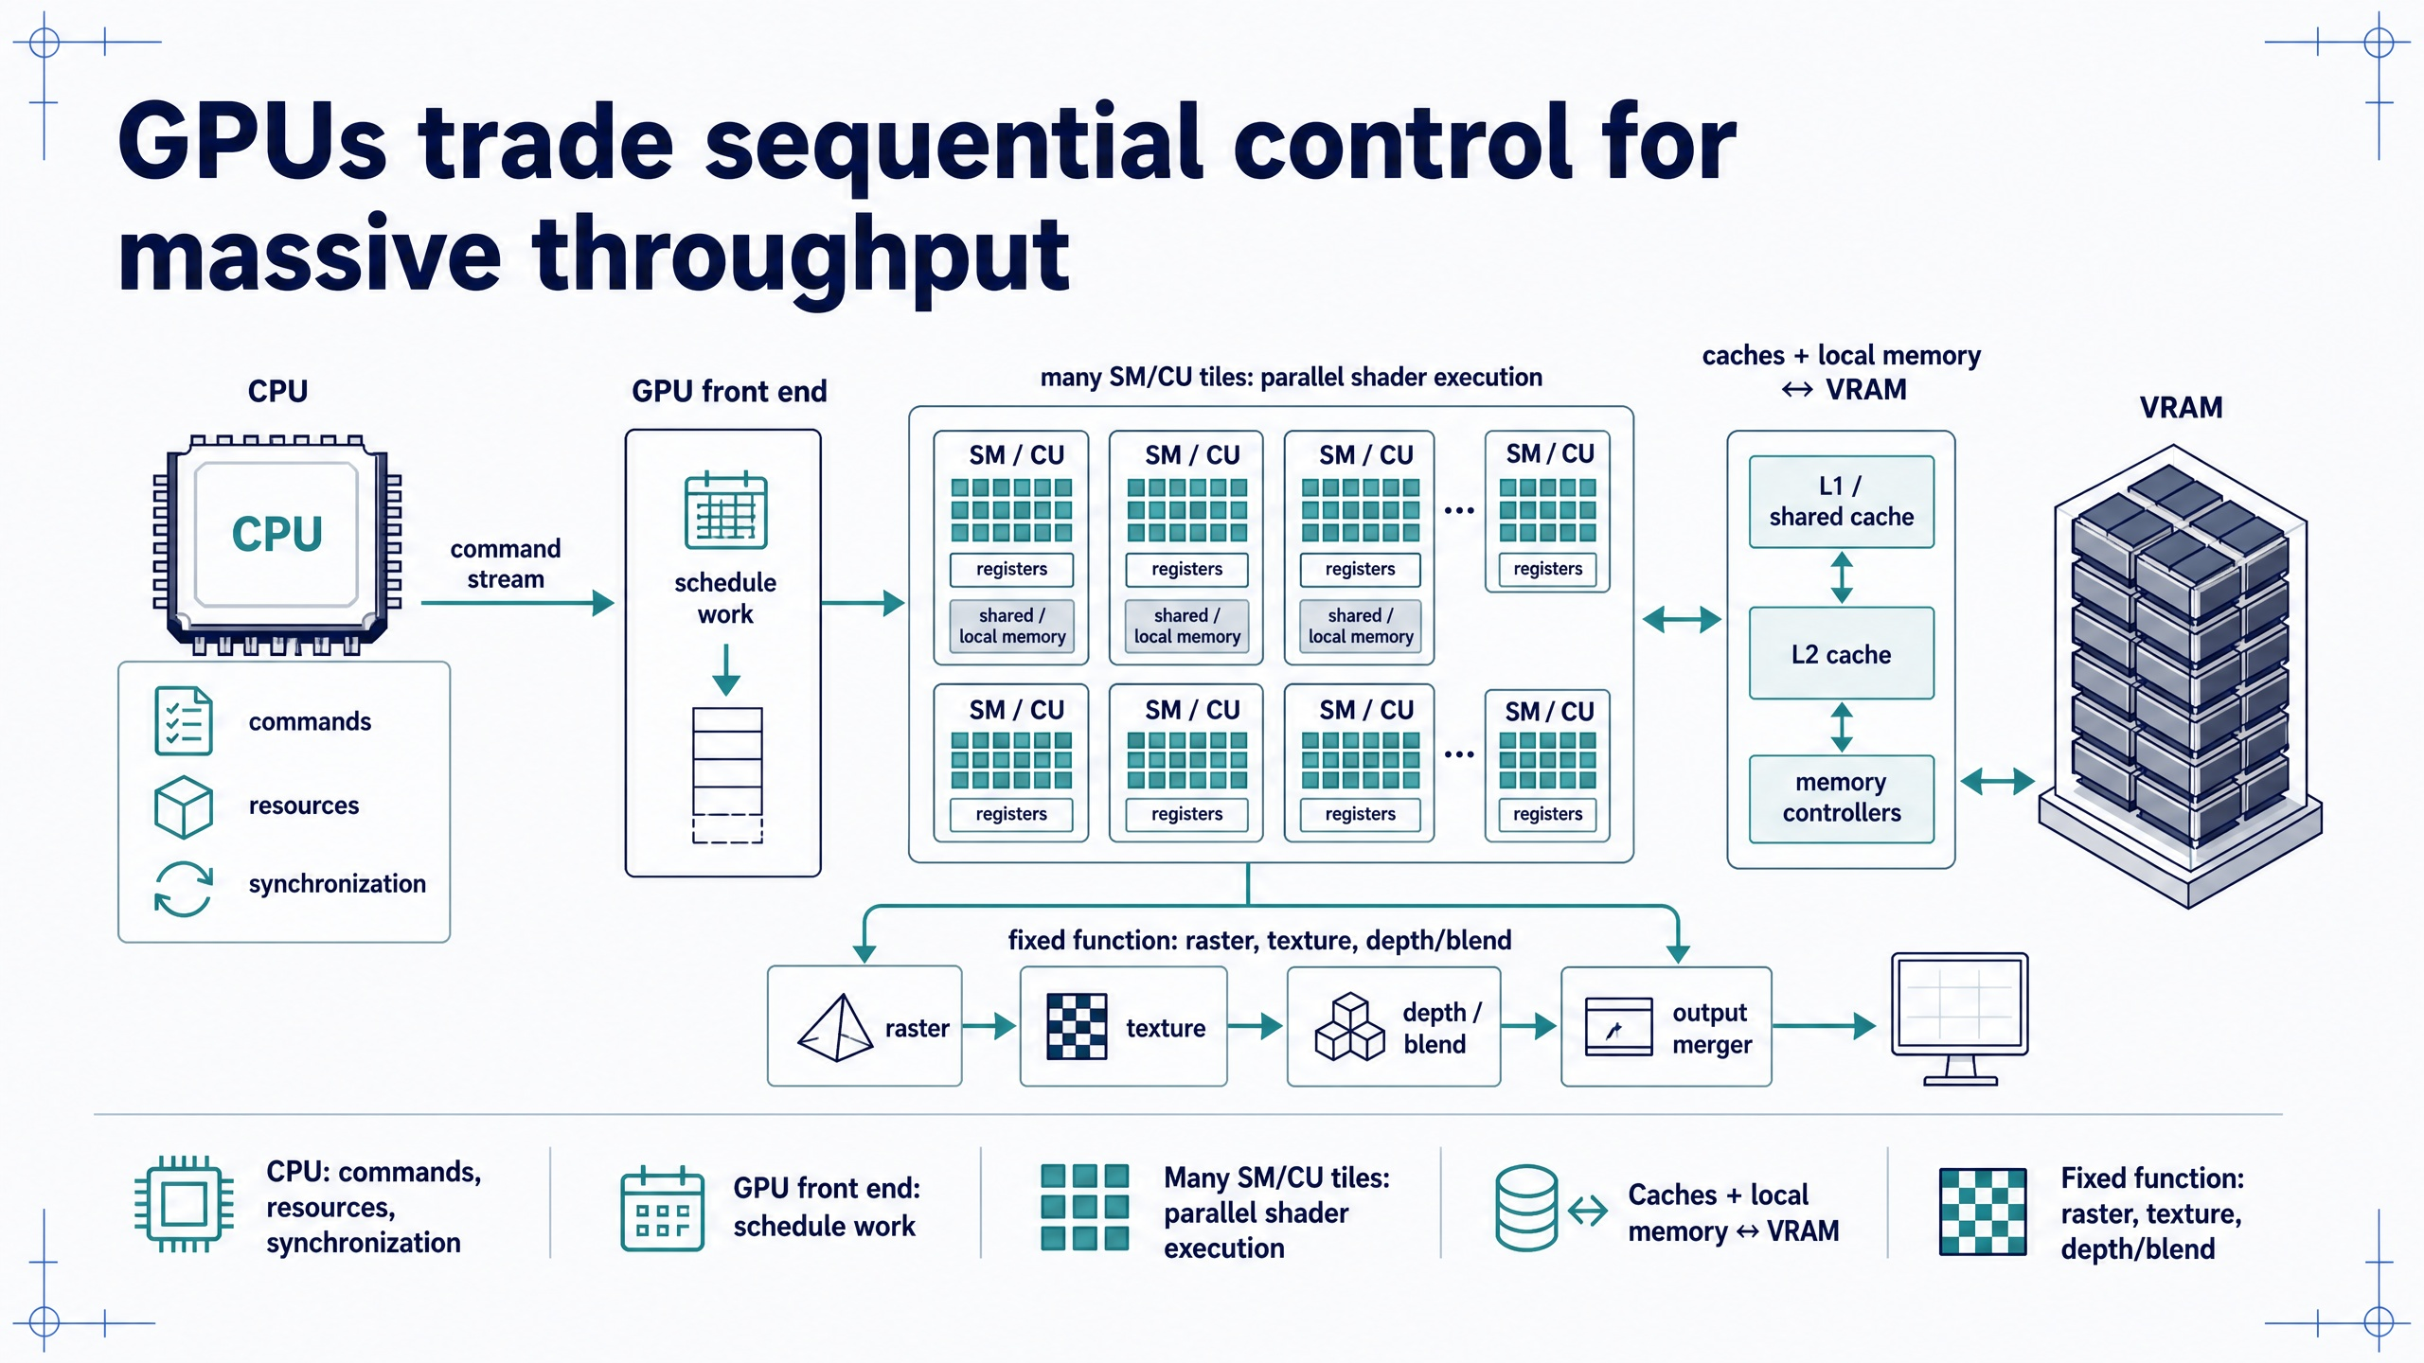
Notes:
### GPU architecture
CPU and GPU cooperate to execute that contract at interactive rates through many parallel processing tiles and latency hiding, constrained by available parallelism, divergence, and data movement.
### Presenter reminders
- Suggested duration: **4 minutes**.
- Distinguish the conceptual graphics pipeline from a literal hardware schedule.
- Use the neutral term SM/CU, then mention that vendors use different names.
- Explain latency hiding without promising that every workload scales well.
- Point out the three common performance constraints: occupancy/parallelism,
divergence, and data movement.
### Near-verbatim delivery
The previous slide described an API and data-flow contract. This slide asks
what kind of machine can execute that contract fast enough to produce
interactive frames.
The CPU and GPU cooperate. The CPU usually manages application logic, creates
resources, records commands, and establishes synchronization. A GPU command
front end accepts that work and distributes large numbers of shader
invocations across many processing tiles. NVIDIA calls these streaming
multiprocessors; AMD commonly calls the corresponding units compute units. For
this lesson, SM/CU means a repeated parallel processing block, not one exact
vendor design.
Inside each tile are many arithmetic lanes, registers, schedulers, and fast
local or shared storage. The GPU keeps many work groups resident so that when
one group waits for data, another ready group can execute. This is latency
hiding. It is one reason GPUs favour throughput across many similar operations
rather than minimizing the completion time of one complicated sequential
thread.
Graphics also uses specialized units for operations such as rasterisation,
texture sampling, depth/stencil tests, blending, and writing output. The exact
balance changes by architecture, but the performance lesson is stable:
parallel work must be available, neighbouring invocations should avoid severe
control-flow divergence, and data should move through the memory hierarchy
efficiently. [Transition.] To describe the geometry processed by this machine,
we need a compact mathematical vocabulary.

Slide 5
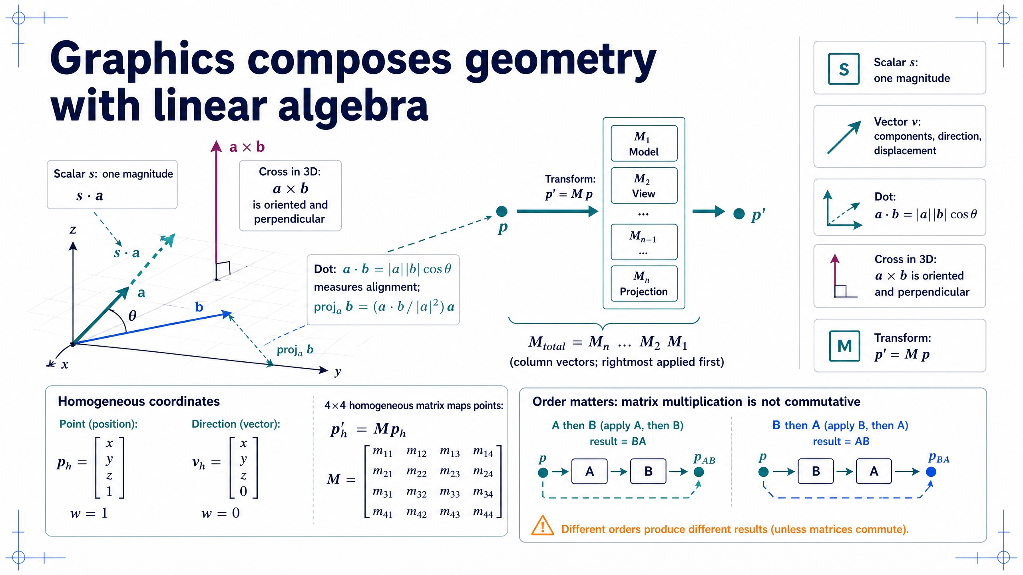
Notes:
### Mathematical vocabulary
Scalars, vectors, dot and cross products, and homogeneous 4×4 matrices give a compact composable language — with `w = 1` for points, `w = 0` for directions, and multiplication that does not commute.
### Presenter reminders
- Suggested duration: **4 minutes**.
- Keep scalars and vectors semantic: the same tuple can represent different quantities.
- Use the dot product for alignment/projection and the cross product for orientation/area.
- State that the cross product described here is the familiar three-dimensional operation.
- Use column-vector convention consistently and emphasize non-commutativity.
- Mention homogeneous `w = 1` for points and `w = 0` for direction vectors.
### Near-verbatim delivery
A scalar is one number, such as a time, mass, intensity, or uniform scale. A
vector is an ordered collection of components. In graphics, a vector may
represent a displacement, direction, colour, normal, velocity, or any other
multidimensional quantity. The components alone do not determine the meaning;
the program and coordinate frame do.
The dot product combines two vectors into a scalar. Geometrically it measures
alignment: after accounting for their lengths, parallel vectors produce a
large positive value, perpendicular vectors produce zero, and opposed vectors
produce a negative value. We use it for projections, facing tests, and many
lighting terms.
In three dimensions, the cross product combines two vectors into a vector
perpendicular to both. Its magnitude equals the area of the parallelogram they
span, and its direction depends on operand order. This makes it useful for
surface orientation, coordinate bases, and triangle normals.
A matrix applies a linear mapping. With homogeneous coordinates, a four-by-four
matrix can also encode translation and perspective-related transformations.
We distinguish points from directions with the homogeneous component: a point
normally has `w = 1`, while a direction has `w = 0`, so translation affects the
point but not the direction.
The decisive advantage is composition. Several transforms can be multiplied
into one matrix. Under the column-vector convention used here, the rightmost
matrix acts first. Matrix multiplication is generally not commutative: rotate
then translate does not normally equal translate then rotate. [Transition.]
These mathematical values still do not contain object meaning; that remains an
application-level representation.

Slide 6
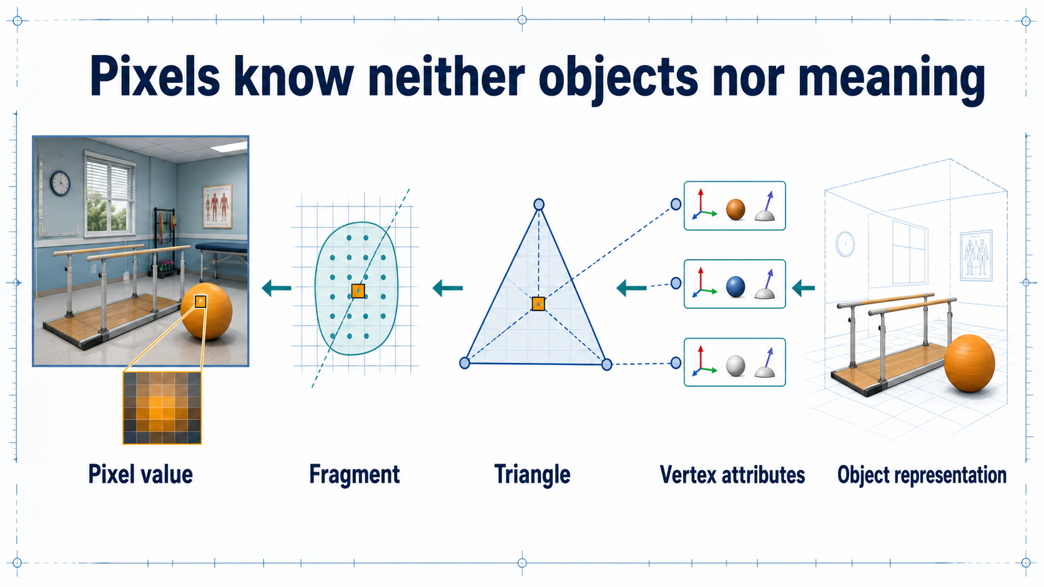
Notes:
### From pixel back to object
The framebuffer stores values, not meaning: a pixel can be traced back to fragment, primitive, vertex, and application data only because the application deliberately represented that semantics.
### Presenter reminders
- Suggested duration: **2 minutes**.
- Explain why this matters for AI and synthetic labels.
- Avoid saying that one pixel always comes from one fragment.
- Emphasise application responsibility.
### Near-verbatim delivery
Imagine selecting one displayed pixel and asking, “What object is this?” The
framebuffer cannot answer in semantic terms unless the application has created
and preserved that information. It stores output values. A candidate fragment
may have contributed to that sample after depth and blending. The fragment
came from a rasterised primitive. The primitive came from vertex data. The
application associated that data with an object and perhaps with a semantic
label such as handrail, patient, or floor.
This distinction matters later when we generate synthetic datasets. A renderer
can produce colour, depth, normals, instance identifiers, or semantic masks,
but only if those outputs are deliberately represented and written. The GPU
does not infer that a triangle belongs to a medically relevant object merely
because it draws it.
So graphics is not only about appearance. It is about maintaining contracts
between high-level world meaning and low-level numerical data. [Transition.]
The first of those contracts is the vertex.

Slide 7
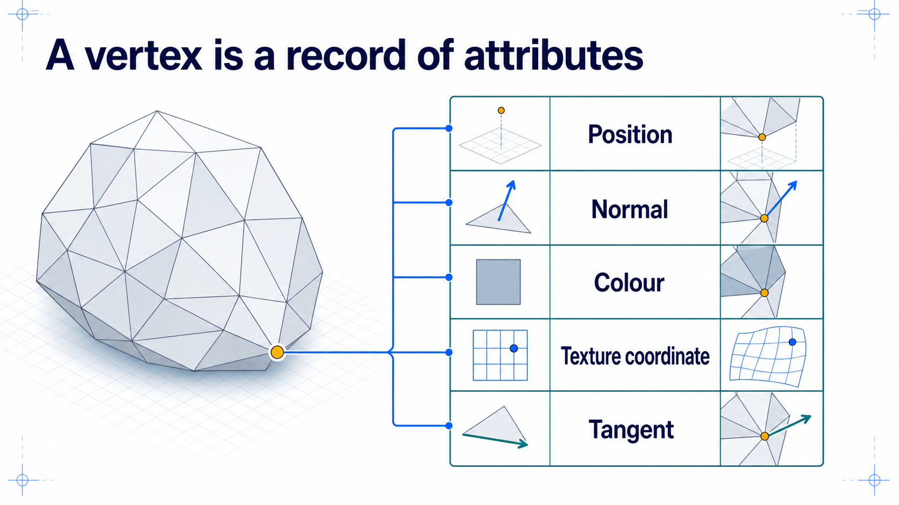
Notes:
### What a vertex really is
A render vertex is an attribute record submitted to the pipeline, not merely a location — which is why one geometric corner may need several vertices at sharp edges and texture seams.
### Presenter reminders
- Suggested duration: **3 minutes**.
- Correct the “vertex equals point” simplification.
- Distinguish geometric location from render vertex record.
- Mention that shaders may use only a subset.
### Near-verbatim delivery
In elementary geometry, we often call a vertex a point at which edges meet.
That is useful, but it is incomplete for rendering. Here a vertex is one record
of inputs submitted to the pipeline. Position is normally one field, but the
same record can contain a normal, colour, texture coordinates, a tangent,
joint indices, joint weights, or application-specific data.
The vertex shader receives whichever enabled attributes are connected to its
inputs. It does not automatically know which numbers are positions or normals.
The application and shader agree on that meaning.
This also explains an apparent paradox. Two vertices can occupy exactly the
same spatial position and still need separate records. At a sharp edge they
may have different normals. At a texture seam they may have different UV
coordinates. The geometric corner is shared, but the render attributes are
discontinuous.
[Pause.] The durable definition is therefore: a render vertex is an attribute
record, not merely a location. [Transition.] Let us now separate the individual
attribute streams inside that record.

Slide 8
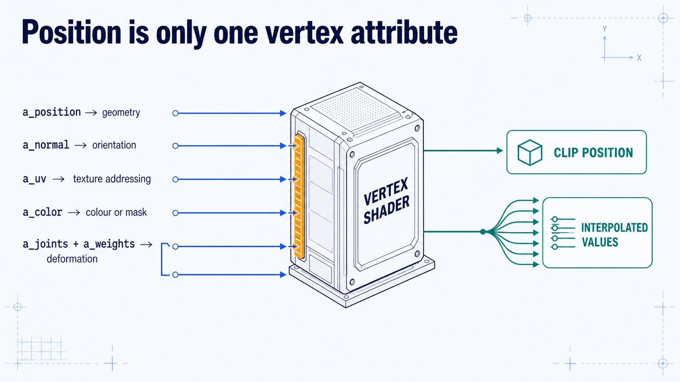
Notes:
### Vertex attributes
Attributes are parallel per-vertex streams — position, normal, UV, colour, joint indices and weights — whose names are application conventions and whose component types must match the shader's inputs.
### Presenter reminders
- Suggested duration: **3 minutes**.
- Explain attributes as parallel per-vertex streams.
- Preview shader outputs without teaching full GLSL yet.
- Highlight integer versus floating-point type matching.
### Near-verbatim delivery
Think of the vertex record as several aligned streams. For vertex number 27,
the renderer can fetch position 27, normal 27, UV 27, and any other enabled
attributes. The vertex shader receives those values together.
Each stream has a role. Position contributes to geometric location. A normal
provides an orientation used by many shading models. UV coordinates address a
texture. Colour might be displayed directly, multiplied into a material, or
used as a mask. Joint indices and weights connect the vertex to a skeleton.
The names shown here are conventions in our code, not universal magic words in
WebGL. The program connects buffer data to shader input locations. The
component type also matters. Integer joint indices should be interpreted as
integers; floating-point positions use floating-point attributes. A mismatch
can generate an error or meaningless input.
The shader must produce a clip-space position, and it may also produce values
for interpolation. [Transition.] Before that can happen, raw bytes in memory
must be described as these structured streams.

Slide 9
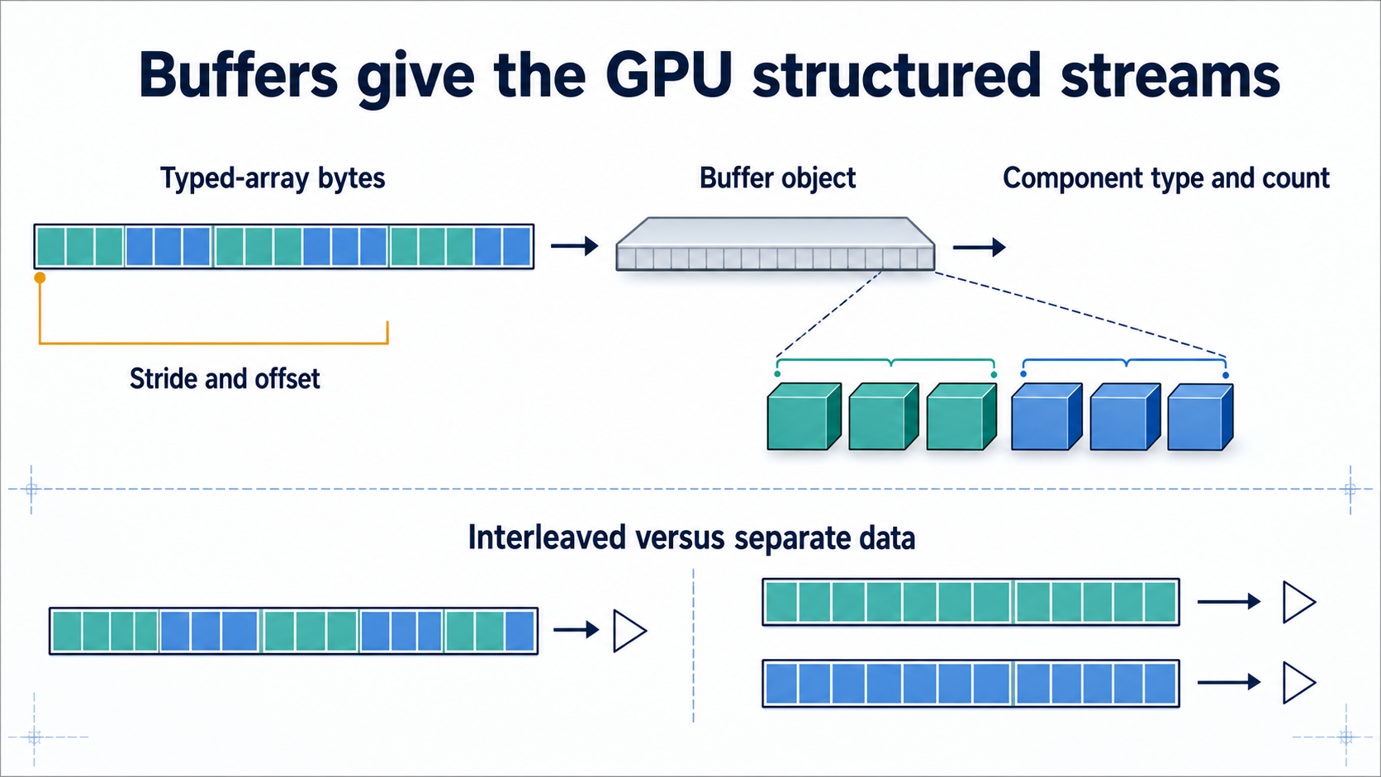
Notes:
### Buffers, stride, and offset
A GPU buffer is undifferentiated data that the application teaches the pipeline to interpret; a valid buffer read with the wrong stride or offset produces a bizarre object.
### Presenter reminders
- Suggested duration: **3 minutes**.
- Walk through one interleaved record numerically.
- Use “interpretation” repeatedly; buffers do not store semantic labels.
- Mention `Float32Array` and byte offsets.
### Near-verbatim delivery
A GPU buffer is a block of data. It does not contain a self-describing table
that says, “these first three values are a position and the next three are a
colour.” The application supplies that interpretation.
Suppose each record contains six 32-bit floats: x, y, z, red, green, and blue.
The stride is six floats, or twenty-four bytes. The position attribute reads
three floats starting at byte zero of each record. The colour attribute reads
three floats starting twelve bytes later. The next vertex begins after the
full stride.
We could instead store all positions in one buffer and all colours in another.
Neither layout is universally better. Interleaving can improve locality when
attributes are consumed together; separate streams can be convenient when
data has different update rates.
The important debugging principle is that a visually bizarre object can result
from a perfectly valid buffer interpreted with the wrong stride or offset.
[Transition.] Once vertices have been processed, the primitive mode tells the
pipeline how to give them geometric meaning.

Slide 10
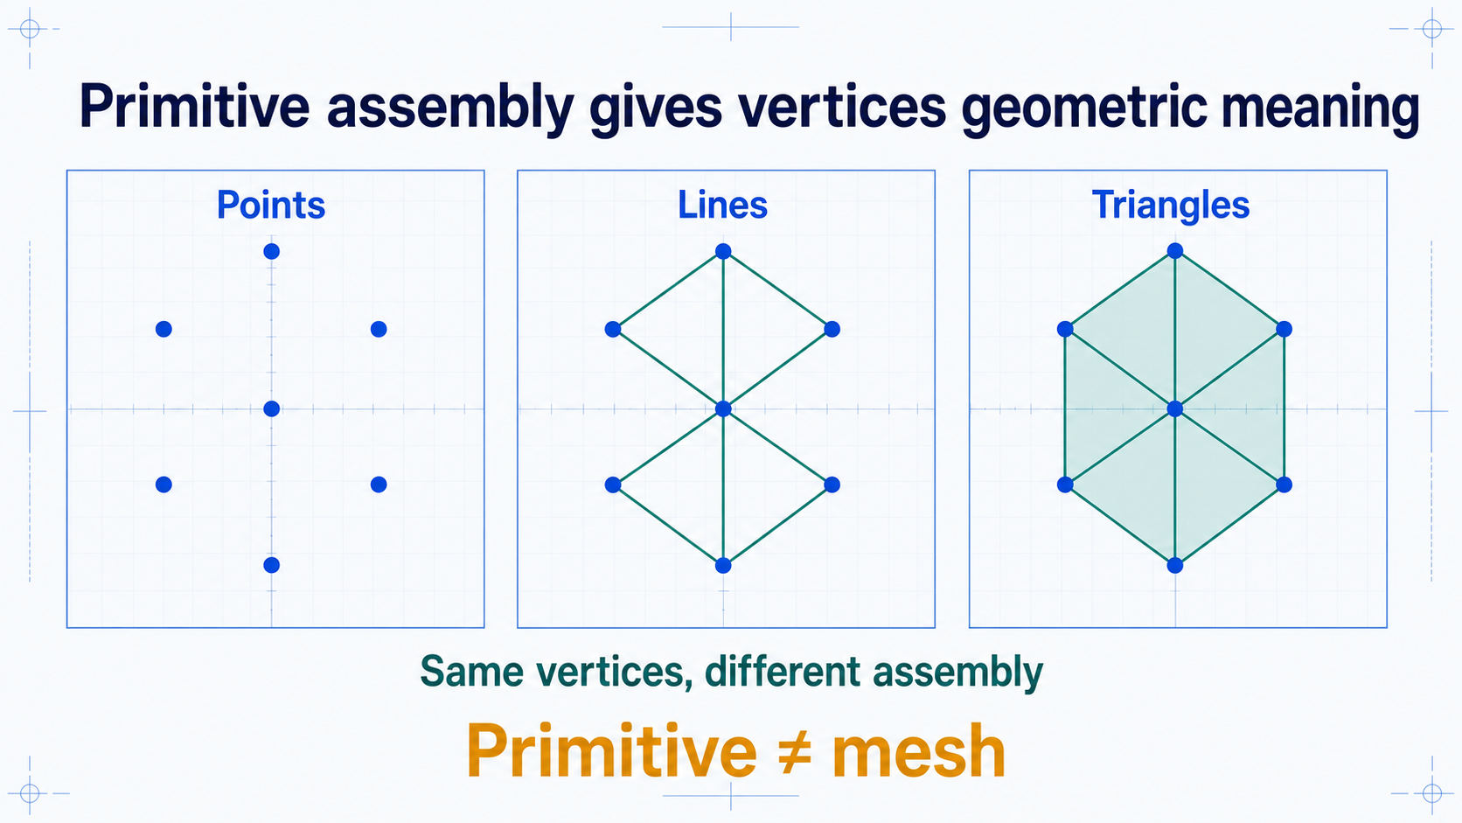
Notes:
### Primitive modes
The same processed vertices become points, lines, or filled triangles depending on the assembly rule; triangles dominate because three points define a plane with well-defined coverage and interpolation.
### Presenter reminders
- Suggested duration: **3 minutes**.
- Make the same-data comparison explicit.
- Define primitive before mesh.
- Mention thick-line portability briefly.
### Near-verbatim delivery
These diagrams use the same processed vertices. What changes is the primitive
assembly rule. In point mode, each vertex produces a point primitive. In line
mode, vertices are connected according to the selected line topology. In
triangle mode, groups of vertices define filled triangles.
A primitive is the basic geometric unit presented to rasterisation. It is not
the same as a complete mesh. A mesh can contain many primitives, multiple
attribute streams, groups, submeshes, and material assignments.
Triangles dominate real-time surface rendering because three non-collinear
points define a plane. Coverage and attribute interpolation are well defined,
and almost any polygonal surface can be decomposed into triangles.
Lines are valuable for diagrams, axes, trajectories, and wireframes, but wide
line behaviour is not equally portable across APIs and hardware. Applications
often render thick lines as triangle geometry.
[Transition.] If a surface contains thousands of triangles, we do not always
want to repeat every vertex record for every triangle. That is the role of
indices.

Slide 11
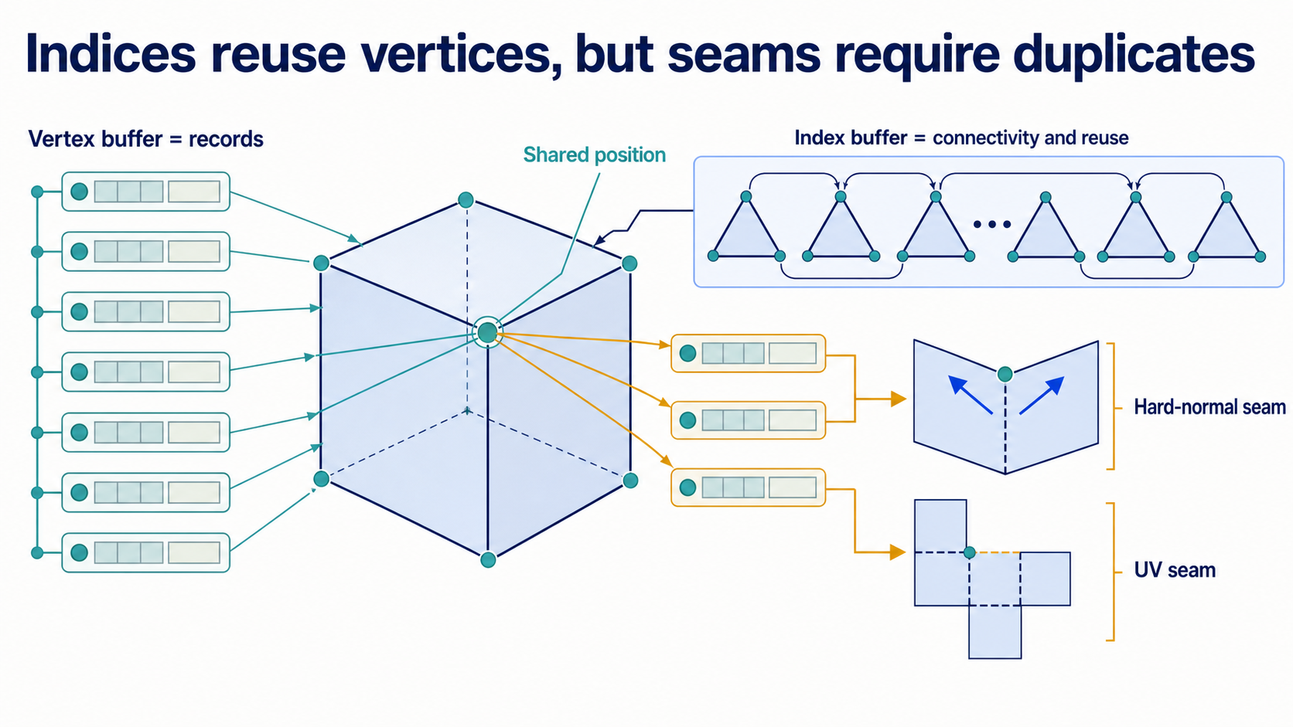
Notes:
### Index buffers
Indices reference vertex records to establish connectivity and reuse, but a cube needing per-face normals and UV seams shows that eight corner positions rarely mean eight render vertices.
### Presenter reminders
- Suggested duration: **3 minutes**.
- Contrast a naïve “cube has eight vertices” statement with render reality.
- Explain why indexing can reduce repeated processing.
- Avoid promising that indexing always reduces data.
### Near-verbatim delivery
An index buffer stores references into the vertex data. Instead of submitting
three new records for every triangle, a draw can reuse records by index. The
indices establish connectivity as well as reuse.
A cube illustrates why we must be precise. Geometrically, a cube has eight
corner positions. For flat shading, however, each face needs a distinct normal.
A corner shared by three faces therefore needs multiple render records even
though the position is the same. A UV unwrap can introduce additional seams
where texture coordinates are discontinuous.
Indexing is useful when the full attribute record can be shared. It can reduce
storage and repeated vertex processing, but it is not a guarantee that every
geometric position appears once.
In WebGL, indexed drawing uses an element array buffer and a call such as
`drawElements`; non-indexed drawing uses `drawArrays`. [Transition.] We now
have enough concepts to read the minimal raw WebGL example.

Slide 12
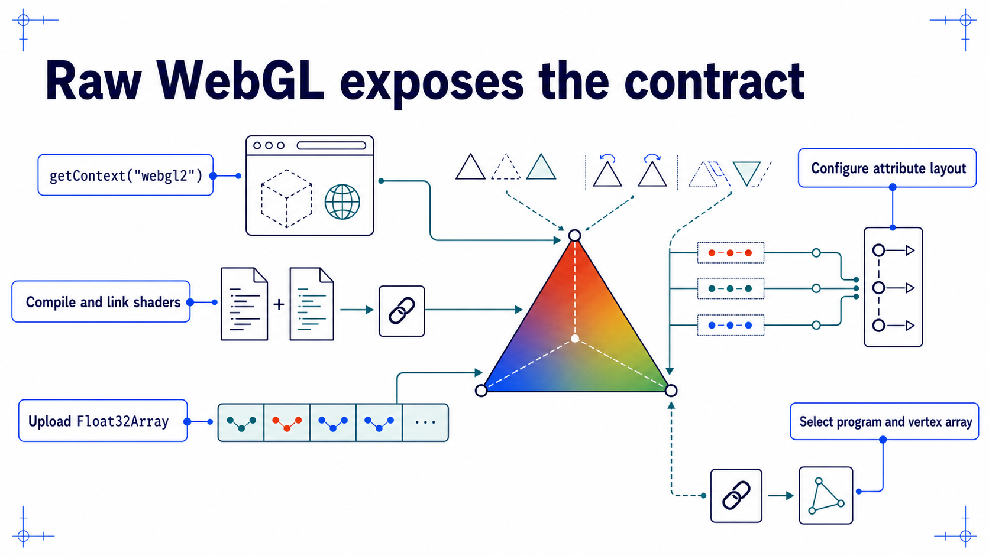
Notes:
### Minimal raw WebGL example
A live triangle traced end to end — context, shaders, interleaved buffer, attribute layout, draw call — then mutated to show position, colour, primitive mode, and culling effects.
### Presenter reminders
- Suggested duration: **4 minutes**.
- [Demo] Run the local triangle.
- Mutate position, colour, mode, then winding/culling.
- Keep code subordinate to the dataflow.
- If the demo fails, use the prepared recording or static sequence.
### Near-verbatim delivery
This is our lowest-level example. First, the browser creates a WebGL 2 context.
We compile a vertex shader and a fragment shader, attach them to a program, and
link that program. Then we upload an interleaved `Float32Array` containing two
position components and three colour components per vertex.
The attribute configuration tells WebGL how to decode those bytes. The stride
is five floats. Position starts at offset zero. Colour starts after two floats.
We select the program, bind the vertex-array state, and draw three vertices as
one triangle.
[Demo.] I will change the first position. The geometry moves because the
position stream changed. I will change one colour. The gradient changes because
the new vertex output is interpolated across the triangle. If I change the
primitive mode, the same vertex data acquires different geometric meaning.
Finally, reversing the order and enabling face culling can make the triangle
disappear.
Nothing in this example knows about rooms, patients, or handrails. It knows
bytes, attributes, programs, state, and a draw command. [Transition.] The next
representations begin with samples rather than connected triangles.

Slide 13
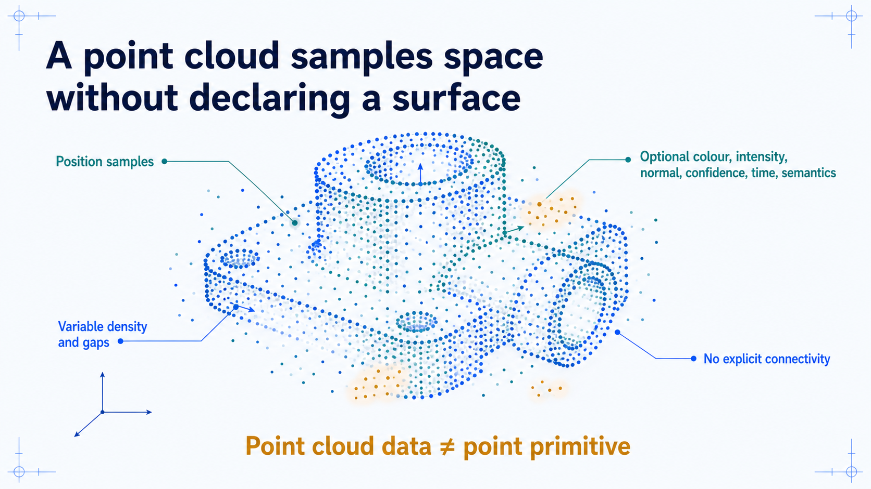
Notes:
### Point clouds
Samples with positions and optional attributes but no explicit surface connectivity, so gaps, insideness, and neighbourhoods must be inferred by additional algorithms and assumptions.
### Presenter reminders
- Suggested duration: **3 minutes**.
- Tie point clouds to acquisition without teaching registration.
- Distinguish storage representation from rendering primitive.
- Mention that local neighbourhoods may be inferred.
### Near-verbatim delivery
A point cloud stores samples in space. Each sample must have a position and may
also have colour, intensity, a normal estimate, confidence, timestamp, or
semantic label. What is normally missing is explicit surface connectivity.
That absence matters. The data does not directly tell us which points form a
triangle, which side is inside, or whether a gap represents an opening,
occlusion, or missing measurement. Algorithms may infer neighbourhoods, fit
local surfaces, or reconstruct a mesh, but those are additional operations and
assumptions.
We also need to separate a data representation from a render primitive. A
point cloud can be displayed with point primitives, but “point cloud” describes
the sample set and its attributes. “Point primitive” describes how submitted
vertices are rasterised.
In Lesson 03 we will ask how sensors create and align these samples. Today the
question is what information the representation gives the renderer.
[Transition.] Adding explicit connectivity leads us to a triangle mesh.

Slide 14
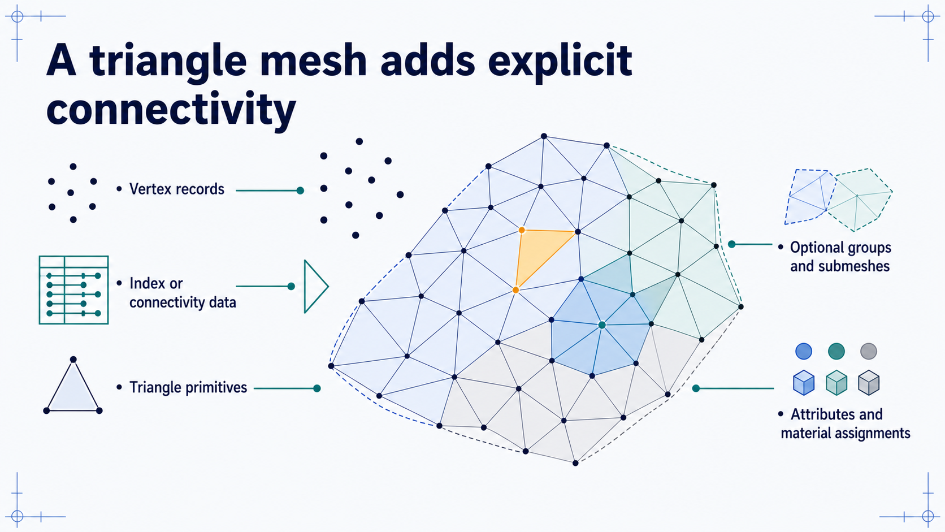
Notes:
### Triangle meshes
Adding indices gives explicit connectivity, enabling adjacency, traversal, and interpolation queries — while still saying nothing about object behaviour or world state.
### Presenter reminders
- Suggested duration: **3 minutes**.
- Define mesh as more than a triangle list.
- Keep topology for the next slide.
- Relate mesh to glTF without introducing the format yet.
### Near-verbatim delivery
A triangle mesh adds explicit connectivity. Vertex records provide positions
and other attributes. Indices say which records form each triangle. A complete
asset may also divide triangles into groups or submeshes and associate them
with different materials.
Connectivity enables operations that a raw point set cannot answer directly.
We can ask which triangles share an edge, walk across neighbouring faces,
interpolate across a defined surface, or classify a boundary. Those answers
depend not only on where vertices are located but also on how they are
connected.
The mesh still does not define the whole object behaviour. It does not say
whether a door can open, whether a character is fatigued, or how collisions
change world state. It is a geometric representation that can participate in a
larger system.
[Point.] The highlighted triangle is one primitive. The surrounding indexed
collection is the mesh. [Transition.] The pattern of connectivity is the
topology, and it determines which operations are valid.

Slide 15
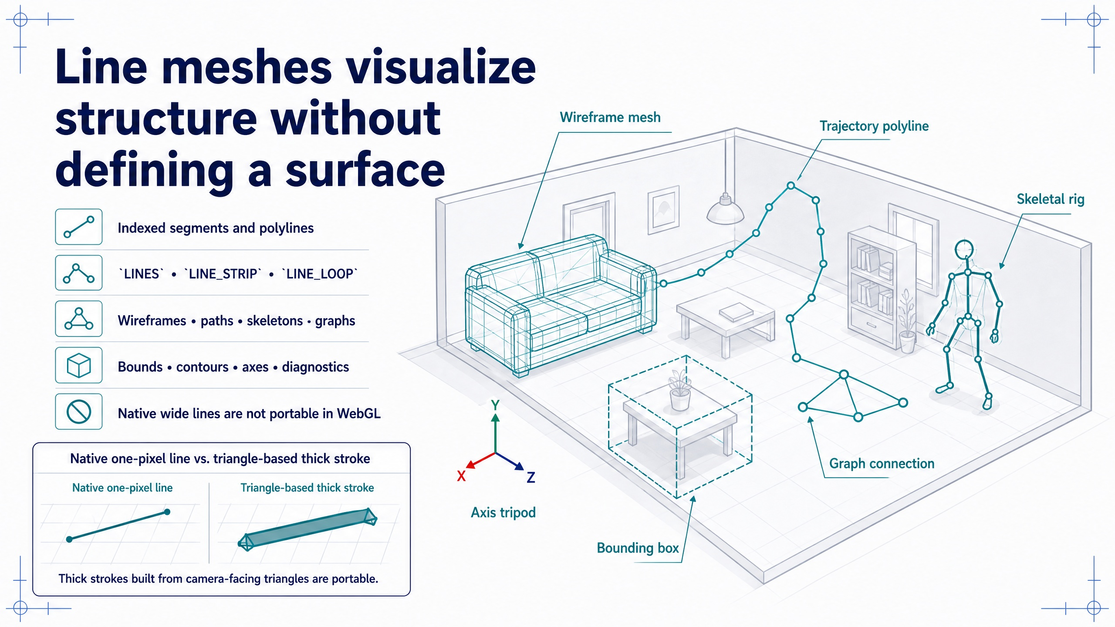
Notes:
### Line meshes
Segments, strips, and loops reveal structure for wireframes, trajectories, axes, and overlays, but define no surface, and portable native line width is effectively one pixel.
### Presenter reminders
- Suggested duration: **3 minutes**.
- Distinguish a line primitive from the broader data structure called a line mesh.
- Explain independent segments, strips, and loops by tracing vertex reuse.
- Emphasize visualization and diagnostic uses.
- Warn that native line width support is implementation-dependent in WebGL.
### Near-verbatim delivery
A line mesh stores vertices plus connectivity that produces line segments or
polylines. With independent lines, every pair of vertices forms one segment. A
line strip reuses adjacent vertices to form a continuous chain. A line loop
adds the closing segment from the final vertex back to the first.
This representation is especially useful when our goal is to reveal
structure: a triangle wireframe, a robot trajectory, a bone skeleton, a graph,
a contour, a bounding box, coordinate axes, or a debugging overlay. Depth,
clipping, transforms, and shading rules can still affect what is visible.
What the line mesh does not provide is a filled surface. It does not by itself
define area, an inside and outside, or a watertight boundary. There is also a
practical WebGL constraint: portable native line widths are limited and often
effectively one pixel. Applications that need reliable thick curves usually
construct ribbons, tubes, or other triangle geometry. [Transition.] Surface
algorithms require stronger connectivity conditions, so we now examine
topology.

Slide 16
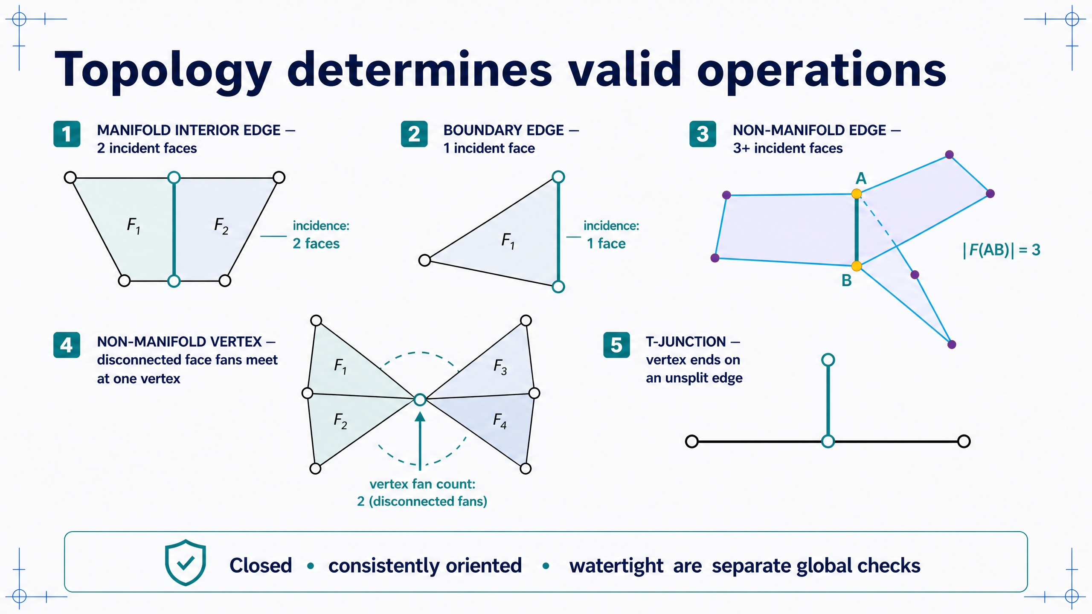
Notes:
### Topology and manifoldness
Interior manifold edges have exactly two incident faces; non-manifold edges, bow-tie vertices, and T-junctions render happily yet make downstream geometry operations ambiguous.
### Presenter reminders
- Suggested duration: **3 minutes**.
- Count incident faces at each highlighted edge.
- Confirm that all three non-manifold faces share the exact same endpoint pair A and B.
- For the bow-tie vertex, trace the two disconnected face fans around the shared vertex.
- Distinguish the non-manifold vertex from the T-junction.
- Keep local manifoldness separate from closedness, orientation, and watertightness.
- Ask which operations could become ambiguous in each defective case.
### Near-verbatim delivery
Topology describes connectivity independently of exact coordinate values. For
a two-dimensional triangle surface, an interior manifold edge has exactly two
incident faces. Locally, those faces form one continuous surface sheet. A
boundary edge has one incident face. Boundaries can be intentional, so one
incident face is not automatically an error.
An edge with three or more incident faces is non-manifold. In the diagram, each
of the three face patches contains the exact same edge AB; they are shown as
three distinct sheets around one hinge, not as edges that merely overlap in the image.
There is no unique single surface neighbourhood around that edge, so operations
such as traversal, normal propagation, smoothing, offsetting, and inside/outside
reasoning may become ambiguous.
Manifoldness must also be checked at vertices. In the bow-tie example, two
triangle fans share only the central vertex. Walking around the vertex cannot
move from one fan to the other through adjacent faces, so its neighbourhood is
disconnected even though no highlighted edge needs three incident faces. This
is a non-manifold vertex-vertex configuration.
A T-junction is different. One triangle vertex lands on the interior of
another edge, but that edge has not been split to include the vertex. The
drawing may look connected while the combinatorial mesh is not conforming.
Finally, a locally manifold mesh is not necessarily closed, consistently
oriented, or watertight. Those are separate checks. A renderer may display all
of these examples, but successful display does not prove that downstream
geometry algorithms have a valid input. [Transition.] Normals add another
layer that changes appearance without repairing topology.

Slide 17
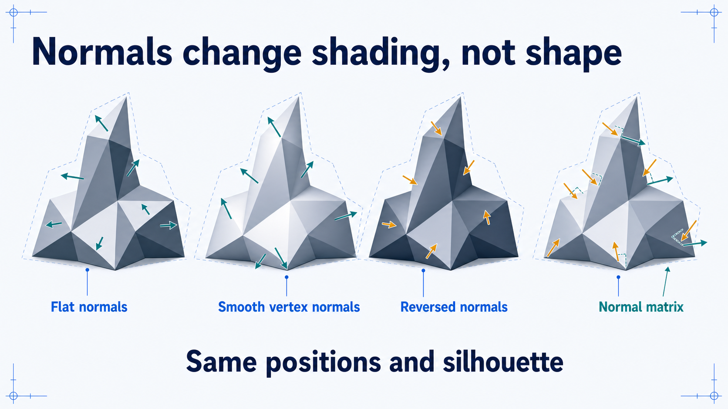
Notes:
### Normals and shading orientation
Flat, smooth, and reversed normals change appearance with identical positions and silhouette, and normals must be transformed by the inverse transpose rather than the model matrix.
### Presenter reminders
- Suggested duration: **3 minutes**.
- [Ask] Which variants actually changed the geometry?
- Point to unchanged silhouette.
- Introduce inverse transpose as a rule, not a derivation.
### Near-verbatim delivery
All four objects have the same vertex positions. Their silhouette is the same.
What changes is the orientation used by the shading calculation.
Flat shading uses one normal per face, so the facets remain visible. Smooth
shading interpolates vertex normals and makes the lighting response vary
continuously, even though the underlying triangles remain flat. Reversed
normals make surfaces respond as if they face the opposite direction.
Normals are directions, not points. Translation should not affect them. Under
non-uniform scaling, applying the ordinary model matrix can also destroy
perpendicularity. The common correction is to transform normals with the
inverse transpose of the relevant linear transformation, often packaged as a
normal matrix.
[Ask.] Which object changed shape? None. The image changed, but the geometric
positions did not. That distinction is important when visual smoothness is
mistaken for geometric detail. [Transition.] A surface stores boundary
information; a volume stores values throughout a three-dimensional domain.

Slide 18
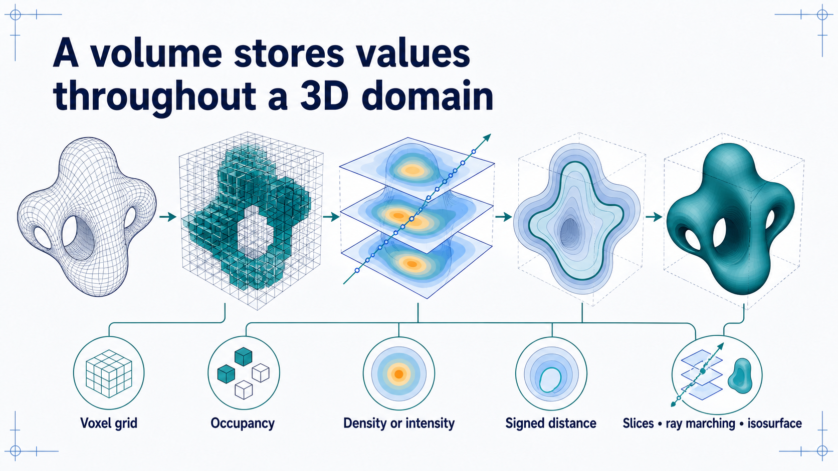
Notes:
### Volumes
Voxel grids and signed distance fields store values throughout a domain rather than at a boundary, answering questions — such as internal density — that an extracted surface discards.
### Presenter reminders
- Suggested duration: **3 minutes**.
- Keep the implementation conceptual.
- Mention medical imaging because it connects to the course application.
- Do not imply that a voxel is always binary.
### Near-verbatim delivery
A surface stores information at a boundary. A volume defines values throughout
a three-dimensional domain. A voxel grid may store binary occupancy, but it
can also store density, medical-image intensity, temperature, probability, or
another field. A signed distance field stores distance to a surface with a sign
convention for inside and outside.
To present a volume, we can show slices, march rays through the field, compute
a maximum-intensity projection, or extract an isosurface. These methods answer
different questions. In a clinical image, a single extracted surface may hide
internal density variation that remains visible in the volume.
Volumes introduce memory and sampling trade-offs. Fine regular grids can become
large, while coarse grids lose detail. Sparse and procedural representations
can reduce some costs but add complexity.
The goal today is not to implement volume rendering. It is to recognise that a
surface and a volume make different commitments about what exists between
samples. [Transition.] We can now compare representations by the operations
they support.

Slide 19
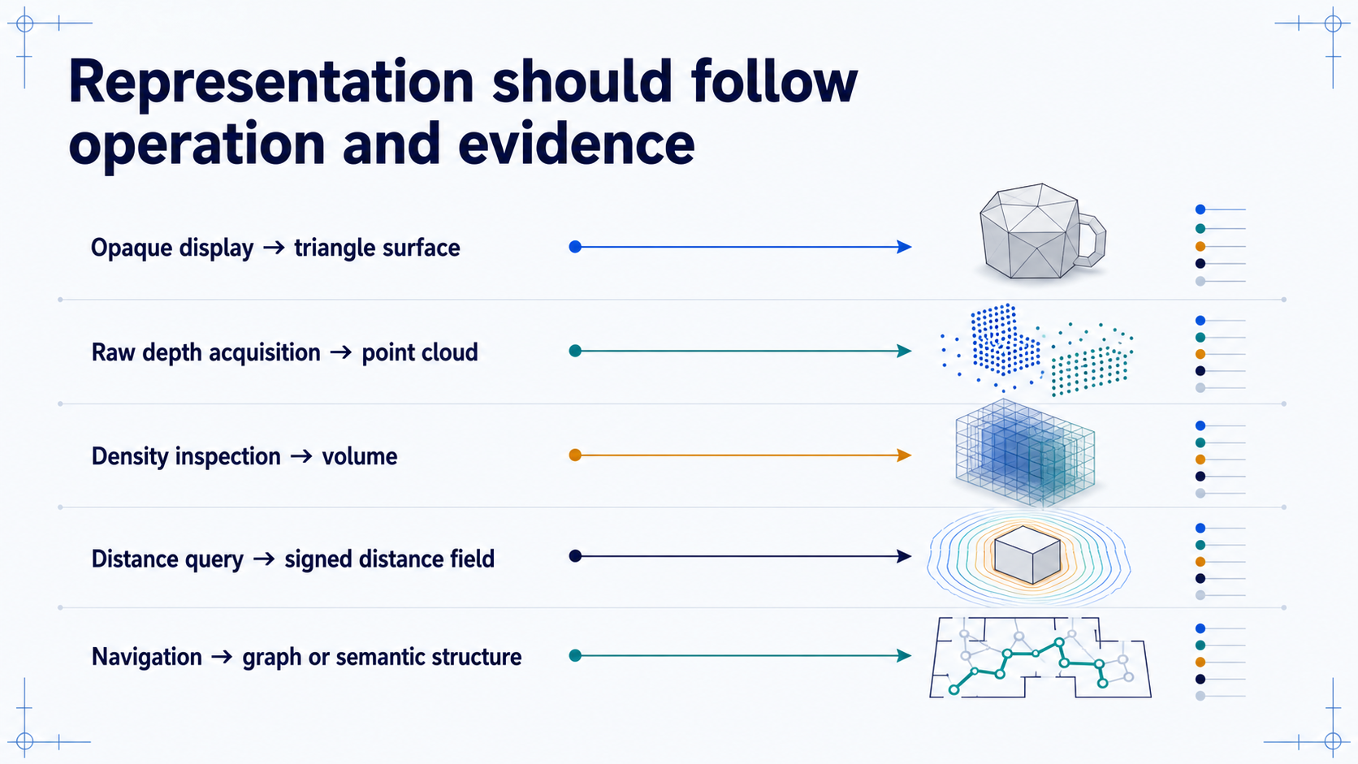
Notes:
### Representation comparison matrix
A decision aid, not exclusive rules: representation should follow the intended operation, the available evidence, and the acceptable loss, and systems often store several together.
### Presenter reminders
- Suggested duration: **3 minutes**.
- Reject a single “best representation.”
- [Ask] Let students challenge one mapping.
- Connect evidence source to representation choice.
### Near-verbatim delivery
This matrix is not a set of exclusive rules. It is a decision aid. If the main
operation is fast opaque-surface rendering, an indexed triangle mesh is often
effective. If the evidence is raw depth acquisition, a point cloud may preserve
what the sensor actually measured. If we need to inspect internal density, a
volume becomes appropriate. Distance queries can favour a signed distance
field. Navigation may require a graph or semantic structure in addition to
geometry.
[Ask.] Could we render a point cloud? Certainly. Could we derive a surface from
it? Yes, with additional assumptions. Could we store a mesh and a signed
distance field together? Production systems often do exactly that.
The representation should follow the operation, the evidence, and the acceptable
loss. A photorealistic output does not prove that the underlying representation
supports the next computation.
[Transition.] Regardless of representation, spatial values only become
meaningful when we know the coordinate frame in which they are expressed.

Slide 20
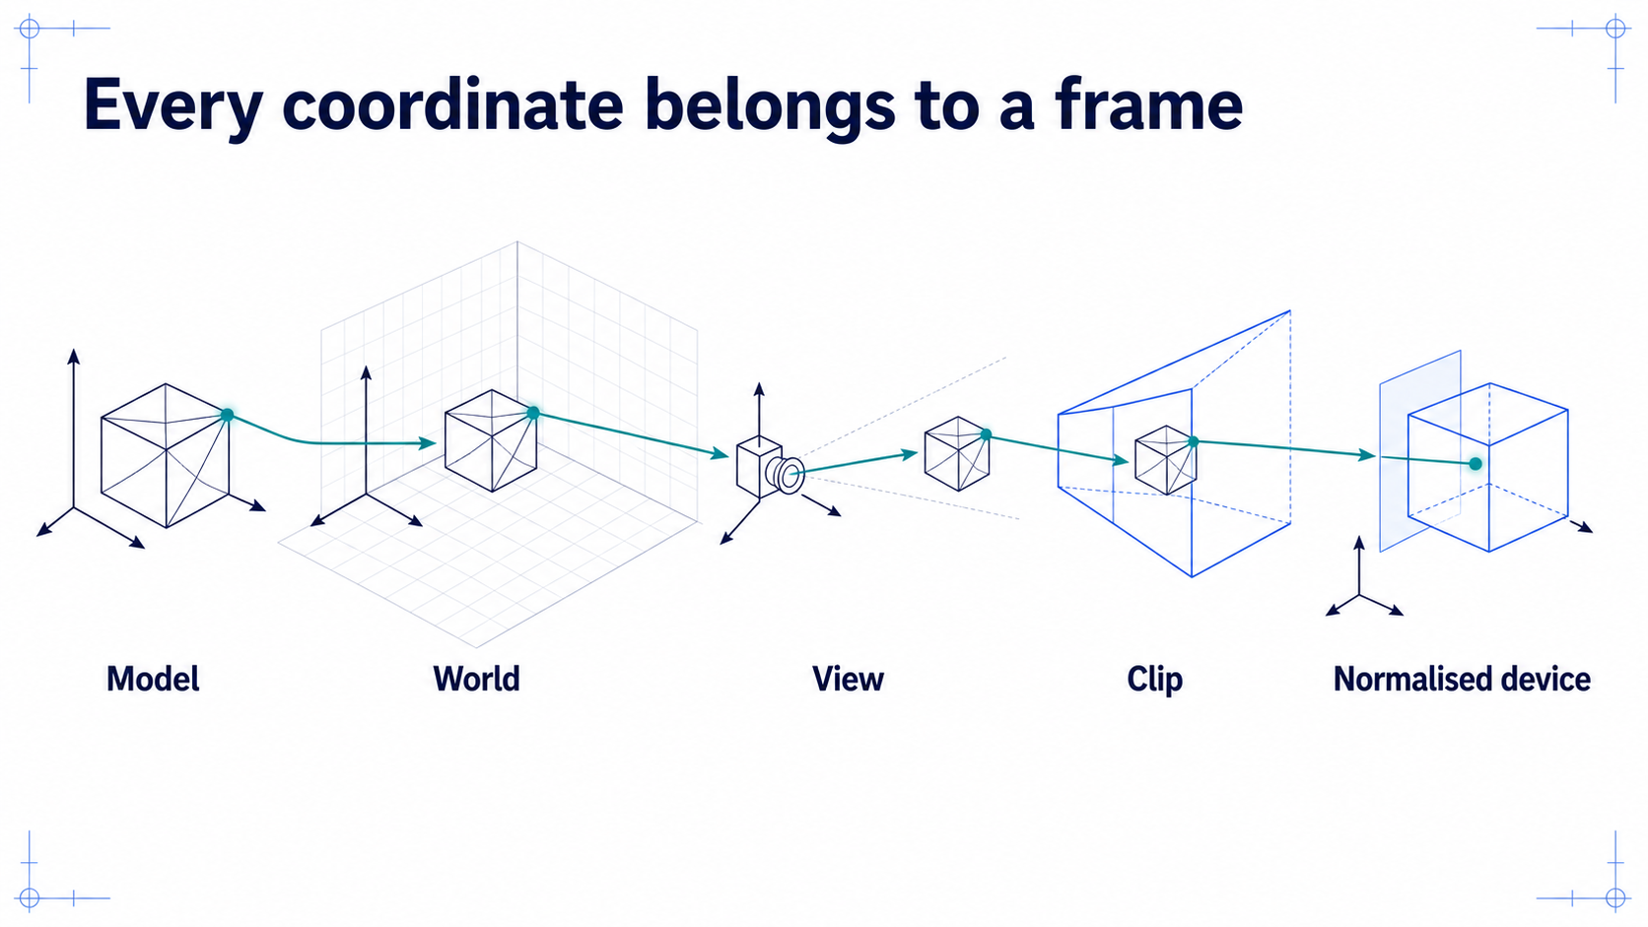
Notes:
### Coordinate frames
Model, world, view, clip, NDC, and screen each answer a different question; a tuple has no meaning without its frame and units, and frame errors also break twins and XR overlays.
### Presenter reminders
- Suggested duration: **3 minutes**.
- Read each frame as a question.
- Link explicitly to twins and XR alignment.
- Keep storage-order conventions separate from mathematical meaning.
### Near-verbatim delivery
The tuple \((1, 0, 0)\) does not tell us a physical or visual location until we
know its coordinate frame and units. In model coordinates, it may mean one unit
to the right of an object's origin. In world coordinates, it refers to the
shared scene. In view coordinates, it is expressed relative to the camera.
Projection produces clip coordinates. After clipping and perspective division,
we obtain normalised device coordinates. The viewport transform maps those
values into framebuffer coordinates.
Each frame answers a different question. Model: where is the point relative to
the object? World: where is the object in the scene? View: where is it relative
to the observer? Clip: can it contribute under this projection? Screen: where
can it appear in the target?
Coordinate mistakes are not confined to graphics. A digital twin, tracking
system, and XR overlay all fail if transforms connect incompatible frames.
[Transition.] Homogeneous matrices let us express and compose these changes.

Slide 21
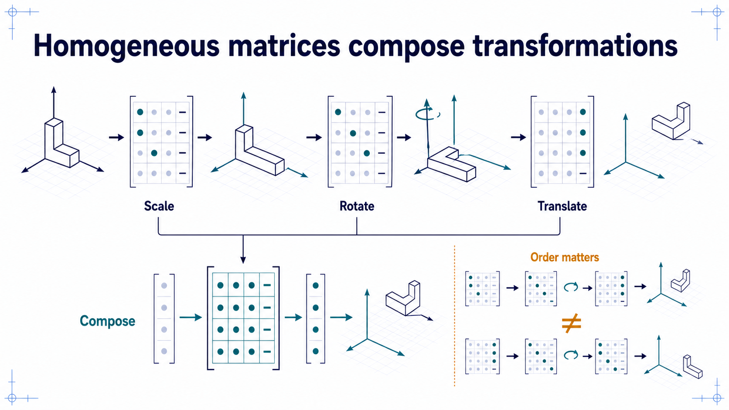
Notes:
### Homogeneous transformations
Four components let translation, rotation, scale, and projection compose into one matrix, with the rightmost acting first under the column-vector convention — so declare and test the convention.
### Presenter reminders
- Suggested duration: **3 minutes**.
- State the column-vector convention.
- Demonstrate that translation and rotation do not commute.
- Avoid a long matrix multiplication derivation.
### Near-verbatim delivery
Homogeneous coordinates represent a 3D point with four components. This lets us
express translation with a matrix and compose it with rotation, scale, and
projection.
We will use column vectors. Under this convention, the rightmost matrix acts
first. If \(M = T R S\), the point is scaled, then rotated, then translated.
Changing the order changes the result. Rotating an object around its local
origin and then moving it into the room is not the same as translating first
and rotating the translated position around the world's origin.
The fourth component also distinguishes common point and direction behaviour.
A point with \(w=1\) is affected by translation. A direction represented with
\(w=0\) is not.
Libraries differ in storage layout, multiplication order, and naming. The
solution is not to memorise one screenshot of a matrix. It is to declare the
convention and test a simple known transform. [Transition.] The rendering
transform is commonly organised into model, view, and projection stages.

Slide 22
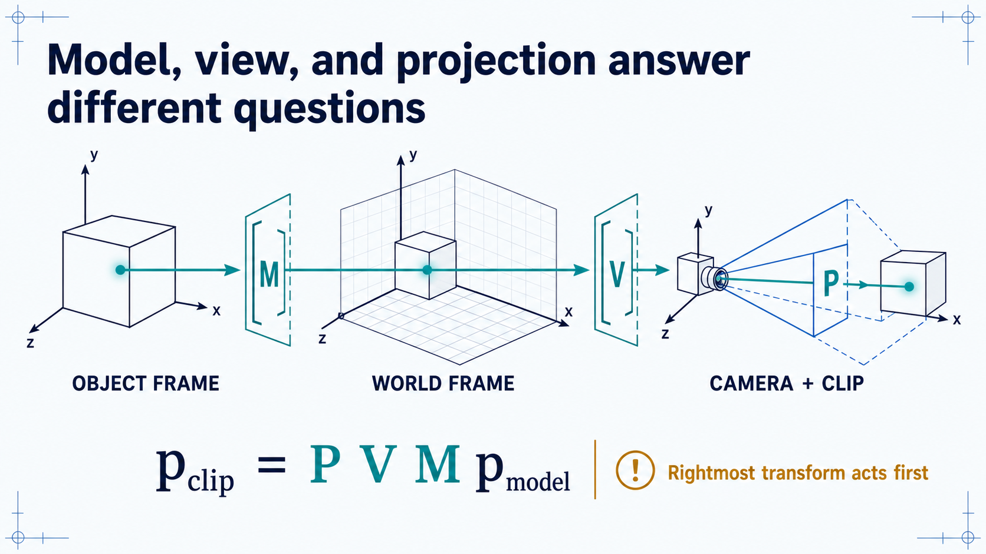
Notes:
### The model–view–projection chain
Read right to left: model places the object in the world, view expresses the world relative to the camera, projection maps into clip space — kept separate because each factor localises a different bug.
### Presenter reminders
- Suggested duration: **4 minutes**.
- Walk the point right to left through the equation.
- Separate camera pose from view transform.
- Mention that the view matrix is commonly the inverse camera-world transform.
### Near-verbatim delivery
This equation is compact, but each matrix answers a distinct question. Begin on
the right. The model matrix places a point from the object's local coordinates
into the world. The view matrix expresses the world relative to the camera. A
common way to obtain it is to invert the camera's transform in the world. The
projection matrix then maps camera-space coordinates into homogeneous clip
coordinates.
Why not combine everything immediately into one matrix? We often do for
execution. But keeping the conceptual factors separate makes reasoning and
debugging easier. If the object is misplaced relative to the room, inspect the
model transform. If every object moves incorrectly when the camera moves,
inspect the view transform. If depth and apparent size behave strangely,
inspect projection and clipping parameters.
After this multiplication we have not yet reached pixel coordinates. Clipping
and perspective division still follow. [Transition.] Before those steps, let us
compare the two projection families students encounter most often.

Slide 23
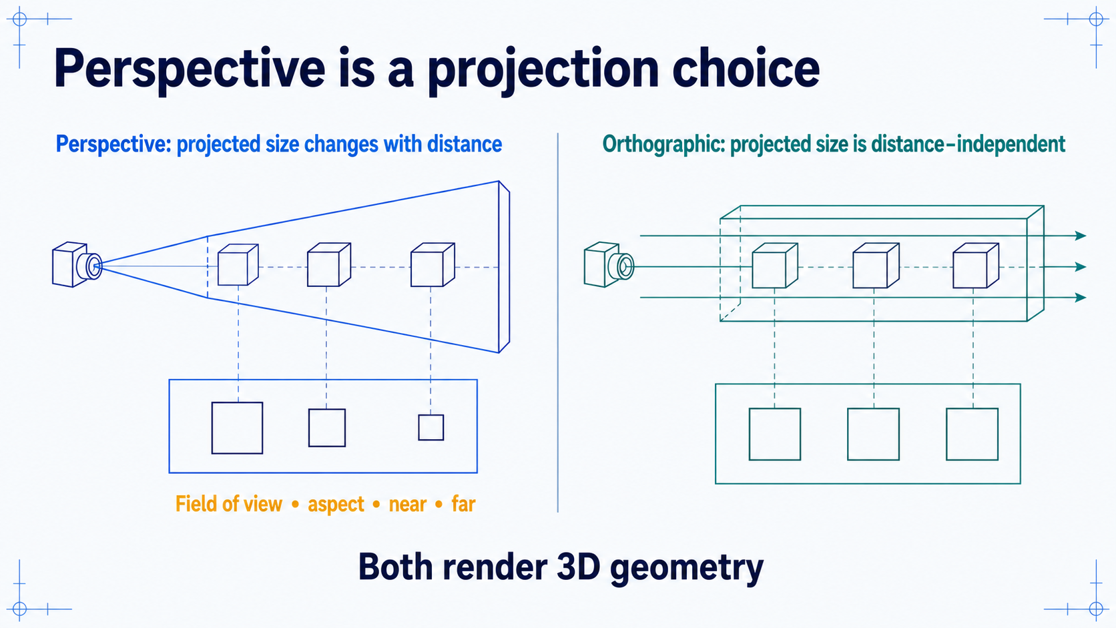
Notes:
### Perspective vs. orthographic projection
Both render 3D geometry; perspective adds distance-dependent size and a frustum whose near and far planes govern clipping and depth precision, while orthographic preserves projected size.
### Presenter reminders
- Suggested duration: **3 minutes**.
- Correct “perspective equals 3D” misconception.
- Point out near/far planes.
- Mention depth precision without deriving it.
### Near-verbatim delivery
In a perspective projection, otherwise similar objects appear smaller as they
move farther from the camera. The frustum is defined by field of view, aspect
ratio, near plane, and far plane. Perspective is useful when we want a familiar
viewing cue, but its parameters also affect clipping and depth precision.
Orthographic projection preserves projected size with distance. Parallel
directions remain parallel in the image under the ideal model. It is useful for
engineering views, maps, technical diagrams, some user-interface layers, and
comparisons where perspective foreshortening would distract.
Both cameras render three-dimensional geometry. Perspective is not a switch
that makes data “become 3D,” and orthographic is not restricted to 2D content.
Notice the near plane. Setting it unnecessarily close to the camera while
keeping a very distant far plane can make poor use of depth-buffer precision.
[Transition.] Projection gives clip coordinates, and clipping decides which
primitives are allowed to continue.

Slide 24
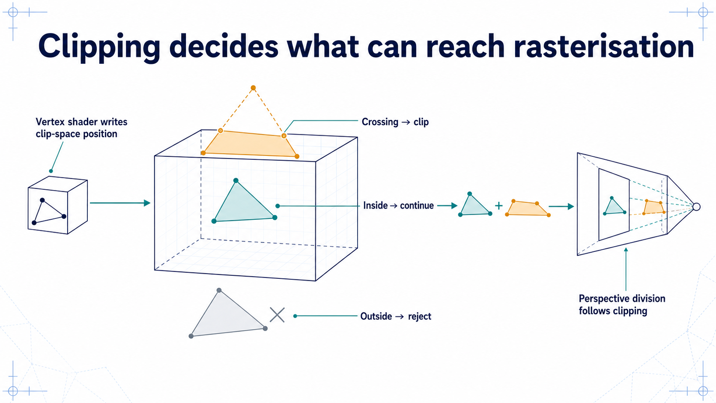
Notes:
### Clipping and perspective division
Primitives are tested against the clip volume before division, which is why a wrong clip-space position cannot be repaired by changing fragment colour — no candidate fragments are ever produced.
### Presenter reminders
- Suggested duration: **2 minutes**.
- Use homogeneous clip space rather than jumping directly to NDC.
- Point out that one bad vertex may distort or remove a primitive.
- Keep this slide brisk.
### Near-verbatim delivery
The vertex shader must write a homogeneous clip-space position. The pipeline
tests primitives against the clip volume. A primitive entirely outside a
relevant boundary can be rejected. One entirely inside continues. A primitive
that crosses a boundary may be clipped, producing a visible portion.
Perspective division comes after clipping. Dividing too early would make
handling primitives that cross important boundaries problematic.
This stage explains why changing fragment colour cannot repair an incorrect
position. If the vertex shader produces coordinates outside the clip volume,
the primitive may never create candidate fragments.
[Transition.] The surviving primitives now have to be converted into coverage
on a discrete framebuffer. That operation is rasterisation.

Slide 25
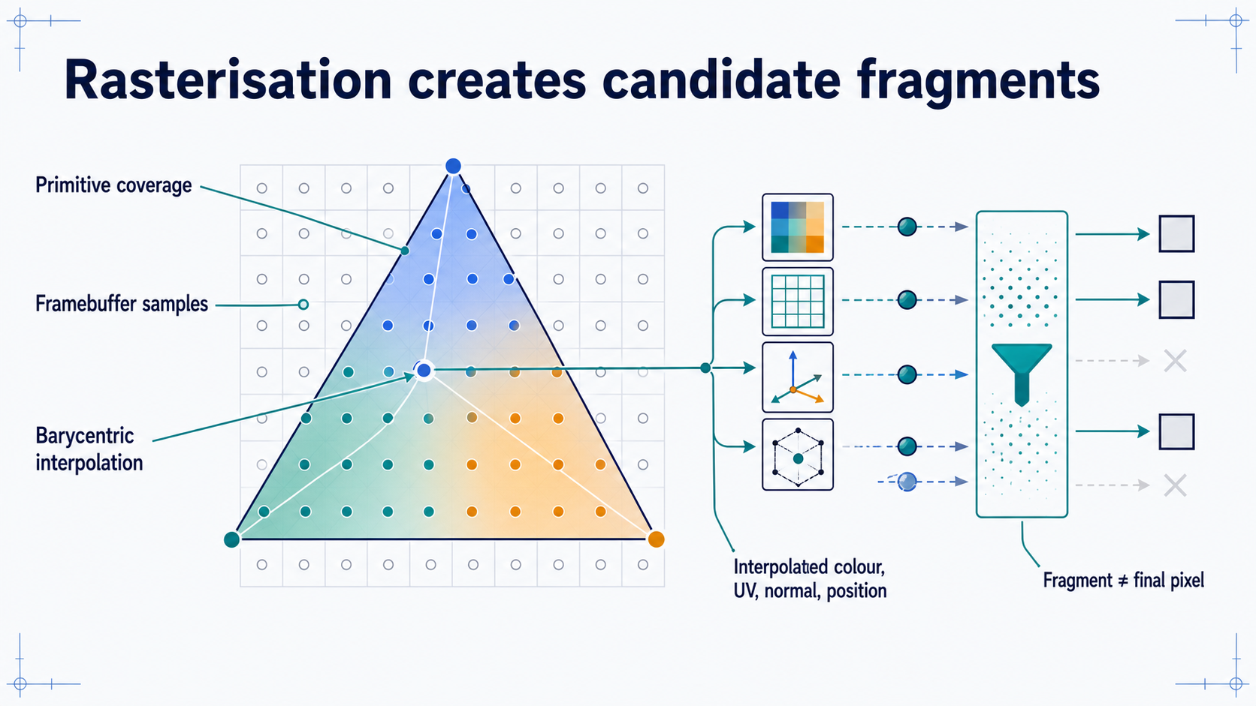
Notes:
### Rasterisation and interpolation
Coverage determines which samples a primitive touches, and barycentric weights interpolate vertex outputs, producing candidate fragments that are not yet guaranteed pixels.
### Presenter reminders
- Suggested duration: **3 minutes**.
- Trace one sample back to three vertices.
- Avoid the phrase “convert triangle into pixels” without qualification.
- Explain candidate fragment.
### Near-verbatim delivery
Rasterisation determines which framebuffer sample locations a primitive
covers. For a triangle, barycentric coordinates provide a useful mental model:
each covered sample receives weights relative to the three vertices. Those
weights interpolate values output by the vertex shader, such as colour, UV
coordinates, normals, or world position.
That is why our WebGL triangle displayed a continuous colour gradient even
though the application supplied only three colours. The pipeline interpolated
the vertex outputs.
The result is a set of candidate fragments. A fragment shader can evaluate an
output for each candidate, but that does not guarantee a final visible pixel.
Depth testing may reject it. Stencil or scissor state may reject it. Blending
may combine it with an existing value. Multisampling can also involve several
samples per displayed pixel.
[Transition.] The next stage applies efficient visibility approximations,
especially depth testing and face culling.

Slide 26
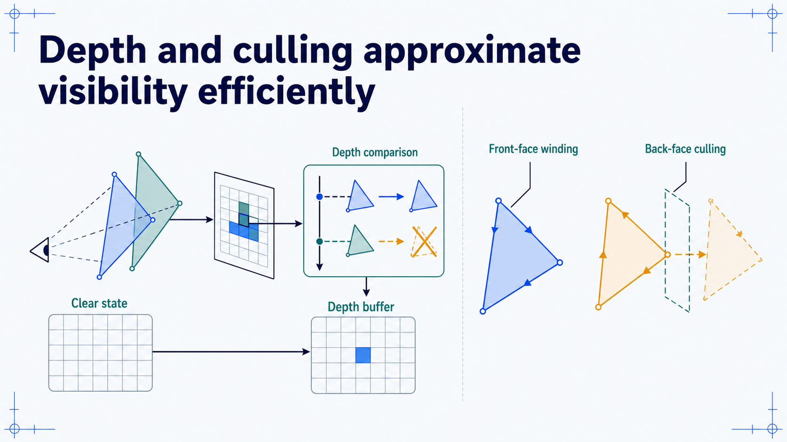
Notes:
### Depth testing and face culling
Closest-sample visibility and winding-based culling are efficient approximations with familiar failure modes — z-fighting, disappearing mirrored geometry, and transparency needing extra ordering.
### Presenter reminders
- Suggested duration: **3 minutes**.
- Demonstrate closest sample winning under the normal configuration.
- Mention early-depth optimisation only as optional detail.
- Explain that transparency may require additional ordering strategies.
### Near-verbatim delivery
The depth buffer stores a depth value per sample. Under a common configuration,
a candidate fragment updates the colour only if its depth is closer than the
stored value. The depth buffer must be cleared appropriately at the start of a
frame, and the comparison must match the projection and depth convention.
Face culling uses triangle orientation. The order of projected vertices
determines whether a face is considered front-facing. For a closed opaque
surface, rejecting back faces can avoid unnecessary work. But a mirrored
transform or inconsistent winding can make valid geometry disappear.
Depth testing is not a complete solution to visibility. Nearly coplanar
surfaces can produce z-fighting. Transparent surfaces commonly require
additional ordering or specialised techniques because blending depends on
existing framebuffer values.
These are examples of graphics state: the same geometry and shaders can
produce different frames under different state configuration. [Transition.]
We will pause here. After the break, we move from spatial data and visibility
to hierarchy, animation, and appearance.
## Break — 10 minutes
Resume with Slide 27.

Slide 27
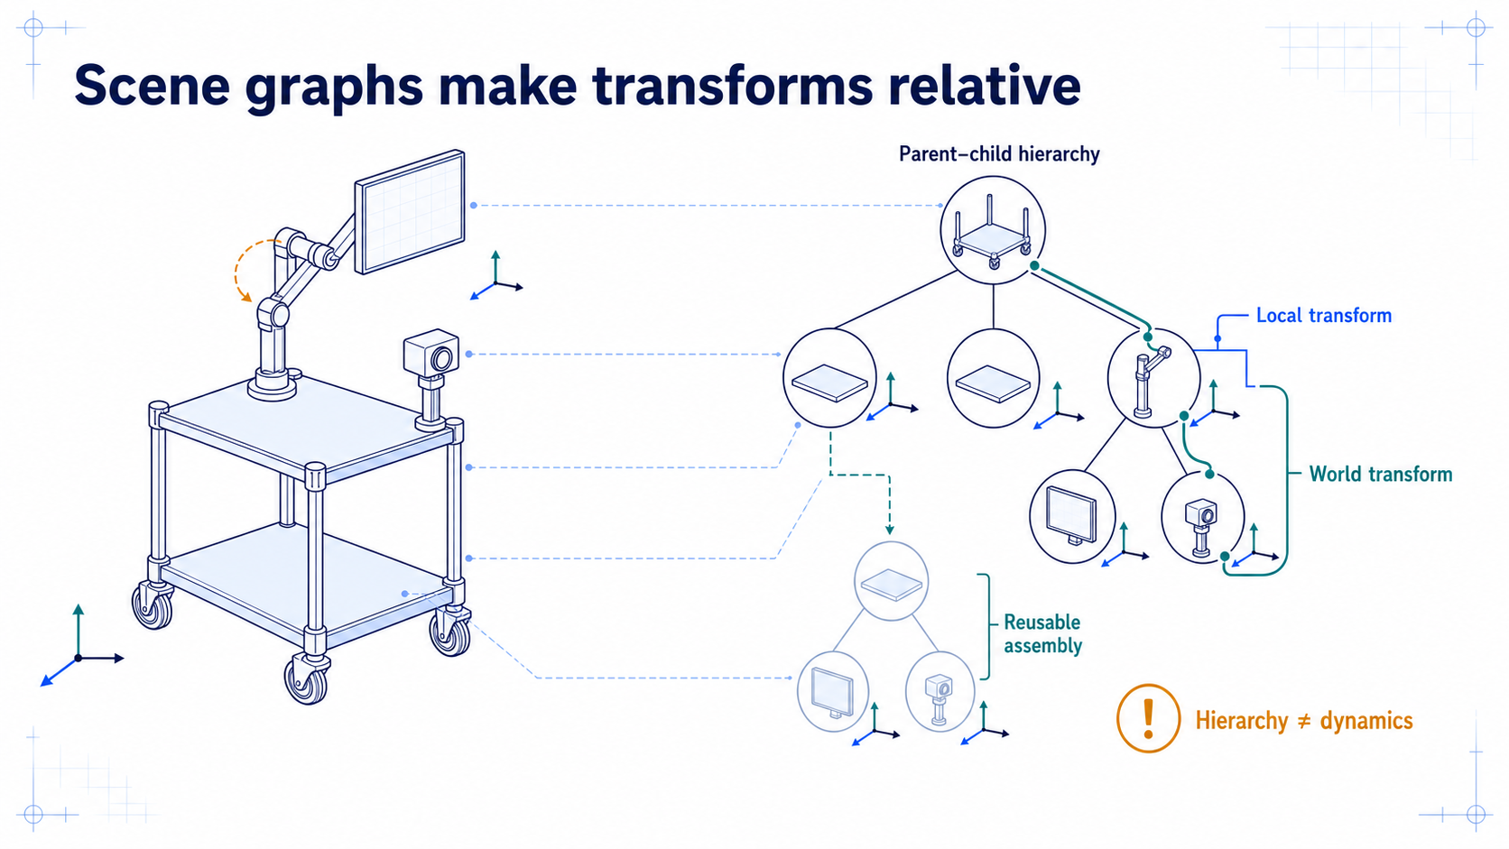
Notes:
### Scene graphs
Parent–child nodes with local transforms compose into world transforms along the path from the root, describing spatial dependency only — not dynamics, semantics, or permissions.
### Presenter reminders
- Suggested duration: **3 minutes**.
- Reorient after the break with a concrete object.
- Move the parent and show children following.
- Do not conflate scene graph with semantic graph or physics engine.
### Near-verbatim delivery
We resume with a structure that reuses the transformation logic we have just
learned. A scene graph represents parent–child relationships. Each node has a
local transform relative to its parent. Its world transform is the composition
of transforms along the path from the root.
If the sensor is a child of the trolley and the trolley moves, the sensor moves
with it. We do not need to recalculate an unrelated absolute pose manually for
every part. The same principle supports vehicles, articulated equipment,
cameras mounted on robots, and nested room assemblies.
The hierarchy describes spatial dependency. It does not automatically define
simulation dynamics, ownership, semantics, or permissible actions. Those are
additional systems.
Three.js uses an `Object3D` hierarchy for this pattern, and glTF stores node
hierarchies in portable assets. [Transition.] A skeleton is a specialised
transform hierarchy used to animate a deformable skin.

Slide 28
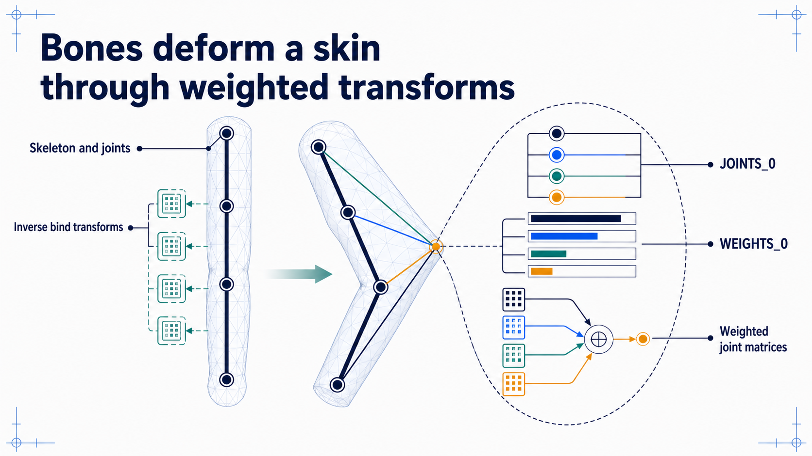
Notes:
### Skeletons and skinning
A joint hierarchy plus per-vertex indices and weights deforms a mesh by linear blend skinning, an efficient approximation that breaks on bad weights, indices, or inverse bind data.
### Presenter reminders
- Suggested duration: **3 minutes**.
- Define joint hierarchy before “bone.”
- Point to indices and weights as vertex attributes.
- Mention weight normalisation and reference pose.
- Do not derive the full skinning equation.
### Near-verbatim delivery
A skeleton is a hierarchy of joint transforms. The visible bones are a useful
animation metaphor, but the computation uses transformations and their
relationships. A reference, or bind, pose establishes how the mesh and
skeleton are aligned. Inverse bind transforms help move vertices into the
appropriate joint spaces.
The skinned mesh stores joint indices and joint weights as vertex attributes.
In glTF these commonly appear as `JOINTS_0` and `WEIGHTS_0`. The indices select
influencing joints. The weights state how strongly each joint contributes.
Linear blend skinning forms a weighted combination of joint transformations
for each vertex.
The weights should sum approximately to one. Wrong indices, unnormalised
weights, or missing inverse bind information can make a joint collapse or tear
the surface.
Linear blend skinning is efficient, but it is an approximation. Volume loss
around strongly bent joints can occur even when the implementation is correct.
[Transition.] Geometry and deformation still do not tell the renderer how a
surface should appear. That role belongs to the material system.

Slide 29
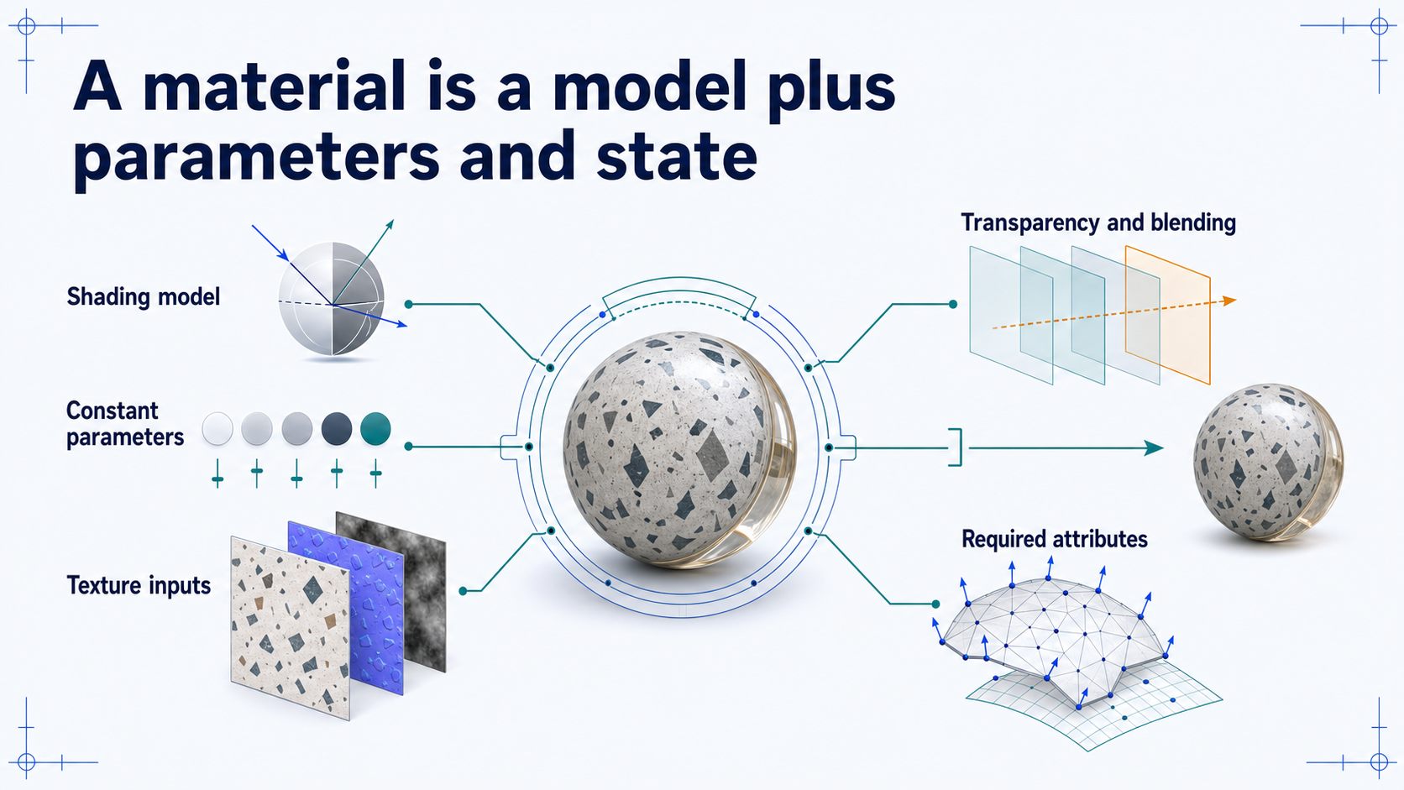
Notes:
### Materials
A material is a contract for evaluating appearance — shading model, parameters, textures, render state — with attribute and lighting requirements that explain most black or strange-looking objects.
### Presenter reminders
- Suggested duration: **3 minutes**.
- Correct overloaded everyday use of “material.”
- Compare unlit and lit material requirements.
- Explain why a missing normal or light can invalidate a material result.
### Near-verbatim delivery
In a renderer, a material is a contract for evaluating surface appearance. It
selects or configures a shading model, supplies constant parameters, references
textures, and may define transparency, blending, depth-writing, or culling
behaviour.
A colour is one possible input. A texture is sampled data. A shader is a
program. A material may use all three, but none is a complete synonym for the
material.
The material also implies requirements. An unlit colour material may need only
position. A lit normal-mapped material may require position, normal, UV, and
tangent data, plus lights and texture inputs. If the mesh does not provide
those attributes or the application interprets them incorrectly, the material
cannot produce its intended result.
This decomposition helps diagnose a black or strange-looking object. Before
changing colours randomly, ask whether the model, attributes, light, textures,
and render state satisfy the material's contract. [Transition.] The most common
material inputs are textures, which require their own coordinate and sampling
model.

Slide 30
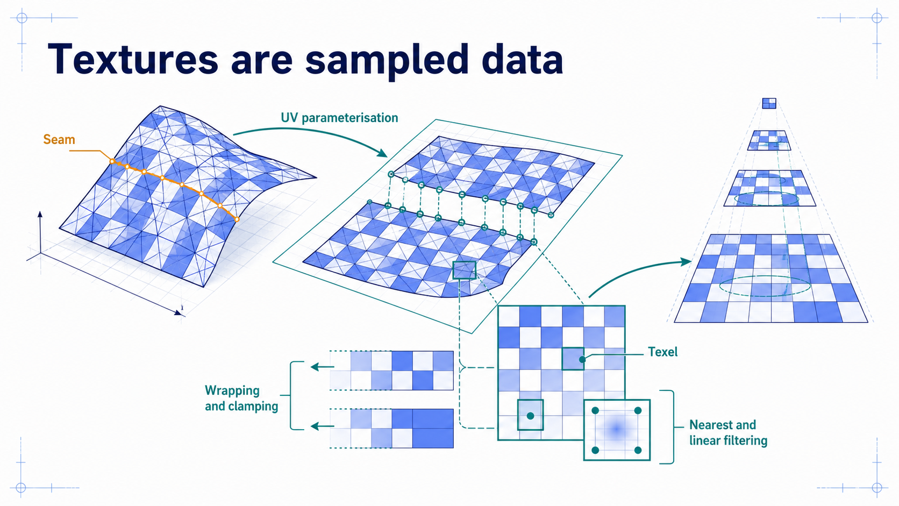
Notes:
### Textures, UVs, and sampling
UV coordinates address sampled data through an authored parameterisation whose seams duplicate vertices; filtering, wrapping, mipmaps, and colour encoding decide what a texel actually contributes.
### Presenter reminders
- Suggested duration: **3 minutes**.
- Trace one surface point to a UV coordinate and texel neighbourhood.
- Explain why seams duplicate vertex records.
- Keep colour-space language practical.
### Near-verbatim delivery
A texture is sampled data. UV coordinates provide an address, usually in a
two-dimensional parameter domain. The mapping from a surface to UV space must
be authored or computed. The image does not automatically know how to wrap
around arbitrary geometry.
Parameterisation introduces seams. A geometric position on two sides of a seam
may require two render vertices because the UV values differ. This is another
reason position alone does not define a vertex record.
Sampling then decides how discrete texels produce a value. Nearest filtering
selects a nearby texel. Linear filtering combines neighbours. Wrapping or
clamping controls behaviour outside the standard coordinate range. Mipmaps
provide progressively reduced versions for minification and improve stability
when one screen sample covers many texels.
Finally, not every texture stores display colour. Base-colour maps need colour
encoding treatment; normal, roughness, metallic, mask, and data textures should
not be decoded as if they were display colours. [Transition.] Different maps
therefore play distinct roles inside one material.

Slide 31
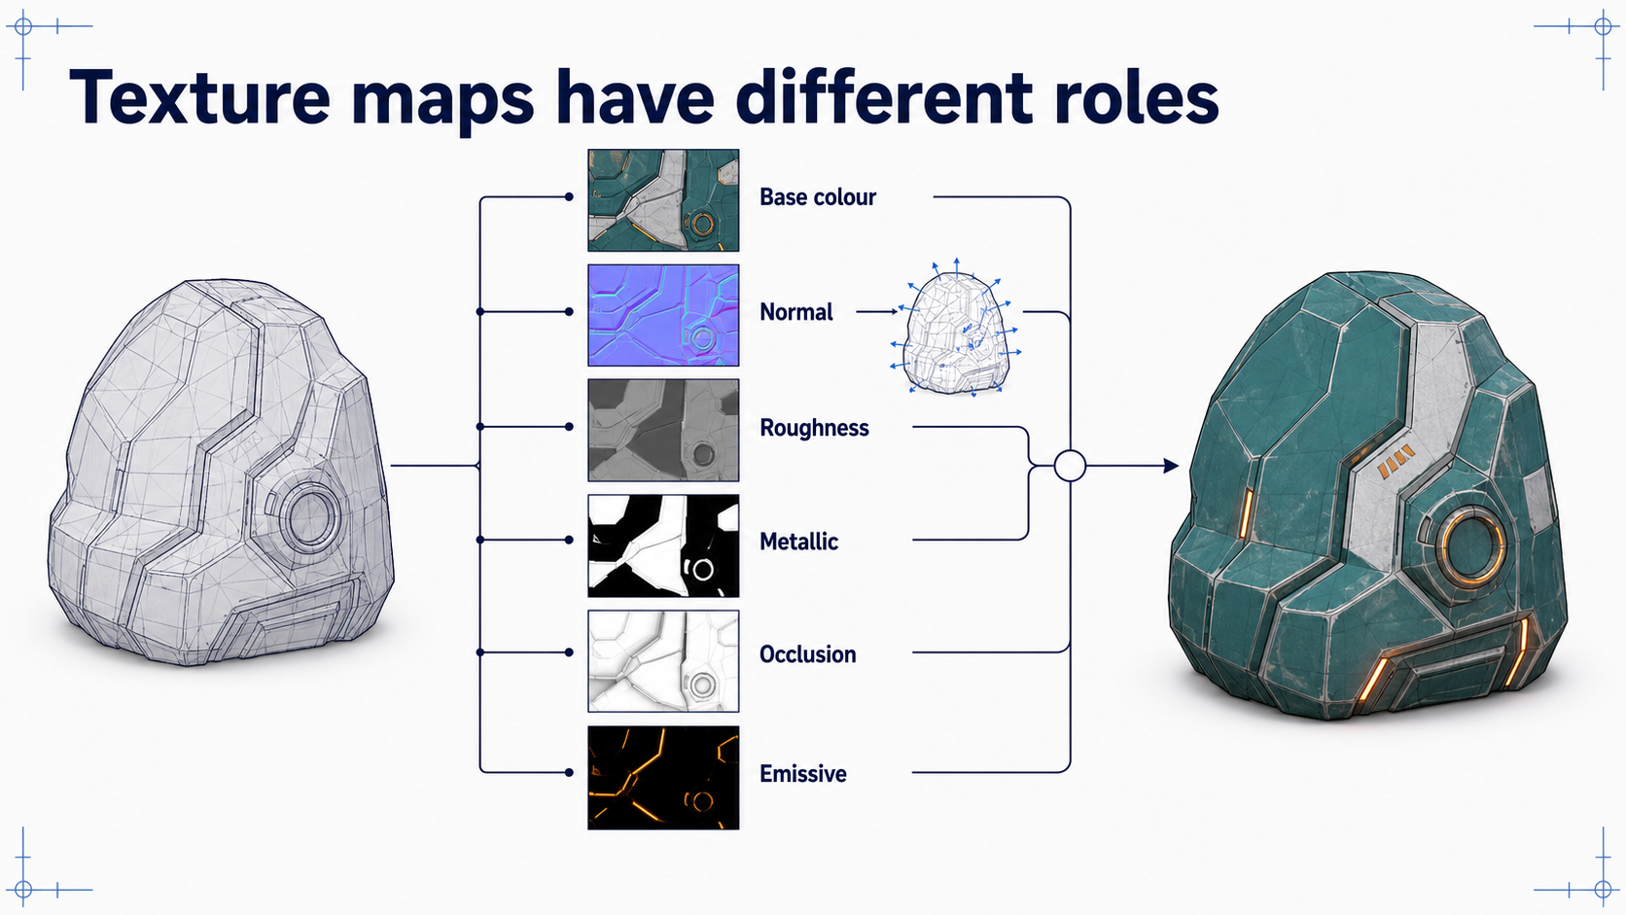
Notes:
### Texture map types
Base colour, normal, roughness, metallic, occlusion, and emissive maps carry distinct semantics — a normal map changes shading orientation, never the silhouette — and channels alone guarantee nothing.
### Presenter reminders
- Suggested duration: **3 minutes**.
- Explain each map in one sentence.
- Emphasise that normal maps alter shading orientation, not silhouette.
- Avoid treating ambient occlusion as universal ground truth.
### Near-verbatim delivery
These textures have different semantics. Base colour provides the material's
base reflectance colour under the chosen workflow. A normal map perturbs the
local shading frame. It can create fine lighting detail, but it does not move
the surface or change the silhouette.
Roughness controls the spread of specular reflection. Metallic controls whether
the surface is treated toward a conductor model in the metallic–roughness
workflow. Occlusion maps provide an authored or precomputed approximation of
local attenuation. Emissive maps add a surface-emission term, although the
object does not automatically illuminate the rest of the scene unless the
renderer implements that transport.
The renderer combines these values according to a material and shading model.
Simply packing images into channels does not guarantee correct semantics. The
channel assignment, colour interpretation, UVs, tangent basis, and shader must
agree.
[Transition.] Textures supply material data. Lights and view direction provide
the geometric relationship used to evaluate that data.

Slide 32
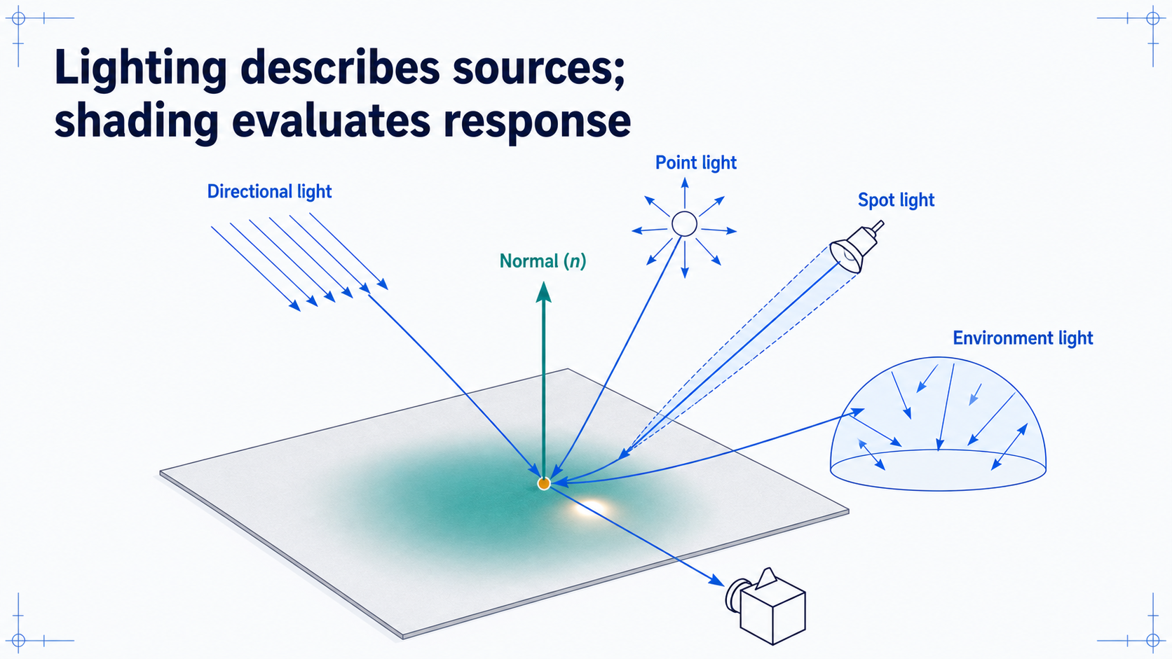
Notes:
### Lighting and shading
Light sources deliver illumination; shading evaluates a response from the normal, light, and view directions, with ambient constants acknowledged as an approximation of indirect light.
### Presenter reminders
- Suggested duration: **3 minutes**.
- Point to \(n\), \(l\), and \(v\) before equations.
- Clarify source model versus evaluated shading.
- Treat ambient as an approximation.
### Near-verbatim delivery
Lighting describes the sources or environment that deliver illumination toward
surfaces and cameras. A directional light approximates a distant source with a
nearly constant direction. A point light emits from a position. A spot light
adds a directional cone. Environment lighting represents illumination arriving
from surrounding directions.
Shading evaluates a response using geometry, material, light, and view
relationships. At this sample, the normal \(n\) describes orientation, \(l\)
points toward the light, and \(v\) points toward the viewer. A diffuse term
captures broad response; a specular term captures view-dependent reflection
under the chosen approximation.
An “ambient” constant can prevent unlit regions from becoming black, but it is
not a complete model of indirect light. The terminology should not hide the
approximation.
[Transition.] Physically based shading organises these approximations and
material parameters more consistently, but it is still a model with
assumptions.

Slide 33
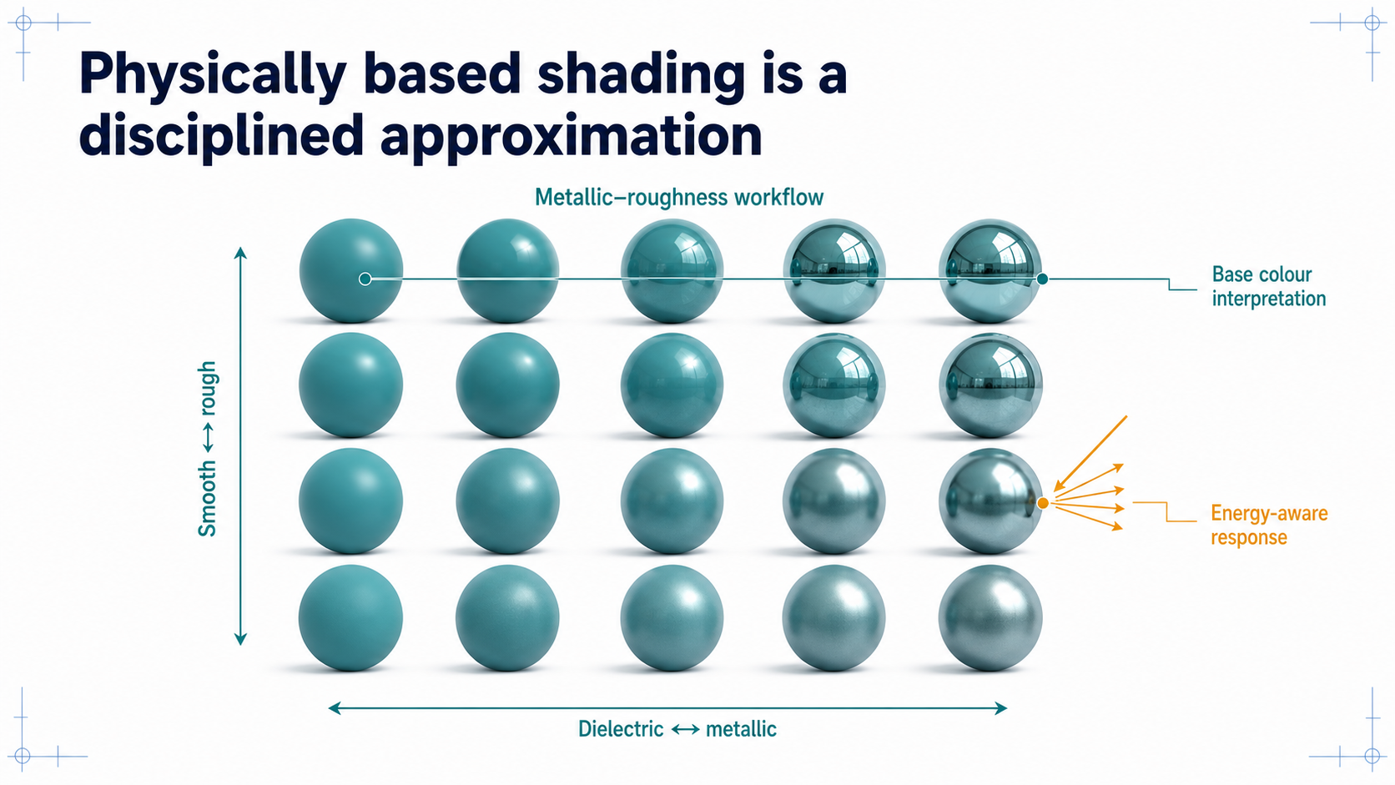
Notes:
### Physically based shading
A metallic–roughness grid over fixed geometry and lighting shows a disciplined family of approximations and asset conventions — not an automatic photorealism switch.
### Presenter reminders
- Suggested duration: **3 minutes**.
- Read one row and one column.
- Avoid a full BRDF derivation.
- State why portability across lighting matters.
### Near-verbatim delivery
This grid holds geometry and lighting constant while varying two material
parameters. Moving horizontally changes metallic behaviour. Moving vertically
changes roughness, which broadens and dims the specular highlight while
spreading reflected energy across more directions.
In a common metallic–roughness workflow, dielectrics and metals interpret base
colour differently. The model also aims to avoid creating arbitrary extra
energy. These conventions make authored materials behave more consistently
when lights and environments change.
“Physically based” does not mean that the renderer has captured every optical
effect or that the inputs are measured correctly. The geometry may be wrong,
the light may be approximate, and the display transform may be incomplete.
PBR is a disciplined family of approximations and asset conventions, not an
automatic photorealism switch.
[Transition.] Materials are ultimately evaluated by programs. The programmable
stages we need today are the vertex and fragment shaders.

Slide 34
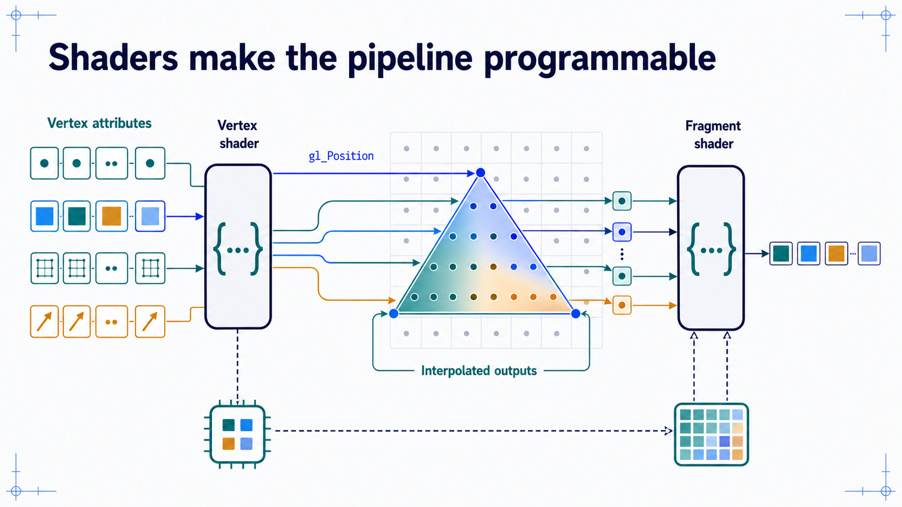
Notes:
### Vertex and fragment shaders
Two programmable stages with distinct execution domains — per submitted vertex, writing clip position, and per candidate fragment — sharing uniforms and textures defined by the application.
### Presenter reminders
- Suggested duration: **3 minutes**.
- Keep execution domains clear: per submitted vertex versus per candidate
fragment.
- Define uniform conceptually.
- Mention that other shader stages exist but are not required here.
### Near-verbatim delivery
A shader is a program executed at a programmable GPU stage. The vertex shader
runs for submitted vertices. It reads enabled attributes and other resources,
and it must write `gl_Position` in clip coordinates. It may also write values
that the rasteriser will interpolate.
The fragment shader runs for candidate fragments generated by rasterisation. It
receives interpolated inputs and can sample textures or use shared parameters
to compute an output.
Uniforms are values shared across many shader invocations for a draw, such as a
transformation matrix or material constant. Textures provide sampled data.
The shader does not automatically understand a light, material, or camera. The
application and program define those structures and conventions. Other modern
pipelines include additional programmable stages, but the vertex-to-fragment
path is sufficient for our foundational model.
[Transition.] We will now read a minimal pair of shaders and follow one value
from an attribute to the final fragment colour.

Slide 35
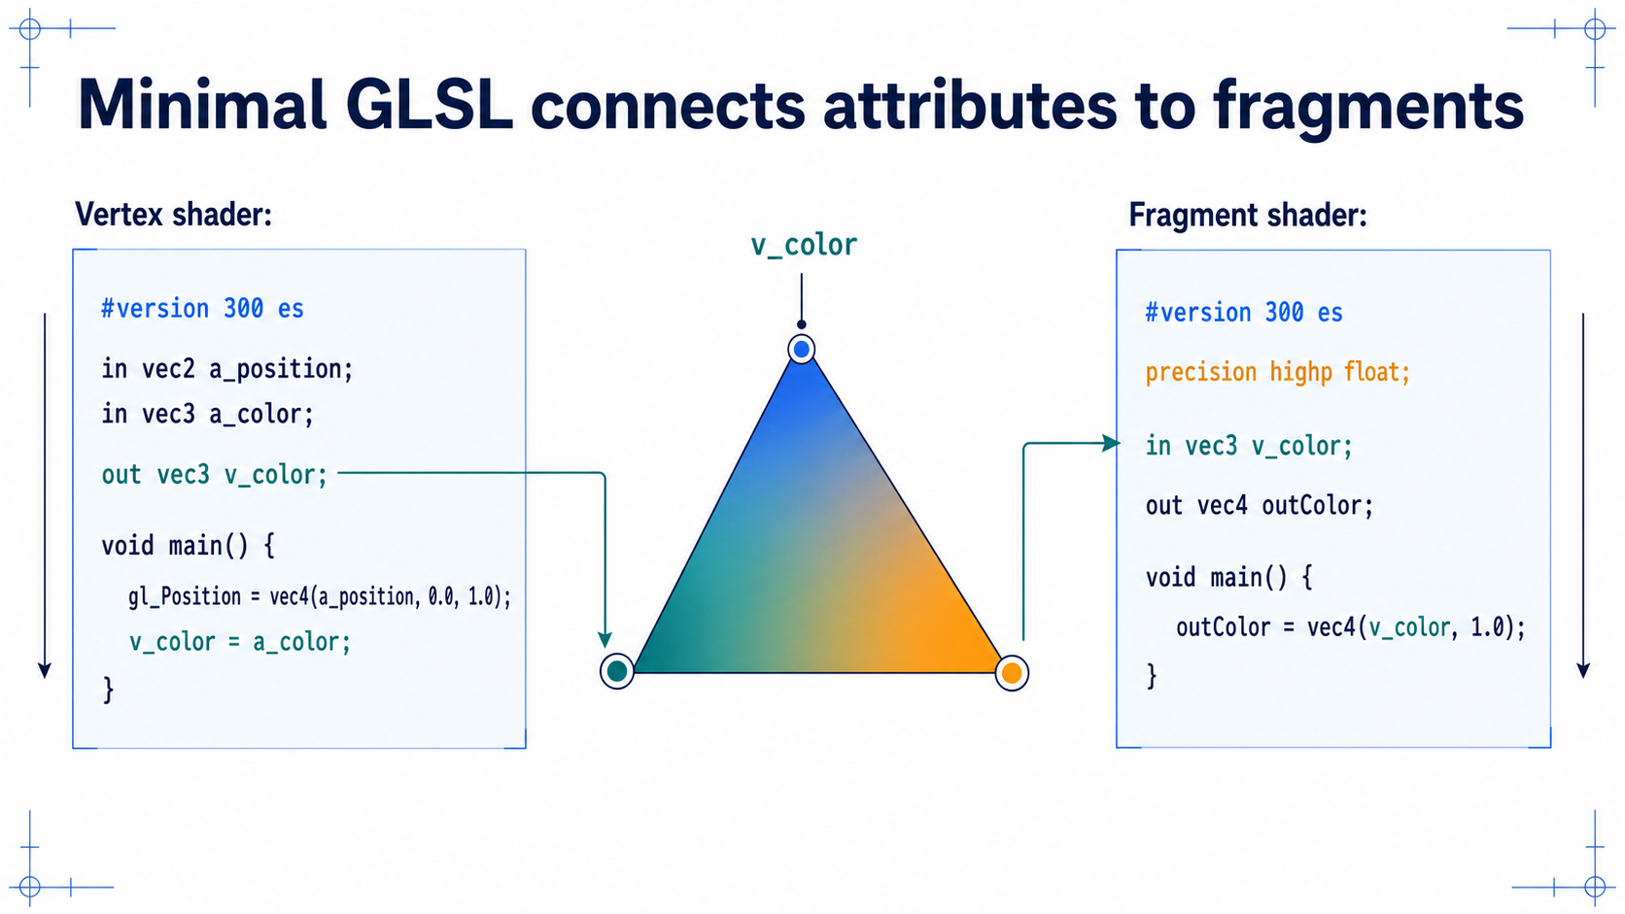
Notes:
### Reading a minimal shader pair
Tracing `gl_Position` and `v_color` shows the gradient's exact origin: three attribute values, three vertex outputs, raster interpolation, and one fragment output.
### Presenter reminders
- Suggested duration: **4 minutes**.
- Read only the essential lines.
- Point to `gl_Position`, then trace `v_color`.
- Explain `#version 300 es` and fragment precision briefly.
- Do not let the slide become a syntax lecture.
### Near-verbatim delivery
The vertex shader declares two inputs. `a_position` receives two components
from the position attribute. `a_color` receives three colour components. The
shader constructs a four-component clip-space position and assigns it to
`gl_Position`. Because this example already supplies clip-space x and y, there
is no model–view–projection matrix yet.
The shader copies the colour into `v_color`. The rasteriser interpolates that
output across the triangle. The fragment shader declares a matching input and
writes it as an RGBA output with alpha equal to one.
`#version 300 es` selects GLSL ES 3.00 syntax used with WebGL 2. The fragment
shader declares floating-point precision because the language requires an
appropriate default precision for these values.
The visible gradient therefore has a precise origin: three attribute values,
three vertex-shader outputs, raster interpolation, and a fragment output.
[Transition.] Higher-level libraries and asset formats package these contracts,
but they do not make them disappear.

Slide 36
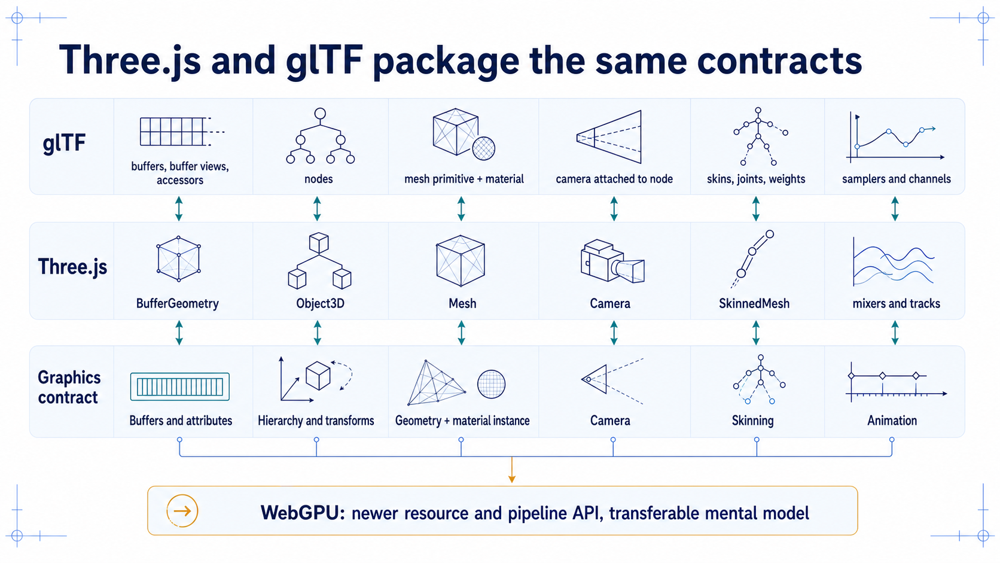
Notes:
### Three.js, glTF, and WebGPU
Libraries and asset formats package these contracts without abolishing them — wrong normals stay wrong, and a glTF scene hierarchy is not a virtual world.
### Presenter reminders
- Suggested duration: **3 minutes**.
- Use the table as a mapping, not a feature comparison.
- State that glTF is an asset format, not a world runtime.
- Mention WebGPU without beginning a second API lecture.
### Near-verbatim delivery
Three.js reduces application boilerplate by packaging related concepts.
`BufferGeometry` manages attributes and indices. `Object3D` provides
hierarchical transforms. A `Mesh` combines geometry, material, and an object
transform. Cameras, lights, and renderers package other parts of the system.
glTF addresses transmission of runtime 3D scenes and models. Buffers, buffer
views, and accessors describe data. Nodes provide hierarchy. Mesh primitives
reference attributes, indices, and materials. Skins and animations carry
articulated asset data.
Neither abstraction abolishes the underlying contracts. Wrong normals remain
wrong. Incompatible coordinate assumptions remain incompatible. A glTF asset
also does not become a complete virtual world merely because it contains a
scene hierarchy.
WebGPU uses newer resource, binding, pipeline, and shader conventions. We are
not learning that API today, but the durable concepts transfer: buffers,
vertex formats, primitives, transforms, textures, samplers, shaders, depth,
blending, and render targets.
[Transition.] We will finish by applying the contract model to four failed
frames.

Slide 37
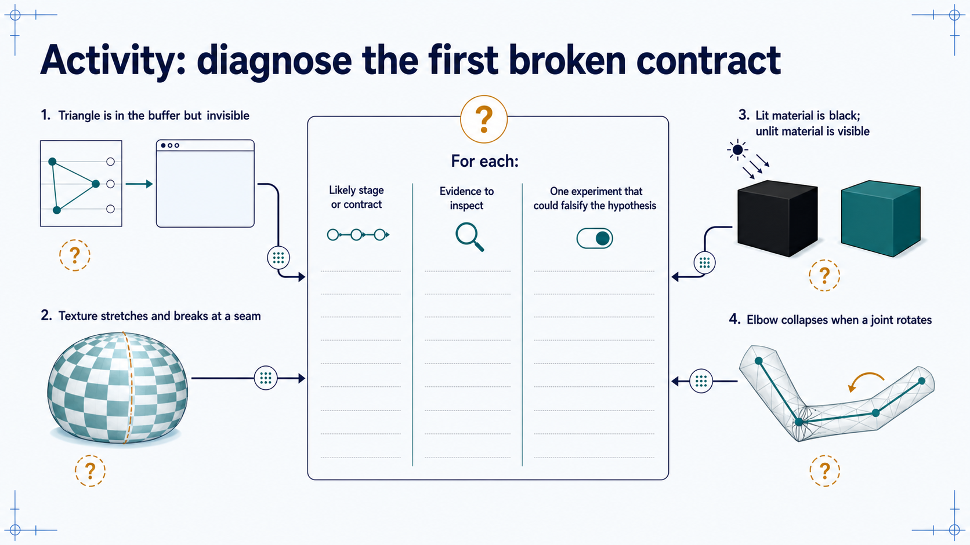
Notes:
### Debugging activity: four broken frames
In pairs, name the first contract to inspect for an invisible triangle, broken texture, black lit material, and collapsed elbow — and a falsifying experiment for each.
### Presenter reminders
- Suggested duration: **8 minutes**.
- [Ask] Work in pairs for five minutes.
- Require a falsifying experiment, not only a guess.
- Debrief in symptom order for three minutes.
- Reward multiple plausible hypotheses with explicit evidence.
### Near-verbatim delivery
[Ask.] Work with one other person. For each symptom, identify the first
pipeline stage or data contract you would investigate. Then name one piece of
evidence and one small experiment that could show your hypothesis is wrong.
You have five minutes.
[After activity.] For the invisible triangle, we might inspect the vertex
shader's clip coordinates, primitive mode, winding, culling, and viewport. A
falsifying experiment could disable culling or replace the transform with a
known identity path.
For the broken texture, inspect UV values, seams, wrapping, and the attribute
layout. For the black lit material, check normals, lights, colour interpretation,
and whether the shader linked and received the intended inputs. For the elbow,
inspect hierarchy, joint indices, weights, weight sums, and inverse bind
transforms.
The goal is not to guess one official answer from an image. It is to propose a
diagnosis that produces evidence. Ask: where did a correct world representation
first become an incorrect graphics input or pipeline result? [Transition.] That
question summarises the entire lesson.

Slide 38
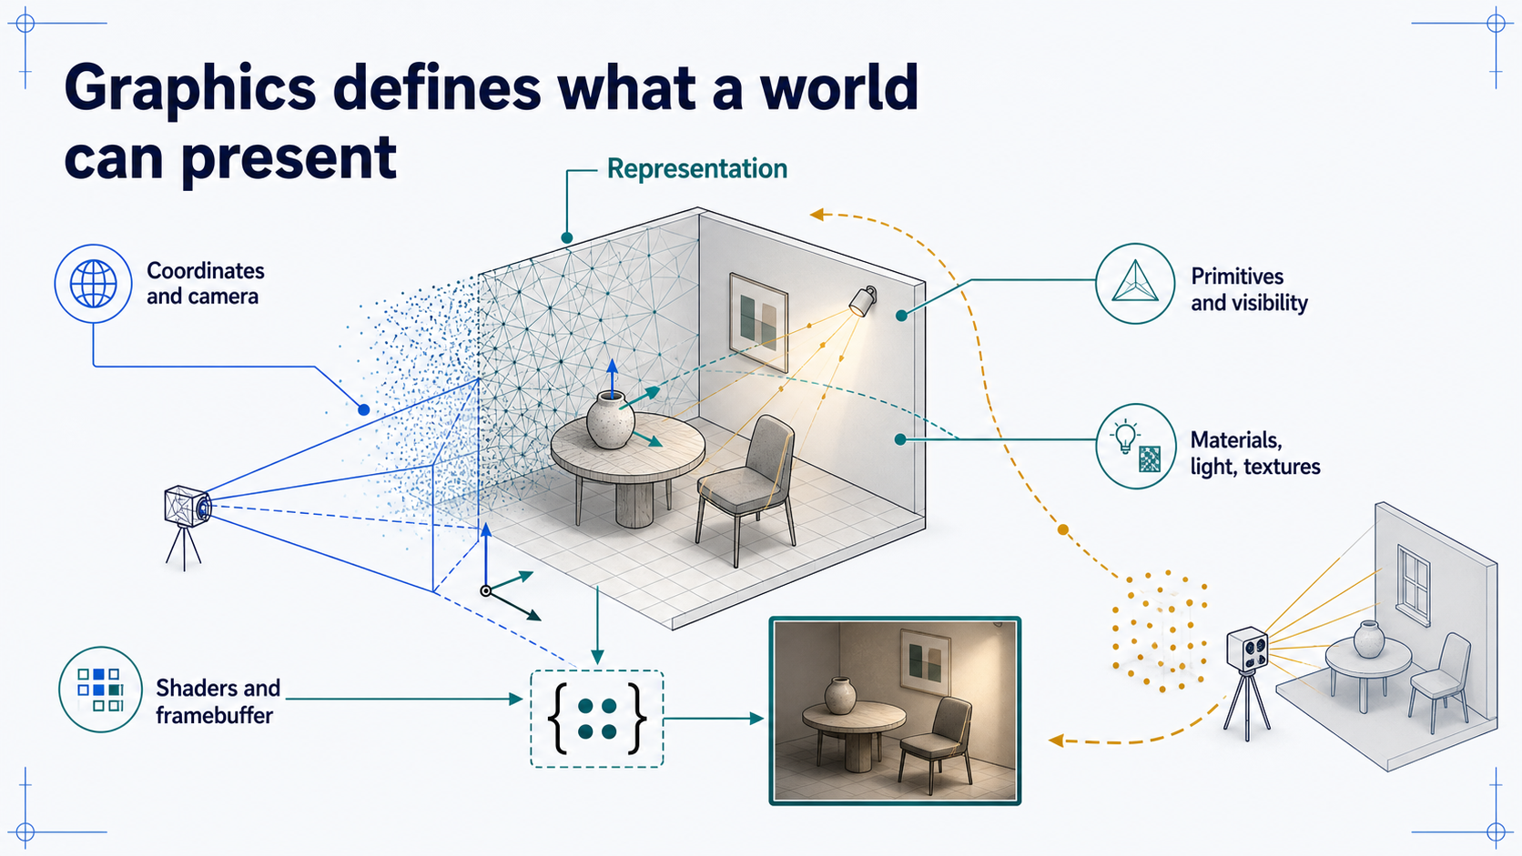
Notes:
### Wrap-up and bridge to Lesson 03
The pipeline reassembled in one pass, with the reminder that rendering quality never demonstrates model validity; next, acquisition reverses the story from physical evidence to representation.
### Presenter reminders
- Suggested duration: **3 minutes**.
- Reassemble the pipeline in the audience's language.
- State the Lesson 03 transition precisely.
- [Ask] Exit question before ending.
### Near-verbatim delivery
We began with the claim that graphics transforms world representations into
observations. We can now unpack it. Vertices are structured attribute records.
Primitives give those records geometric meaning. Points, surfaces, and volumes
store different evidence. Transformations connect coordinate frames. Cameras
and projection define an observer. Rasterisation, depth, and culling determine
candidate visibility. Materials, textures, lights, and shaders evaluate
appearance. The framebuffer receives the result.
None of these steps proves that the world model is valid. A beautifully
rendered handrail can still have the wrong dimensions. A smooth character can
still use incorrect joint semantics. Rendering quality and model validity are
related only through explicit evidence and requirements.
[Ask.] On a blank card, answer this: when an image is wrong, which contract
would you inspect first, and what evidence would you seek?
Next, we reverse the direction of the story. Lesson 03 asks how cameras, depth
sensors, calibration, and reconstruction turn physical evidence into points,
geometry, and maintained digital representations. [Pause.] That is the bridge
from computer graphics to acquisition and digital twins.

Slide 39
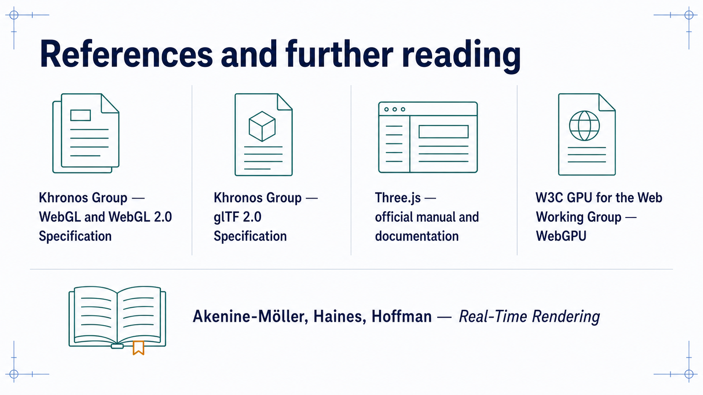
Notes:
### References
Untimed slide listing standards, official documentation, and textbooks, with the overview document and source ledger holding full links and provenance.
### Presenter reminders
- Suggested duration: **not presented**.
- Leave visible after questions if useful.
- Do not read citations aloud.
- Point students to the overview for complete links and review questions.
### Near-verbatim delivery
These are the principal standards, official documentation, and textbooks used
for the lesson. The overview document contains the complete links, definitions,
worked WebGL example, misconceptions, and review questions. The source ledger
will also distinguish normative API claims from pedagogical simplifications
and generated course illustrations.

