Slide 1

Virtual Worlds
A.A. 2026/27
Dipartimento di Informatica
Università di Pisa

Slide 2
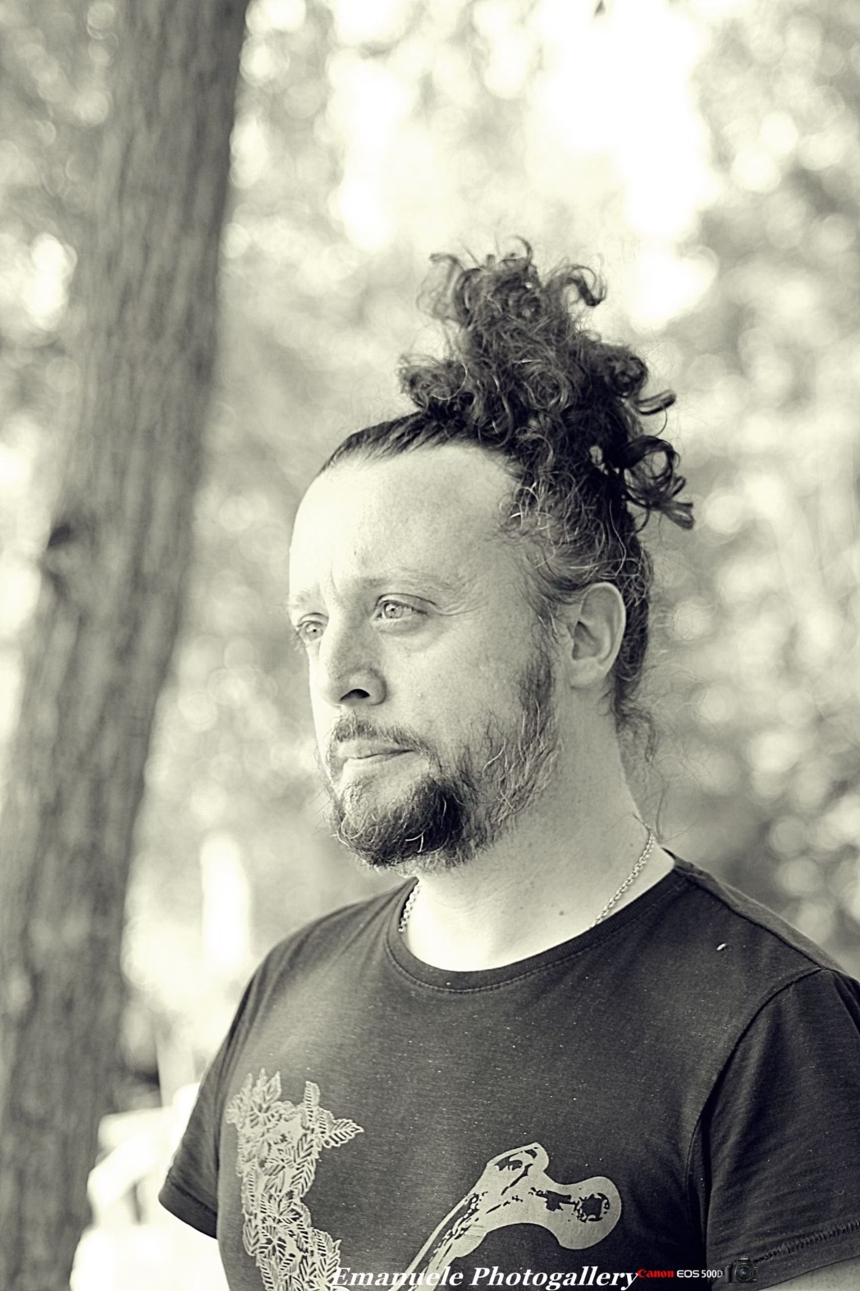
Marco { Di Benedetto }, Ph.D.
Senior Researcher @ CNR-ISTI-AIMH
Areas of Interest:
Artificial Intelligence
Computer Graphics
Computer Vision
Agentic Systems
Course Page:
https://aimh.isti.cnr.it/marcodibenedetto/virtual-worlds-2026-27/
marco.dibenedetto@isti.cnr.it
Virtual Worlds – A.A. 2026/27 – Dipartimento di Informatica – Università di Pisa
2

Slide 3
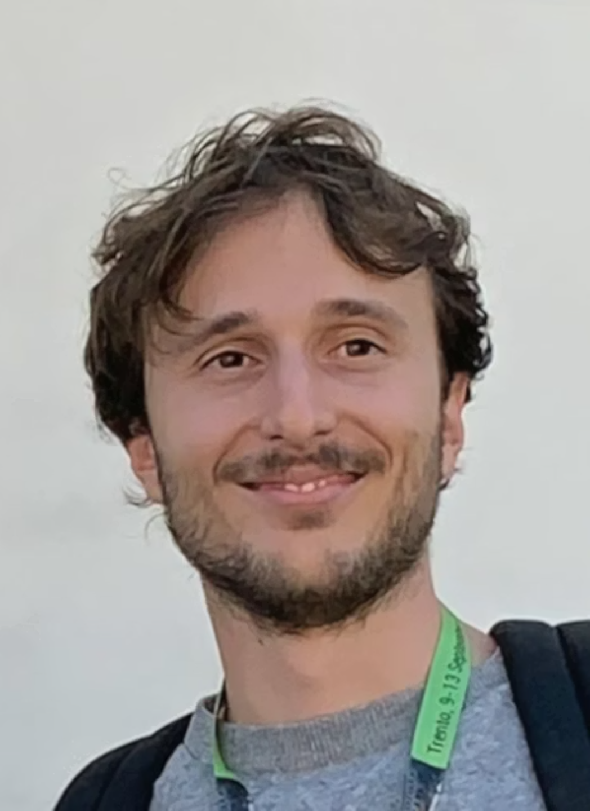
Fabio Carrara, Ph.D.
Senior Researcher @ CNR-ISTI-AIMH
Areas of Interest:
Artificial Intelligence
Computer Vision
Multimedia Information Retrieval
fabio.carrara@isti.cnr.it
Virtual Worlds – A.A. 2026/27 – Dipartimento di Informatica – Università di Pisa
3

Slide 4
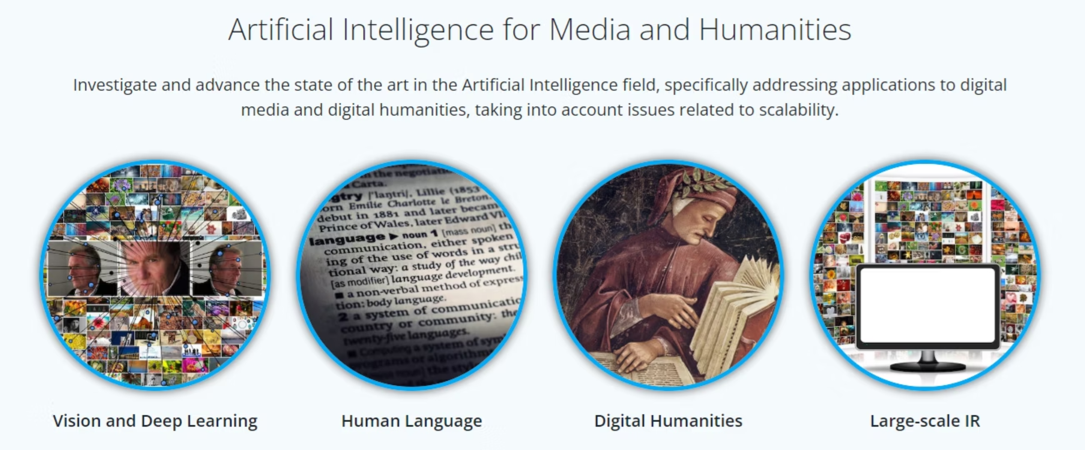
Our Research Laboratory
Artificial Intelligence for Media and Humanities - AIMH - https://aimh.isti.cnr.it/
Virtual Worlds – A.A. 2026/27 – Dipartimento di Informatica – Università di Pisa
4

Slide 5


Assessment Methods
Mini-Project …
… AND Oral Presentation
Work in groups of 2-3 students to develop a Python or JavaScript application. You can choose from an assigned topic or propose your own project
(subject to agreement).
Present your project orally to demonstrate your work and understanding. This will include questions about your project and general course content
Proactive commitment for attending students
More detailed oral session for working students
Virtual Worlds – A.A. 2026/27 – Dipartimento di Informatica – Università di Pisa
5

Slide 6
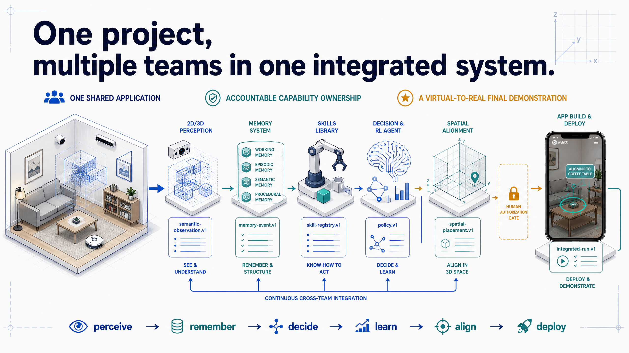
Assessment Methods – Course Project
TO BE CONFIRMED
A shared, course-wide project that will partition students into teams, to which a single and independent part of the system will be assigned.
Topics will be related to agentic systems,
reinforcement learning, virtual world training,
2d/3D computer vision, XR, app deployment.
Virtual Worlds – A.A. 2026/27 – Dipartimento di Informatica – Università di Pisa
5-bis

Slide 7


Communications
Direct Communication
Scheduled Reception
For quick questions and immediate feedback, reach us directly via CNR-ISTI email or after lessons.
For in-depth discussions or specific inquiries, see us after lessons or schedule dedicated reception hours by agreeing on a time via email.
Virtual Worlds – A.A. 2026/27 – Dipartimento di Informatica – Università di Pisa
6

Slide 8


Course Context
The course is divided into two parts, each focusing on different aspects of Virtual Worlds and AI
(12 + 12 == 24 lessons of about 2 hours each)
Part 1: Marco Di Benedetto
Part 2: Fabio Carrara
Virtual Worlds & Reality Fusion
AI & Sensing
Digital Content
3D Deep Learning
Computer Graphics / XR
Human Pose Estimation
Reinforcement Learning
Open-Vocabulary Perception
Agentic Systems
Edge AI
Virtual Worlds – A.A. 2026/27 – Dipartimento di Informatica – Università di Pisa
7

Slide 9
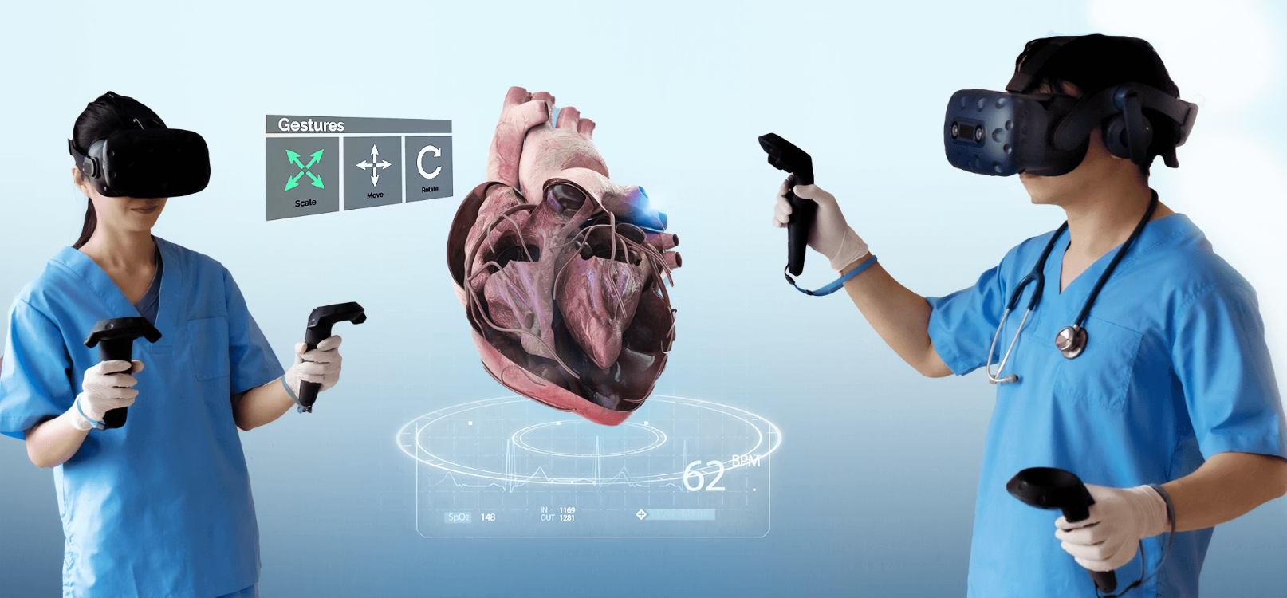
Course Context - Part 1
Virtual Worlds & Reality Fusion
Explore the intersection of virtual worlds and artificial intelligence.
As future leaders in IT and digital health, understanding these technologies is crucial for advancing medical education, training, and patient care.
We'll examine both theoretical foundations and practical implementations.
Virtual Worlds – A.A. 2026/27 – Dipartimento di Informatica – Università di Pisa
8

Slide 10
Learning Objectives - Part 1
1
Define virtual worlds and their foundational concepts
Establishes core virtual world architectures, digital twin theory with 3D digitalization techniques, and synthetic data generation
2
Computer Graphics fundamentals
Covers 3D geometry representations, materials/texturing/rendering principles, and hands-on programming
3
Extended Reality Technologies
Explores the AR/VR/MR continuum for immersive applications, including tracking systems, SLAM algorithms, and registration techniques
4
Advanced AI Integration
Introduces reinforcement learning for virtual modeling
5
Practical Focus
Apply concepts to real scenarios including training, digital twins, PPE detection
6
Comprehensive Assessment
Combines weekly implementation tasks with a final team project integrating digital twins, synthetic data generation, and interactive visualization
Virtual Worlds – A.A. 2026/27 – Dipartimento di Informatica – Università di Pisa
9

Slide 11
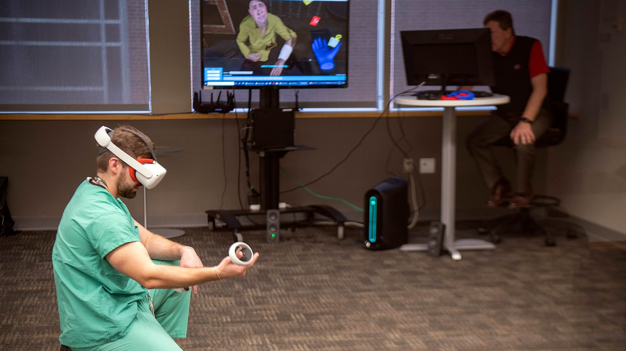
Course Context - Part 2
AI & Sensing
Examine how artificial intelligence leverages virtual worlds as both environments and tools.
We will study how AI systems perceive, learn, and act within 3D spaces, and how virtual worlds provide a unique setting for training, evaluating, and deploying these systems.
The focus is on bridging theory and practice to understand the role of AI in shaping the future of interactive and intelligent virtual environments.
Virtual Worlds – A.A. 2026/27 – Dipartimento di Informatica – Università di Pisa
10

Slide 12
Learning Objectives - Part 2
1
Explain the role of AI in understanding and navigating virtual worlds: Connect perception methods to the challenges of complex 3D spaces
2
Compare representations and models for AI in virtual environments: Evaluate how different approaches enable recognition and interaction in synthetic worlds
3
Analyze virtual worlds as platforms for AI development: Examine their use for data generation, training, and simulation
4
Assess deployment challenges at the boundary of real and virtual: Explore domain gaps, adaptation, and efficiency in practical applications
Virtual Worlds – A.A. 2026/27 – Dipartimento di Informatica – Università di Pisa
11

Slide 13



What we expect from you
Basic-Mid programming skills
AI/ML foundations
… and a lot of computer scientist curiosity
Supervised / Unsupervised, Neural Networks, Clustering, …
In theory and practice (Python, JavaScript, Java, C, C#, C++, …)
Virtual Worlds – A.A. 2026/27 – Dipartimento di Informatica – Università di Pisa
12

Slide 14



Advices
Seek Clarification
Engage with Exercises
Integrate Theory and Practice
If something is unclear, please ask! We encourage you to reach out for support during your learning process.
Almost every lesson will include small questions or exercises. These are not additional burdens, but integral parts of your active studying.
Do not separate theoretical study from practical application. Trying to do the project without integrating theory will lead to a **bloodbath**!
Virtual Worlds – A.A. 2026/27 – Dipartimento di Informatica – Università di Pisa
13

Slide 15
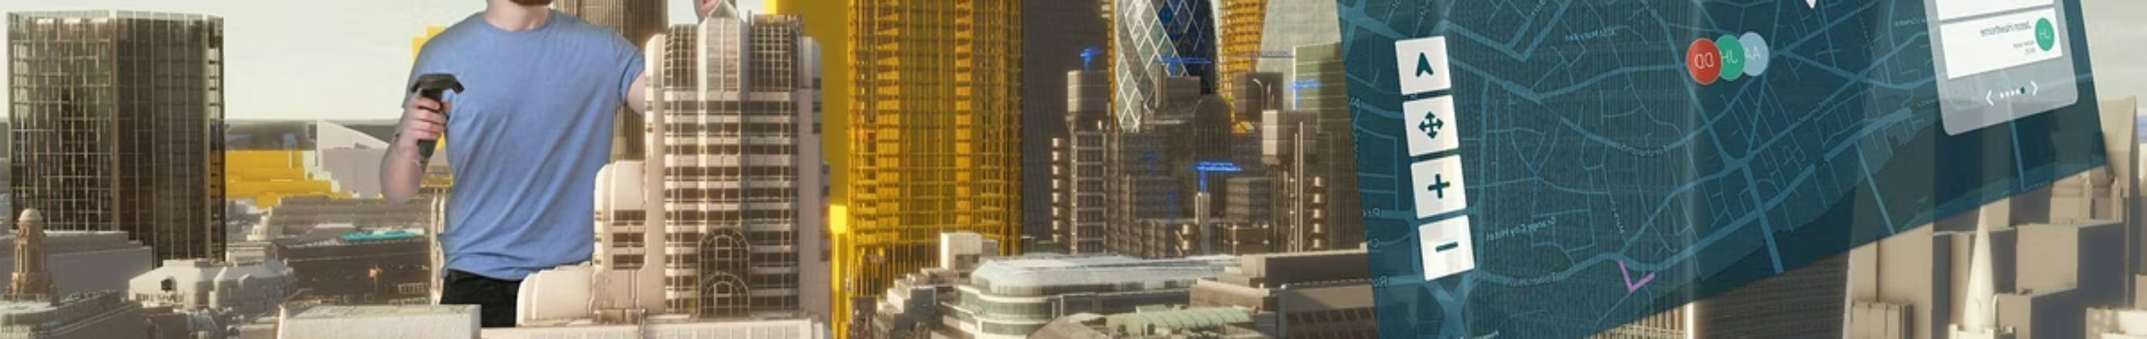
Questions?
Virtual Worlds – A.A. 2026/27 – Dipartimento di Informatica – Università di Pisa
14

